Slide 1
Virginia Interfaith Center for Public Policy
Yanet Amado and Lana Heath de Martinez
Notes:
Lana introduces VICPP

Slide 2
Current Events: What’s going on?
Lana Heath de Martinez, M.Div.
Welcoming All Coordinator, Virginia Interfaith Center for Public Policy
Notes:
Lana: We will talk in broad overview about recent policy changes, cases in Virginia, Sanctuary work, and legislative advocacy at the state level. The workshop this afternoon will have more time for details and questions. INTRODUCE YANET.

Slide 3
Federal Changes
Daca Court Case
TPS cancellation
Separating Children at the border - note that this is not new, just expanded
Yanet Amado
VICPP Welcoming All Organizer
UndocuRams founder
Virginia Intercollegiate Immigrant Alliance coordinator
Notes:
YANET: Essentially what is happening with DACA and TPS is that 45’s administration is ILLEGALIZING over a million more members of our community. People who are documented, have gone through a prescribed process, and are losing their status for no reason other than an administration’s xenophobic whims. While we lobby for better federal policies, we need to prepare locally for defense of these community members as any other person who is undocumented and facing potential detention or deportation. Separating children from their parents is nothing new, but it is greatly expanded. Obama infamously referred to a detnetion center run by a private prison company as a “childcare center”. Let’s be honest and direct - these are concentration camps detaining people without probable cause, including very young children. And 45 is just one of many tycoons getting rich off of human bondage.

Slide 4
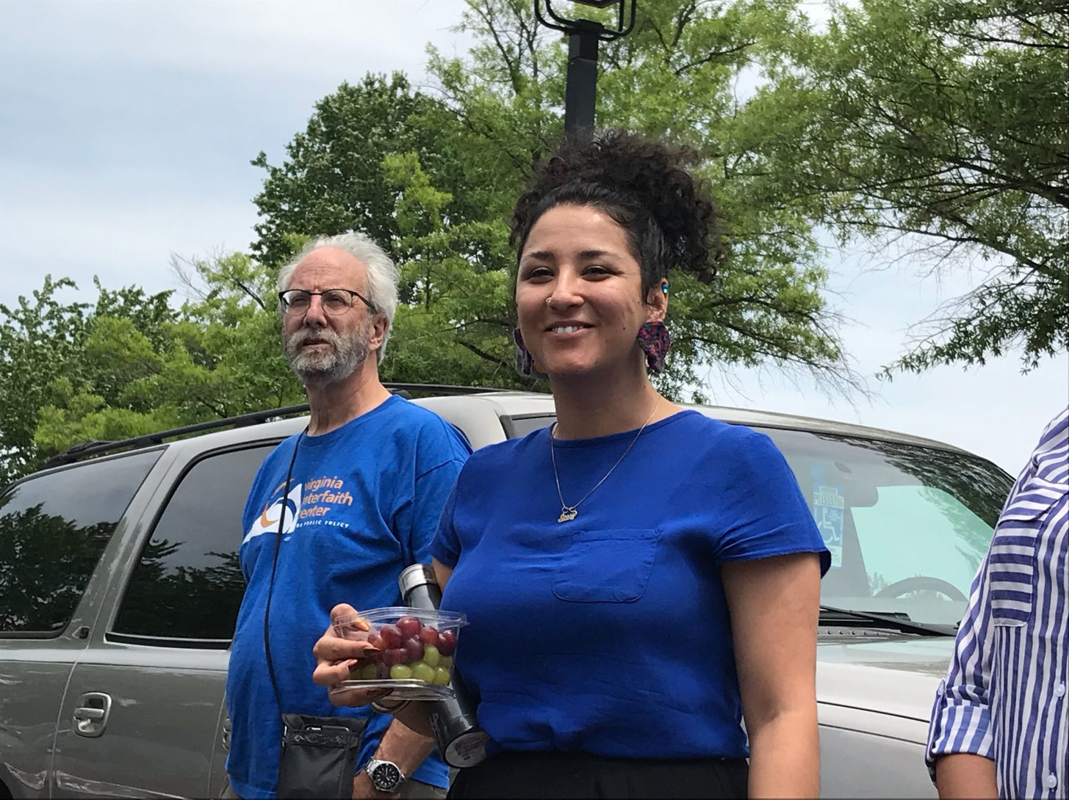
Current Events in Virginia - Ale
Alejandra Pablos was arrested while peacefully protesting at the ICE office on Arboretum in January. She just had her hearing this week and her case was continued until October.
#AleVsICE #FreeAle
http://www.richmond.com/news/local/chesterfield/activist-appeared-in-chesterfield-court-tuesday-on-trespassing-charge-connected/article_3643d4d0-e5cf-5574-a606-671ddaa3989a.html
Notes:
LANA
Intersection of immigration and criminal law.

Slide 5
Join ICE Accountability team!
Hold vigils, actions, meetings at local ICE office.
centralvasanctuary.com
Notes:
Lana

Slide 6
Current Events in Virginia - Erick
Erick Hernandez was unlawfully held at the Henrico County jail on an ICE detainer in March. Due to rapid community mobilization he was released while a dozen or so people protested outside the jail.
Notes:
YANET

Slide 7
Join or start a Fair Process Policy campaign in your locality!
tinyurl.com/fairprocess
Notes:
LANA

Slide 8
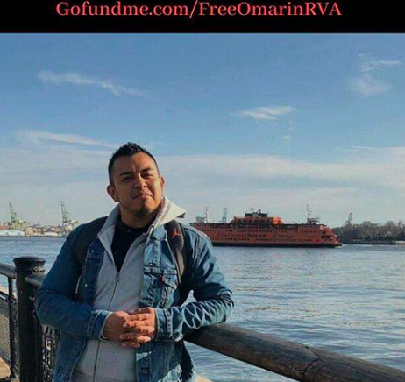
Current Events in Virginia - Omar
Yesterday 78 people in several states were picked up in ICE raids, including a VICPP staffperson’s family member. He is being held at Farmville with bond set at $5000.
To contribute to Omar’s bond and the emergency fund for other people detained yesterday in Virginia:
gofundme.com/FreeOmarInRVA
Notes:
YANET

Slide 9
Raise money for the Sanctuary Fund.
This fund is allocated for legal defense and bail for people at risk of deportation.
tinyurl.com/sanctuaryfund
Notes:
LANA: Or other bail funds. Most essential is getting people free to fight their case from the outside. 70% better chance outside of detention and 70% better chance with a lawyer.

Slide 10
Sanctuary Congregation Networks
Notes:
YANET: ONE WAY THAT PEOPLE OF FAITH ARE RESPONDING IS BY JOINING SANCTUARY CONGREGATION NETWORKS.

Slide 11
Sanctuary DMV
Northern Virginia
Washington D.C.
Maryland
Sanctuarydmv.org
Notes:
YANET: CONGREGATIONS IN NORTHERN VIRGINIA, DC AND MARYLAND HAVE FORMED THE SANCTUARY DMV NETWORK. IF YOU ARE IN THAT AREA WE ENCOURAGE YOU TO JOIN AS WELL.

Slide 12
Central Virginia Sanctuary
Fredericksburg
Williamsburg
Charlottesville
Metro Richmond
Petersburg
A project of the Virginia Interfaith Center for Public Policy.
Centralvasanctuary.com
Site is in progress - watch for updates!
Notes:
YANET: CONGREGATIONS IN CENTRAL VIRGINIA HAVE FORMED THE CENTRAL VA SANCTUARY NETWORK.

Slide 13
Join as Congregation or Individual
Congregations that join the Network commit to:
-Supporting hosting congregations
-Sharing calls for support from the steering committee and rapid response team
-Providing member liaisons to the steering committee
-Inviting congregation members to join Circles of Protection
Notes:
LANA:

Slide 14
Sanctuary Congregation Work
Sanctuary work in Congregations is comprised of 3 general areas:
Policy Advocacy. The goal is not to keep people on “church arrest”, but to create spaces where all are safe and free. This means advocating for policies at the local and state level that provide constitutional protections and fair processes for people who are immigrants.
Notes:
LANA
Join Fair Process campaign or Witness at the Capitol!

Slide 15
Sanctuary Congregation Work
Sanctuary work in Congregations is comprised of 3 general areas:
2. Direct Support. Hosting community members facing deportation, supporting campaigns to have cases dismissed, providing legal support and bail funds, transportation, etc.
Notes:
LANA

Slide 16
Sanctuary Congregation Work
Sanctuary work in Congregations is comprised of 3 general areas:
3. Public Actions. This includes marches, vigils, protests, teach-ins and other actions that cast a narrative of welcome and inclusion, providing a moral vision for our communities.
Notes:
LANA

Slide 17
Education, education, education!
Notes:
YANET: This is a complicated and convoluted subject area. You don’t have to know everything - or even a lot - to be an effective advocate. But - we all should keep learning! VICPP can provide workshops, trainings, speakers, and other resources for your congregation.

Slide 18
Central VA Sanctuary - Circles of Protection
Fundraising
Legal Defense
Hospitality
Transportation
ICE Accountability
Accompaniment
Notes:
LANA
INDIVIDUALS CAN JOIN THE SANCTUARY NETWORK WHETHER OR NOT CONGREGATION HAS JOINED.
All are added to rapid response

Slide 19
Virginia Legislative Update
Drive Virginia Forward - driving privilege cards for all who live and pay taxes in Virginia.
-Ask local police chief/sheriff for letter of support.
-Express support to elected officials.
-Ask local police chief/sheriff not to issue court summons for driving without a license.
Policies that VICPP supports and opposes at the General Assembly.
Notes:
LANA
Victims/Witnesses Protection - forbid law enforcement from inquiring about immigration status or reporting victims and witnesses.

Slide 20
Virginia Legislative Update
Tuition Equity - instate tuition for all Virginia students.
-Contact Speaker Cox and tell him to meet with Virginia Students.
-Tell your elected officials to support tuition Equity.
-Lobby local colleges/universities for support for students.
Policies that VICPP supports and opposes at the General Assembly.
Notes:
YANET

Slide 21
Virginia Legislative Update
Victims/Witnesses Protection - forbid law enforcement from inquiring about immigration status or reporting victims and witnesses.
-Ask elected officials to support.
-Lobby local law enforcement to adopt this is a local policy.
Policies that VICPP supports and opposes at the General Assembly.
Notes:
LANA
Victims/Witnesses Protection - forbid law enforcement from inquiring about immigration status or reporting victims and witnesses.

Slide 22
Virginia Legislative Update
Oppose:
ICE Detainer bills
Anti-Sanctuary City bills - Cline had one in 2018 that was just vetoed.
Anti-Refugee Bills
Policies that VICPP supports and opposes at the General Assembly.
Notes:
LANA - OVERVIEW, YANET - SANCTUARY IS A POLITICAL TERM. IT IS GENERALLY UNDERSTOOD TO MEAN A LOCALITY IS NOT PROACTIVELY COLLABORATING WITH ICE, BUT HAS NO DEFINITION.
Victims/Witnesses Protection - forbid law enforcement from inquiring about immigration status or reporting victims and witnesses.

Slide 23
What to expect from our workshop...
Personal stories from presenters…
Stories of families supported by the Central VA Sanctuary network…
How to start a new Sanctuary Congregation Network...
Practical ways to assist…
Time for questions...
Notes:
YANET

