Slide 1

#WhereRtheRefugees
Holding the Administration Accountable for Lowest Refugee Arrival Numbers in History

Slide 2
Where Are the Refugees? #WhereRtheRefugees

Slide 3
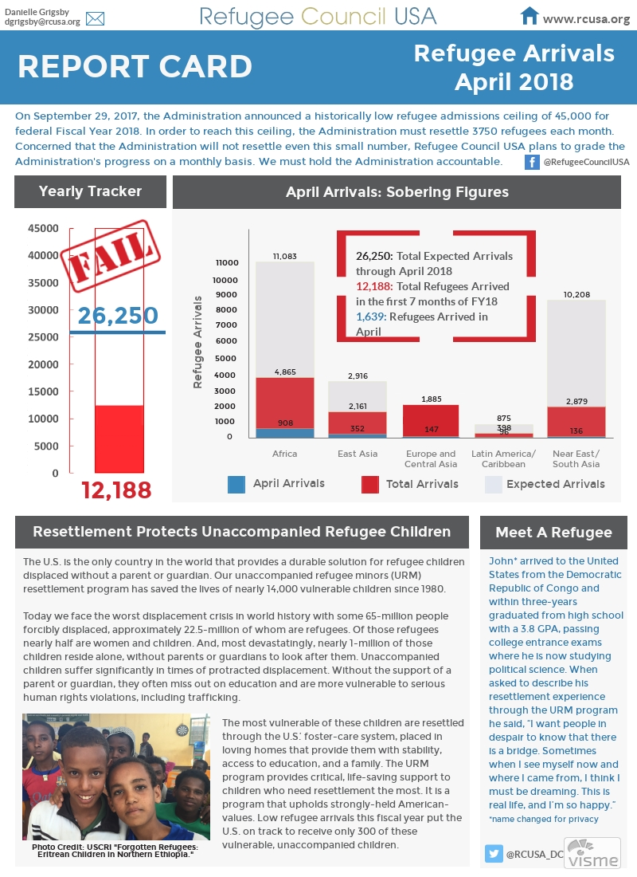
Why #WhereRtheRefugees?

Slide 4
Lowest Numbers of Refugee Arrivals In History
In the midst of the worst global displacement crisis in history with more than 22.5 million refugees worldwide, it would be inhumane and an abdication of U.S. leadership to fail to meet this year’s refugee admissions goal of 45,000.
On March 31st, the halfway point for Fiscal Year (FY) 2018, the administration will have resettled just 11,000 refugees.
The administration is only on track to resettle 20,000 refugees this year, not even meeting their own goal.
This amounts to a broken promise to tens of thousands of refugees who face the most rigorous security vetting and medical screening process of any traveler to the United States.

Slide 5
Hold the Administration
Accountable
Resettlement is reserved only for refugees who cannot return to their home countries or rebuild their lives in the country where they first fled.
While families remain separated and refugees wait - at times in very unsafe conditions - the administration has imposed a series of bans to dismantle the refugee resettlement program.
We have a moral responsibility to hold the administration accountable to resettling at least 45,000 refugees this fiscal year, and to urge them to set the admissions goal for FY19 for at least 75,000.

Slide 6
Dismantling the Refugee Resettlement Program
The Administration is diligently working to dismantle the entire refugee resettlement program as part of their anti-immigrant and White Supremacist agenda.
The Administration is forcing dozens of refugee resettlement agencies to close
If we only have 20,000 refugees resettled in FY18, it will be more difficult for us to advocate for enough funding in FY19 and the administration will likely lower the number again.

Slide 7
Faith Community
Paradigm Shift
Faith communities have traditionally engaged on resettlement of refugees through co-sponsorship, service provision and assistance.
Now we must shift to a role of advocacy, prophetic witness and community organizing in solidarity with refugee leaders.

Slide 8
Refugee Leadership Development For Social Change
Leadership Development of impacted individuals is a core tenet of building collective power and creating a model of community organizing
Faith communities build relationships and accompany refugee leaders
CWS has worked to do refugee leadership trainings and develop teams throughout the country and has seven target states: Columbus, OH, Lancaster, PA, Harrisonburg/Richmond, VA, Durham/Greensboro, NC, Nashville/Knoxville, TN, Atlanta, GA, Houston/Austin/Dallas-FTW/Armarillo, TX

Slide 9
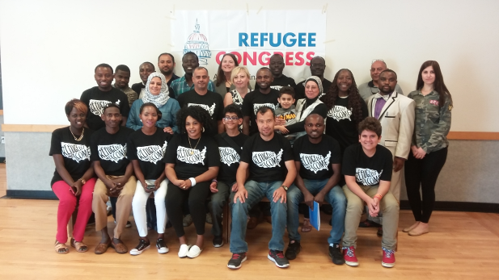
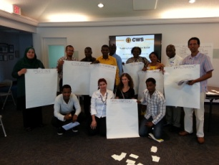
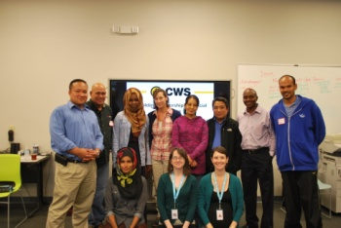
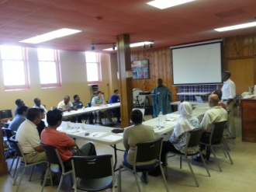
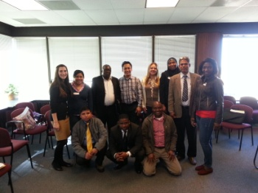
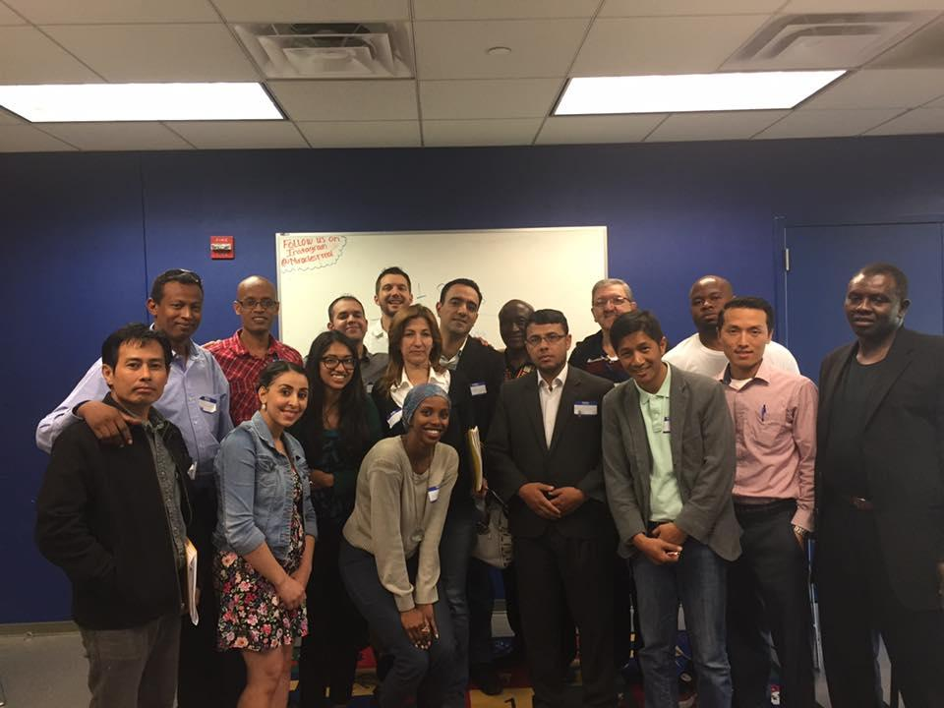
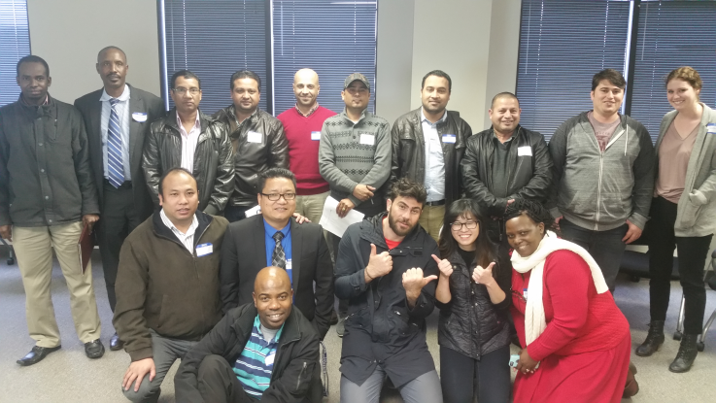
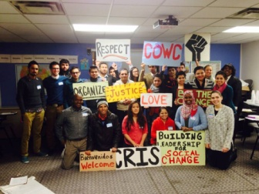
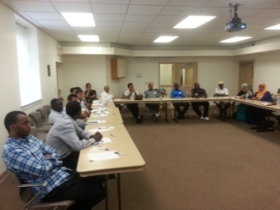
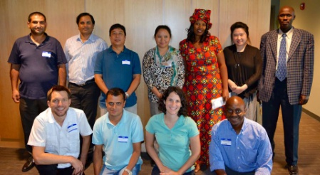
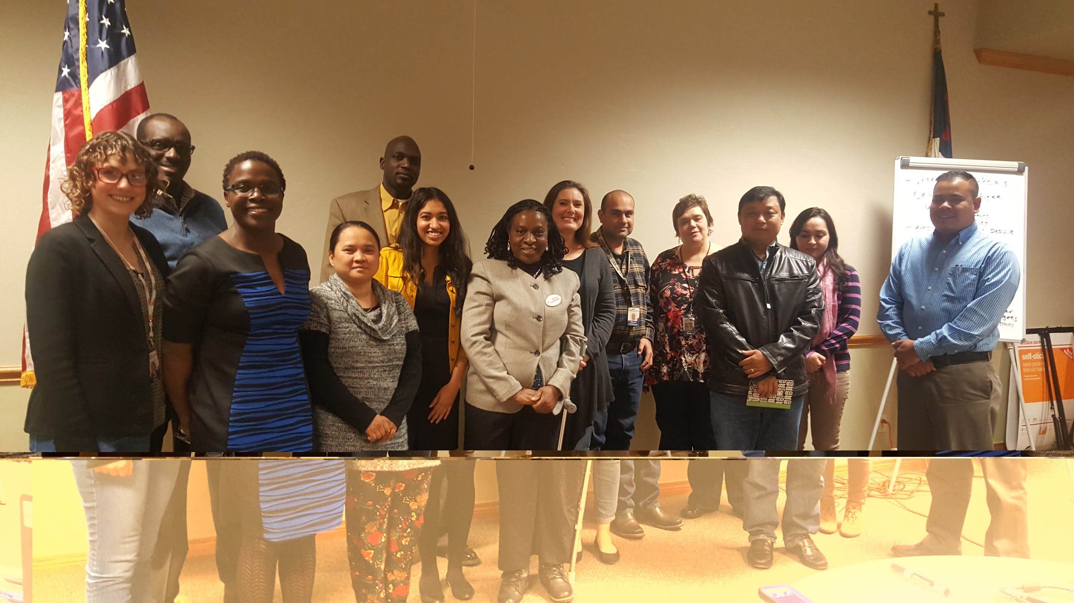
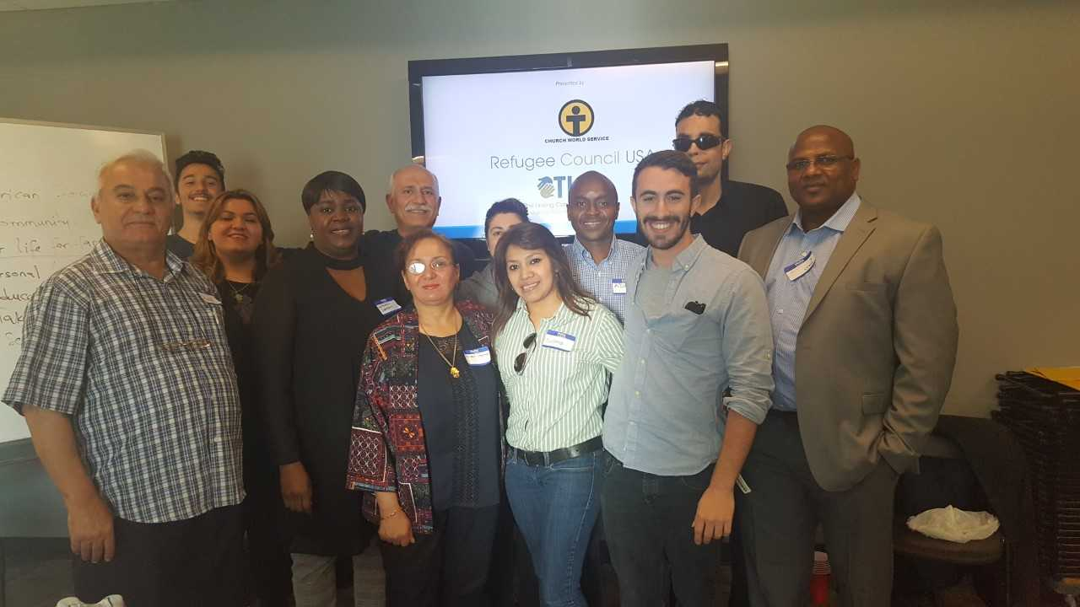
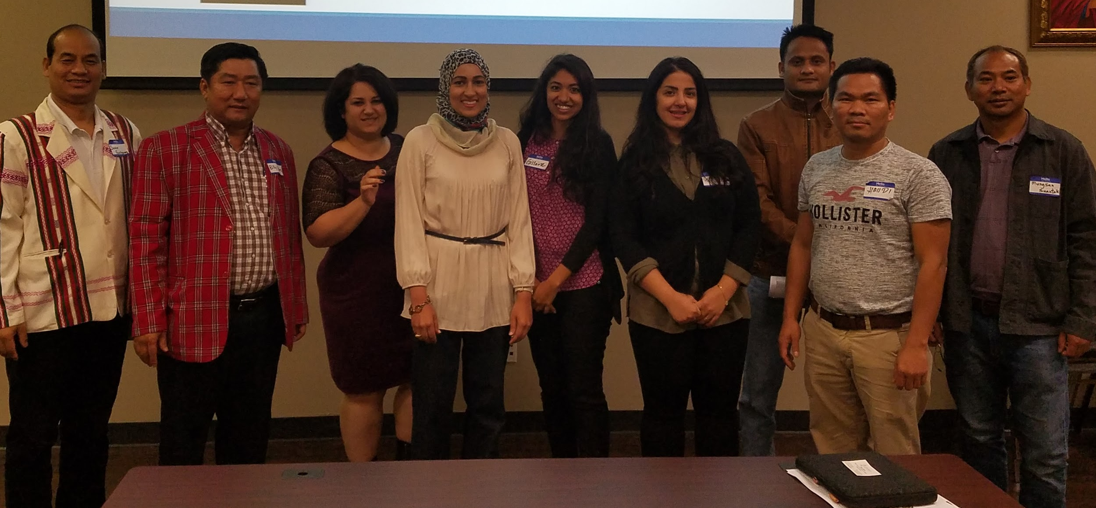
LEADERSHIP FOR SOCIAL CHANGE ONE CITY AT A TIME
Nashville, TN
Harrisonburg
Atlanta
Durham
Greensboro
Houston
Dallas
Columbus
Lancaster
Richmond
Amarillo
Austin
San Antonio

Slide 10
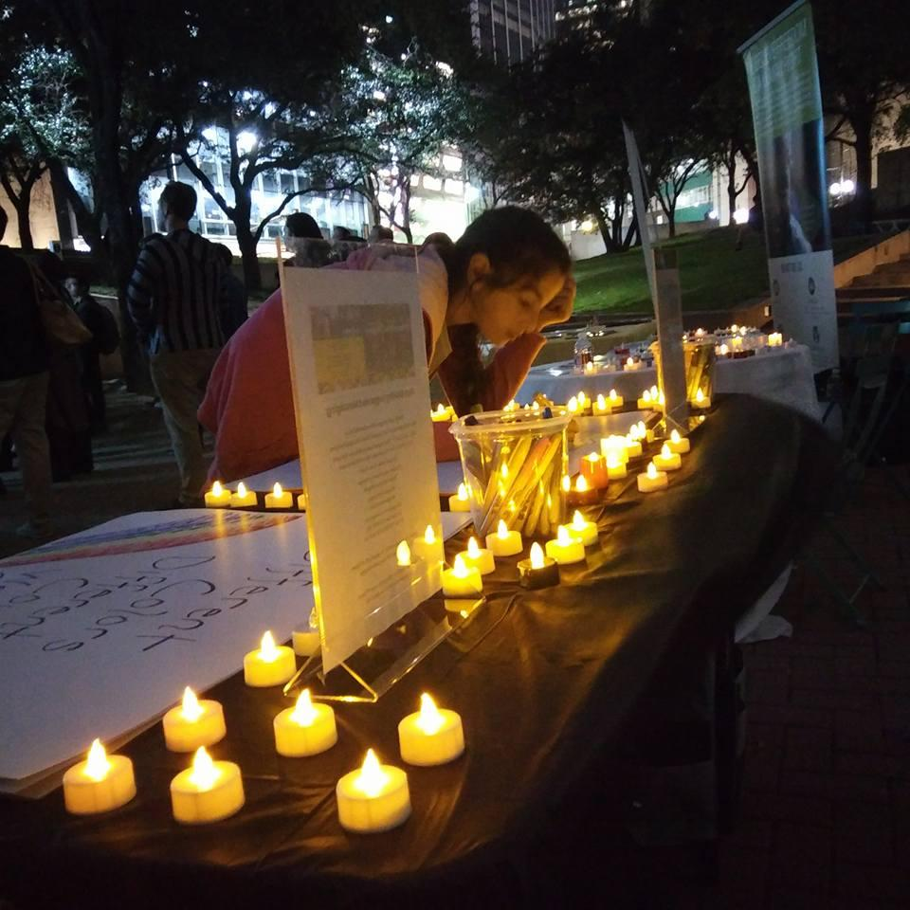
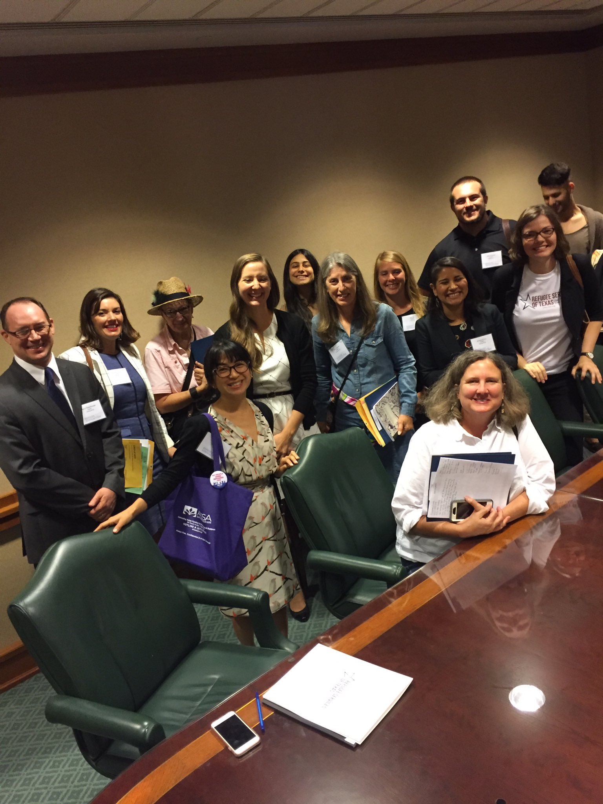
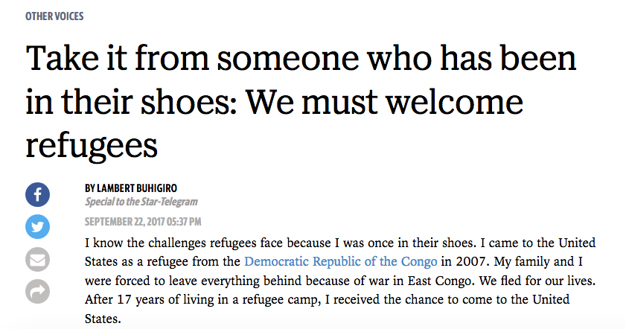
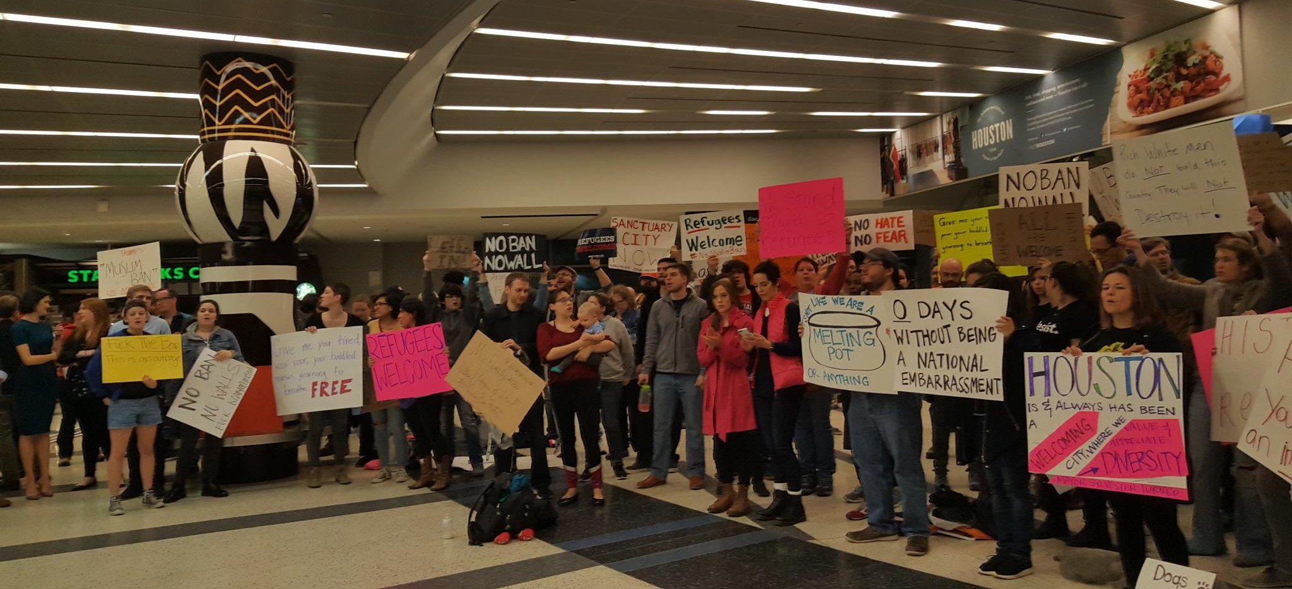
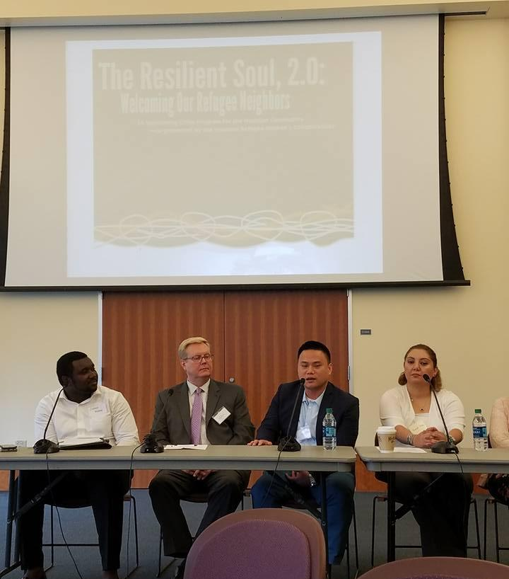
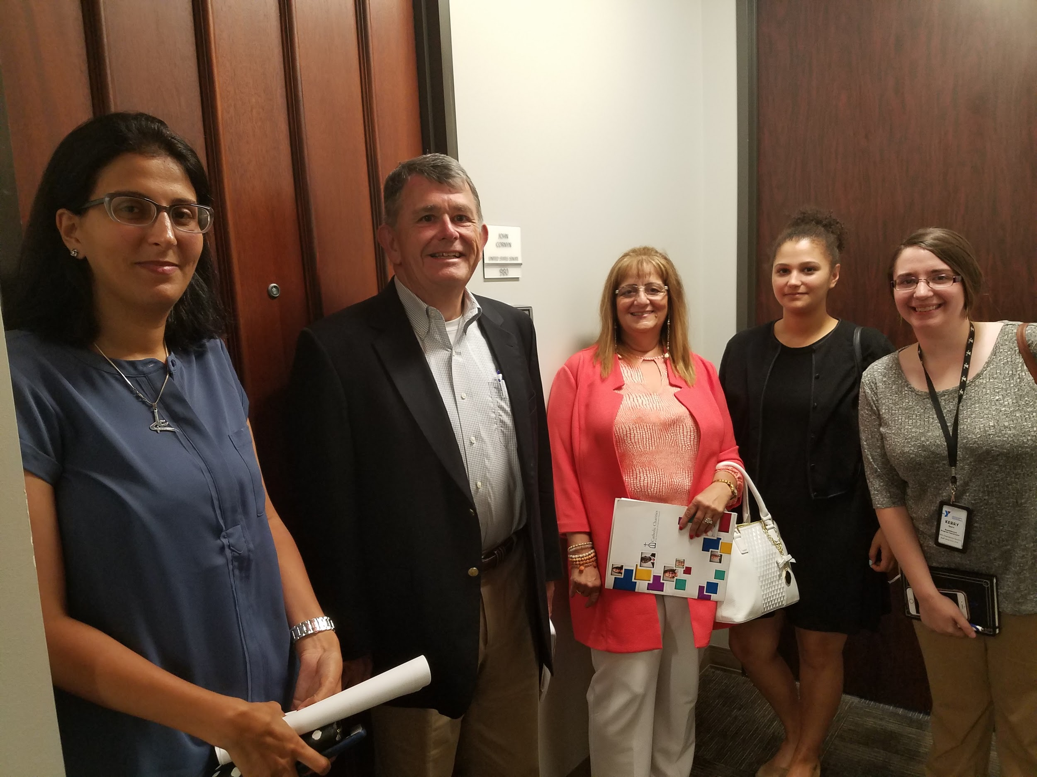
LEADERSHIP IN ACTION
Dallas Vigil for refugees
Refugee Advocacy Day in Austin
Fort Worth Refugee op-ed
Protest in Houston airport
UH Refugee Summit
Meeting with Senator Cornyn

Slide 11
Five Ways to Take Action
Join the National Call-in Day Actions
Host an interfaith #WhereRtheRefugees event
Plan a visit with your member of Congress
Write op-eds and letters to the editor
Share on social media
See the toolkits: bit.ly/WhereRtheRefugees and World Refugee Day toolkit

Slide 12


Share on social media

Slide 13
Call Your Representative
CALL YOUR SENATORS & REPRESENTATIVES TODAY:
Click Here or Call (866) 961-4293* *Please call 3 times to connect with your Representative and both of your Senators
Sample Script: "I'm your constituent from [CITY/TOWN], and I urge you to support the U.S. refugee resettlement program. I strongly oppose President Trump's all-time low cap on refugee admissions, as well as his continued Muslim and refugee bans. I urge you to do everything in your power to see that the administration resettle at least the 45,000 refugees they have set as the cap for 2018 and urge the administration to commit to resettling at least 75,000 in 2019. Resettlement is a core American legacy that allows refugees to rebuild their lives in safety and dignity. My community welcomes refugees, and I urge you to reflect the best of our nation by supporting the refugee resettlement program."

Slide 14
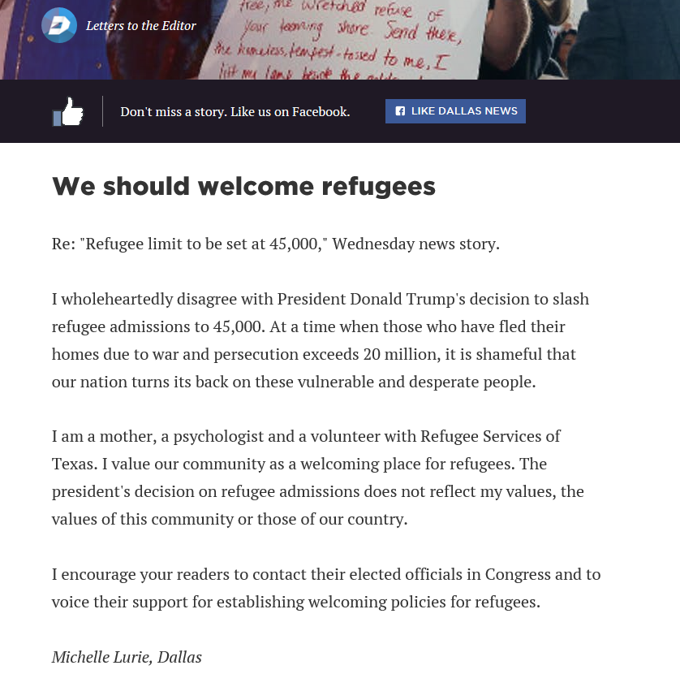
Write op-eds/letters to the editor

Slide 15
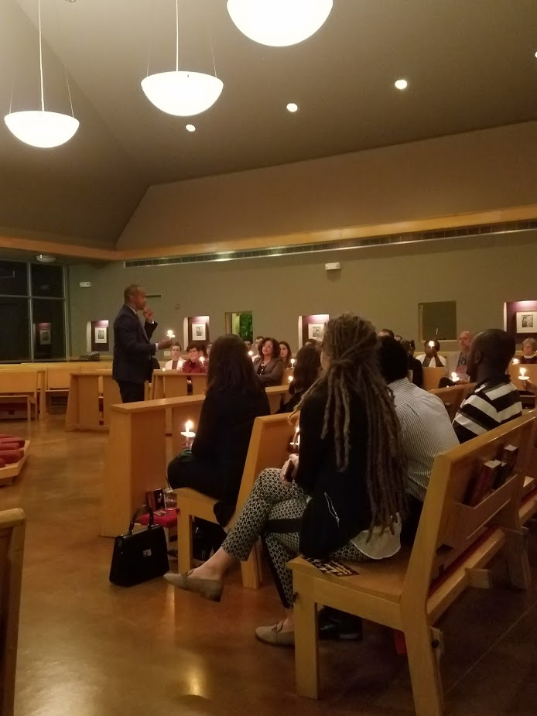
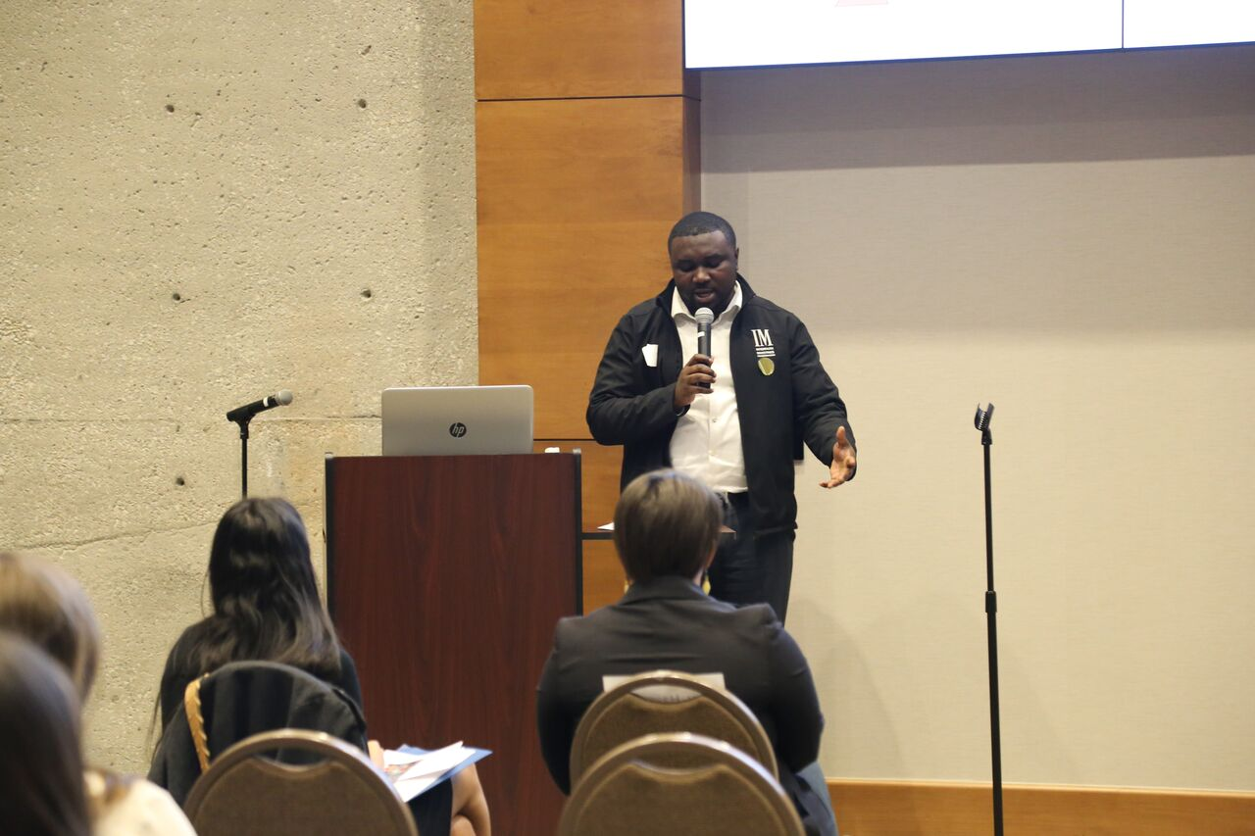
#WhereRtheRefugees Texas Vigils

Slide 16
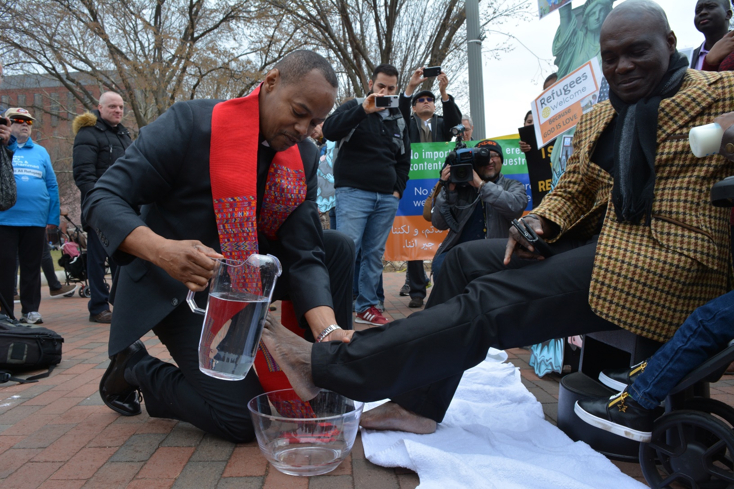
Ethical Spectacle: Foot Washing of Refugees

Slide 17
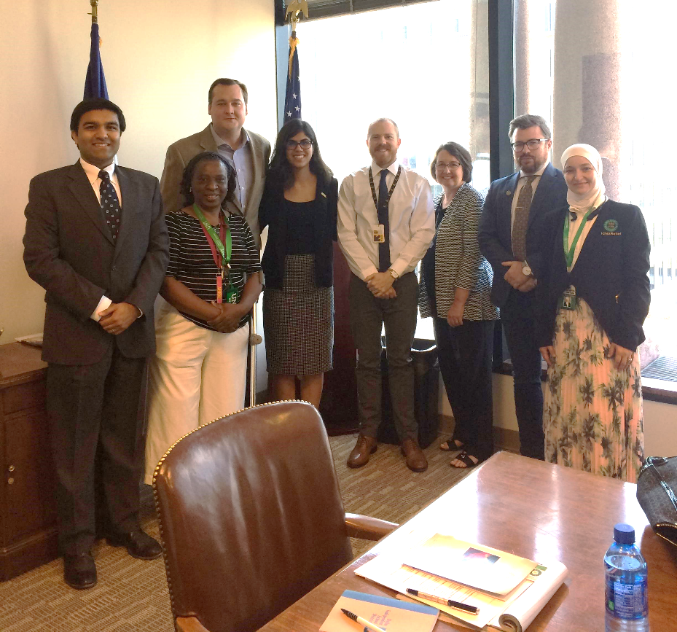
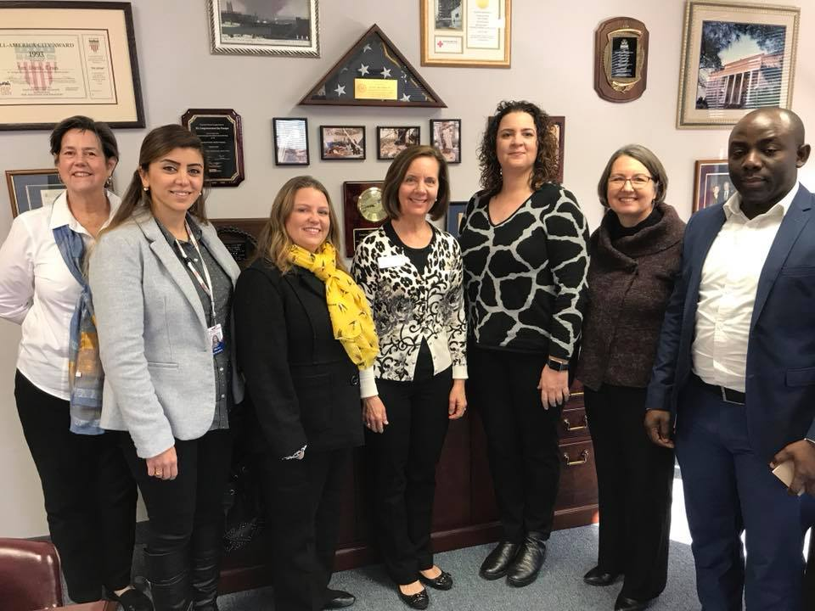
Visits with members of Congress

Slide 18
What Action Steps Can We Take as Faith Communities?

