Slide 1
Social Distancing in sacred scripture: A Burden and a blessing
With special thanks to Charles Wesley

Slide 2
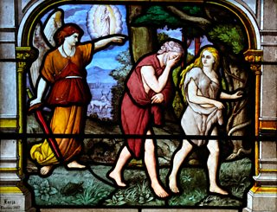
The LORD God sent him forth from the garden of Eden, to till the ground from which he was taken. 24 He drove out the man; and at the east of the garden of Eden he placed the cherubim, and a sword flaming and turning to guard the way to the tree of life. (Gen 3:22-24 NRS)

Slide 3
A flaming sword preserves the tree Of life, lest self should enter in; It keeps out self, and every way It turns, the man of sin to slay. More and more let love abound, Never, never may we rest, Till we are in Jesus found, Of our paradise possest. He removes the flaming sword, Calls us back, from Eden driven, To his image here restor’d, Soon he takes us up to heaven. -- Charles Wesley
“Therefore, lest Adam and Eve, after having eaten of the tree of life, live forever and remain in eternal lives of suffering, God forbade them to eat … that which he had been prepared to give them before they incurred the curse and when they were still clothed with glory.”
Ephrem the Syrian, Commentary on Genesis 2.35.1

Slide 4
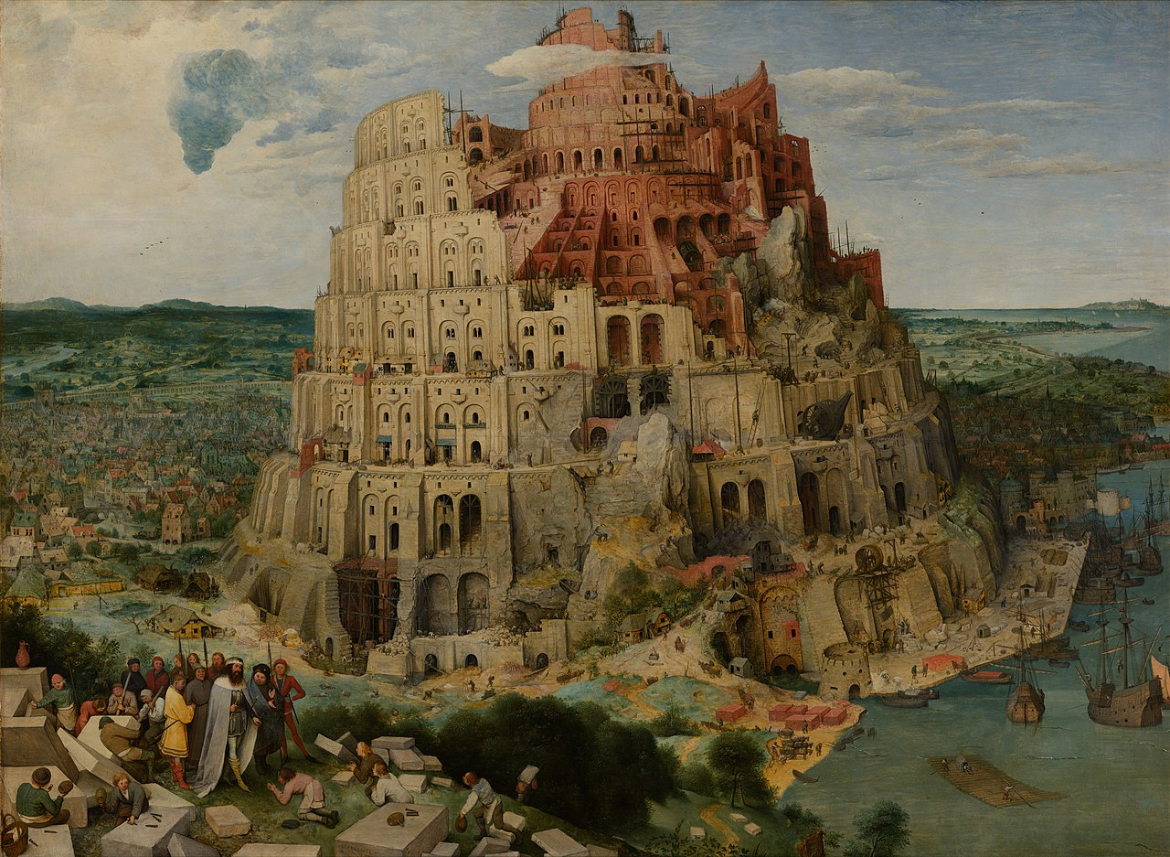
So the LORD scattered them abroad from there over the face of all the earth, and they left off building the city. (Gen 11:8 NRS) Pieter Brueghel, “The Tower of Babel” (1567)
If my own party I approve, And cleave to my own sect, Holding the few with partial love, The many I reject; My nature’s narrowness I feel, Myself I blindly seek, And still a slave in Babel dwell, A shackled schismatick.
O that the Spirit of our Lord Might set his prisoners free, Might speak the sectaries restor’d To glorious liberty! O that the catholick love divine Shed in our hearts abroad Might all our jangling parties join, And swallow us up in God!
Charles Wesley

Slide 5
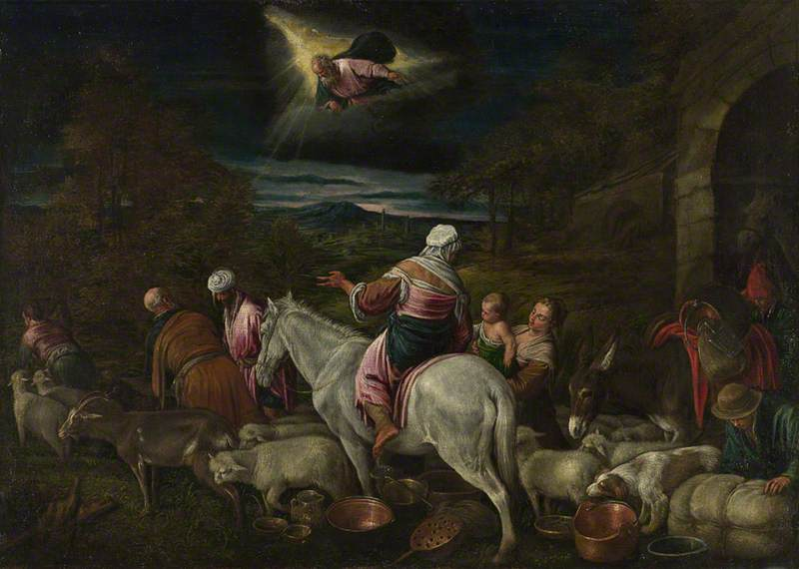
Obedient to his God’s command, And influenc’d by faith alone, Abraham left his native land, Went out, and sought a place unknown.
As in a strange, tho’ promis’d, land, (A land his distant heirs receiv’d,) He, and his sons in tents remain’d; He knew on whom he had believ’d.
And shall not we the call obey, And haste where God commands, to go? Despise these tenements of clay, These dreams of happiness below?
Yes Lord; we hearken to thy call, As sojourners o’er earth we rove, We have for thee forsaken all, And seek the heaven of perfect love.
The Departure of Abraham by Jacopo Bassano the elder (c.1510–1592)

Slide 6
By the waters of Babylon there we sat down and there we wept when we remembered Zion. (Psalm 137:1)
Fast by the Babylonish tide, (The tide our sorrows made o’erflow) We dropt our weary limbs, and cried In deep distress at Sion’s woe, Her we bewail’d in speechless groans In bondage with her captive sons.
In vain our haughty lords requir’d A song of Sion’s sacred strain, “Sing us a song your God inspir’d.” How shall our souls exult in pain, How shall the mournful exiles sing, While bond-slaves to a foreign king?
- Charles Wesley
(Waters of Babylon study by A. Lois White)

Slide 7
Thee, Savior, to Know is Heaven Below
Absent Love is Present Hell
Painting by Hannah Greer

Slide 8
Jesus, believing in thy name, We see the tree of life arise, Thy grace removes the sword of flame, And gives us back our paradise. - Charles Wesley Painting from Catolic Church on Mayreau, St. Vincent & Grenadines, West Indies

Slide 9
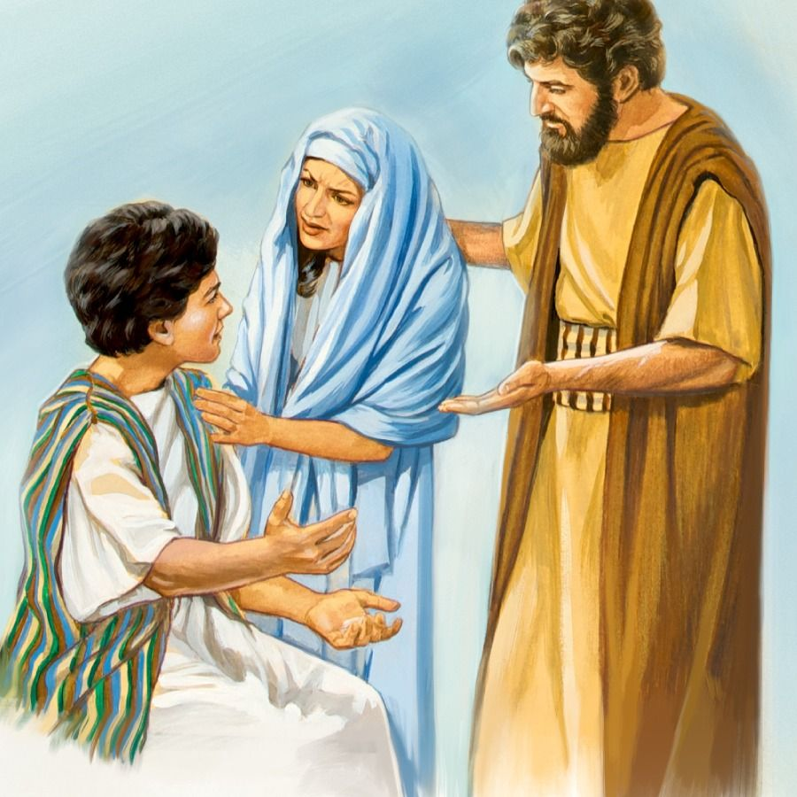
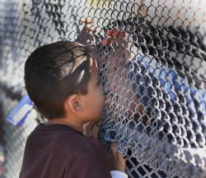
"Child, why have you treated us like this? Look, your father and I have been searching for you in great anxiety." (Luk 2:48 NRS)
“Why hast thou thus dealt with us?” —[Luke 2:48]
Left in grief and pain,
Thine absence we deplore,
And seeking on, we find again
And never lose thee more.
- Charles Wesley

Slide 10
1 Farewell, my all of earthly hope, My nature’s stay, my age’s prop, Irrevocably gone! Submissive to the will divine I acquiesce, and make it mine; I offer up my son. 2 But give I God a sacrifice That costs me nought? my gushing eyes The answer sad express, My gushing eyes and troubled heart Which bleeds with its belov’d to part, Which breaks thro’ fond excess. - Charles Wesley

Slide 11
“If I go not away, the Comforter will not come unto you.” John 16:7
Son of God, for Thee we languish, Still thine absence we bemoan, Overwhelm’d with grief and anguish, Poor, forsaken, and alone: Thou art to thine heaven departed; See us thence, with pity see, Comfortless and broken-hearted, Drooping, dead for want of Thee.
Hans von Kulmbach – The Ascension of Christ (c. 1560)

Slide 12
“If I go not away, the Comforter will not come unto you.” John 16:7
For thy transient outward presence We thine endless love shall feel, Seated in our inmost essence Thou shalt by thy Spirit dwell: Jesus come; Thyself the Giver Let us for the gift receive, Let us live in God forever, God in us forever live!
Jyoti Sahi (Indian, 1944–), Pentecost, 1983

Slide 13
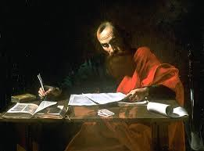
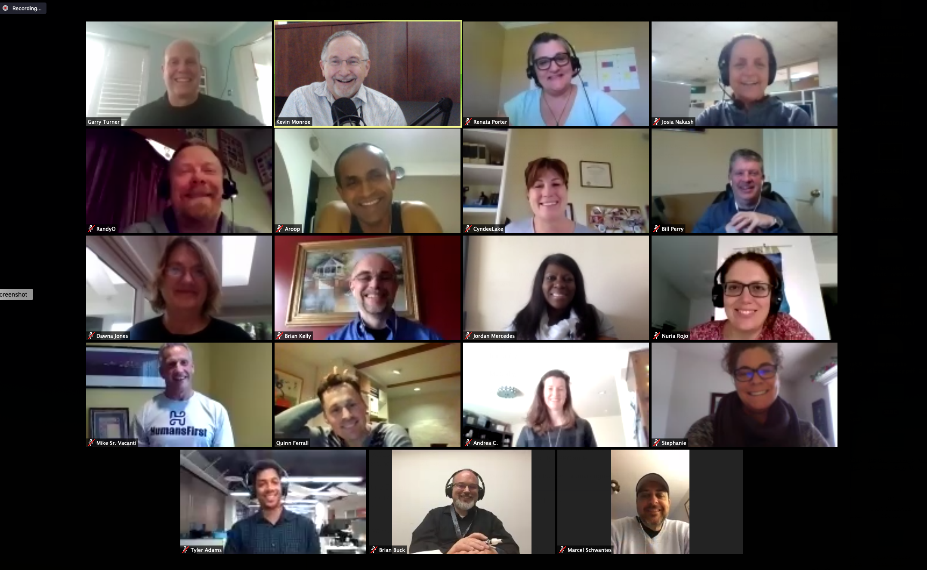
Hymn - Invitation to Our Absent Friends.
Come all the members far and near, Whoe’er to Christ are join’d, Jesus our common head is here, Ye cannot stay behind.
The body with the head is nigh: Let every faithful soul, Let every joint its strength supply To edify the whole.
’Tis done: thro’ faith our hands we join, In Jesu’s love we meet, And cloath’d with righteousness divine The body is compleat. (Charles Wesley)
Valentin de Boulogne: St. Paul Writing His Letters

Slide 14
For those that are shut up.
[1.] Jesus, our absent Brethren bless,Absent in body not in heart, Kept from the channels of thy grace, Shut up with Thee who pray apart, And let that Spirit obtain’d for all, On Eldad and on Medad fall.
2. O might they now the blessing find, The grace on this assembly shed, While to the living members join’d, And close united to our Head One body and one church we rise, And greet our brethren in the skies.
Painting by Michal Baca

Slide 15
`
On Phil[ippians] 3. 13
1. Come let us who to Christ are join’d Forgetting still the things behind This only Thing persist to do, Our Calling’s Glorious Prize pursue.
2. Our Works, and Gifts, and Graces past, All, all behind our Back be cast, This, only This remembred be, Jesus hath lov’d, and died for me!
3. He died, that We to Him might live, Might all His Righteousness receive, Fulness of Love, and Health, and Power; He died, that we might sin no more.
4. He shed His Blood to wash us clean, From All Unrighteousness and Sin, To save from All Iniquity, Jesus hath lov’d, and died for me.
5. He died, that We might be made whole, Holy in Body, Spirit, Soul, Might do His Will like Those above, Renew’d in all the Life of Love.
6. Lay the Foundation then no more, Reach forth unto the Things before, On to the Prize undaunted press, And seize the Crown of Righteousness.
7. We shall the End of Faith attain, The Uttermost Salvation gain, (Our Gospel Hope, our Calling’s Prize, The Tree of Life in Paradice.)
8. Shall taste the Manna of His Grace, And pure in Heart behold His Face, Our Jesus shall Himself impart, And cleanse, and fill the Sinless Heart:
9. His Nature to our Souls make known, And write the Name in the White Stone, We all shall All His Fulness prove, And find the Pearl of Perfect Love.
Charles Wesley Image: Anne Cameron Cutri

Slide 16
You have done what no previous generation of Christians has done before: celebrated Holy Week during a global pandemic with the assistance of web conferencing technology.
What burdens and blessings have you encountered? What new insights into the gospel of Jesus Christ have you gained? What have you learned that you will take with you on the journey ahead?

