Slide 1





JUST COMPENSATION TASK FORCE
SALARY
COMPARATIVE
ANALYSIS
2024

Slide 2

OUR PURPOSE
FROM 2024 AC JTF RECOMMEDNATION
“We recommend that the Just Compensation Task Force continue its work for another year to study clergy compensation in the Virginia Conference in its totality and present its findings and recommendations pertaining to this topic to the 2025 Virginia Annual Conference.”

Slide 3

OUR PURPOSE
FROM 2024 AC JTF RECOMMEDNATION
Topics that the task force would study include, but will not be limited to, the following:
  Salary statistics including documented iniquities with regard to clergy status, district, gender, race, ethnicity, and years of service.
  Minimum parsonage standards

Slide 4

PARSONAGE REVIEW COMMITTEE
SUB-COMMITTEE
Nelson Amendment:
“I move that the Virginia Annual Conference create a task force or refer to the appropriate existing body to study and consider adding to the minimum standards for parsonage and annual parsonage review regular standardized professional inspection of health hazards including but not limited to mold, mildew, lead paint, asbestos, and radon.”

Slide 5
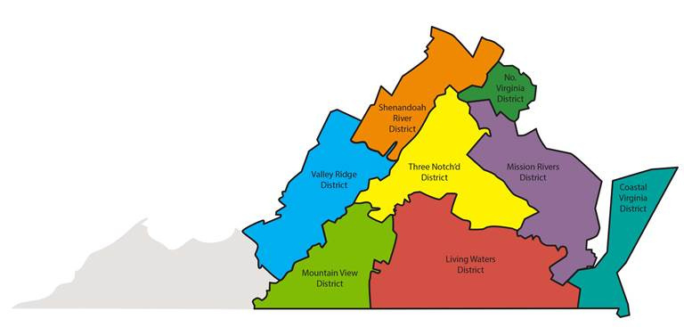
WHO WE ARE
VIRGINIA CONFERENCE UMC
1350 Clergy
(664 active)
8 DISTRICTS
878 churches

Slide 6

WHO WE ARE
BY ETHNICITY
(OF 664 ACTIVE CLERGY)
57 African American
9 Hispanic
84 Asian
(Includes Korea and India)
3 Multi-Racial
511 Caucasian/White
0 Native American

Slide 7
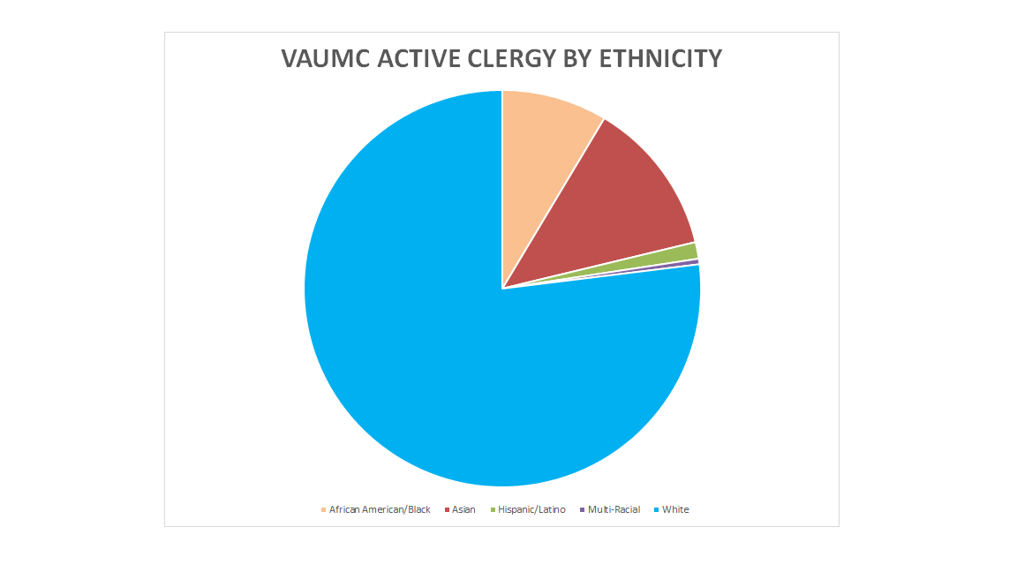

Slide 8
WHO WE ARE
BY GENDER
(OF 664 ACTIVE CLERGY)
Licensed Local Pastors
  Full-time: 80 (M), 55 (F)
  Part-time: 43 (M), 29 (F)
Provisional Deacons
4 (M), 5 (F)
Associate Members
1 (M), 1 (F)
Provisional Elders
28 (M), 26 (F)

Slide 9
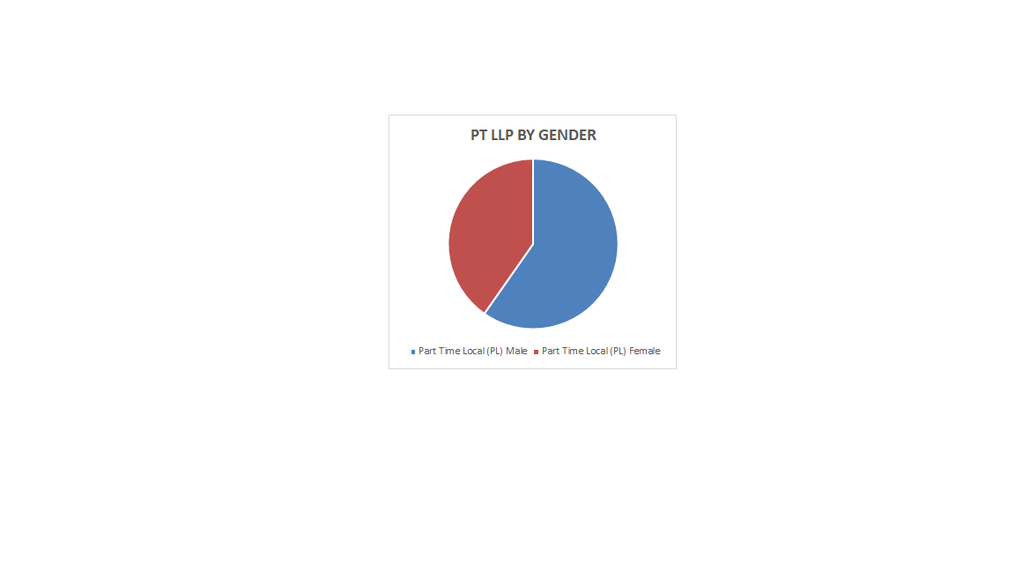
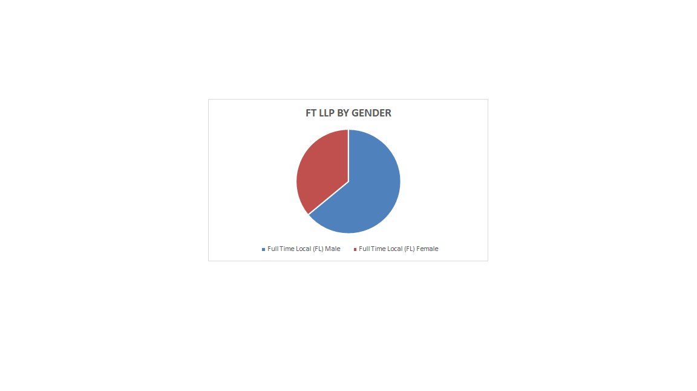

Slide 10
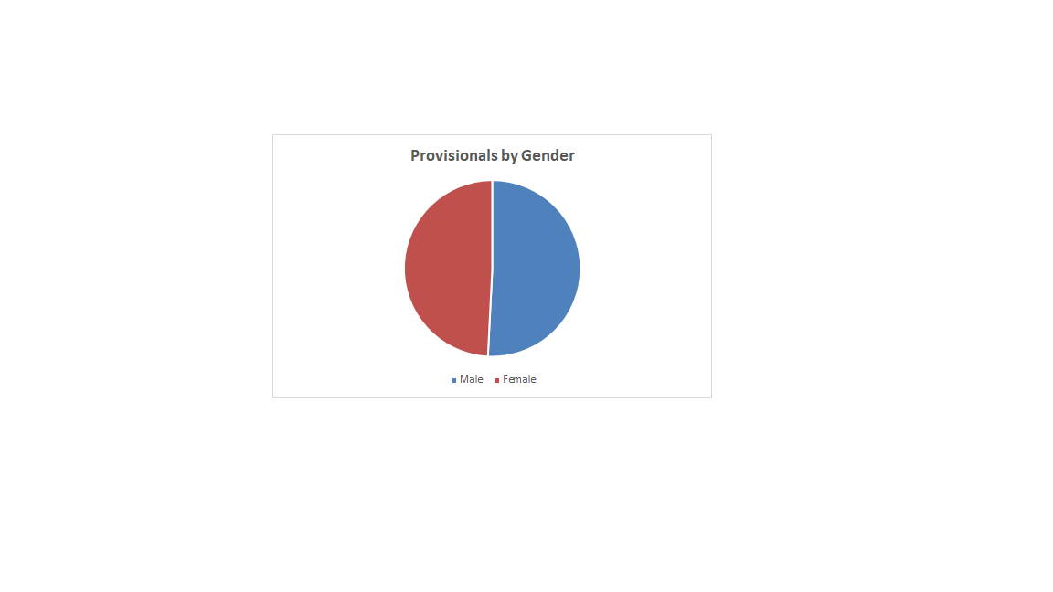

Slide 11
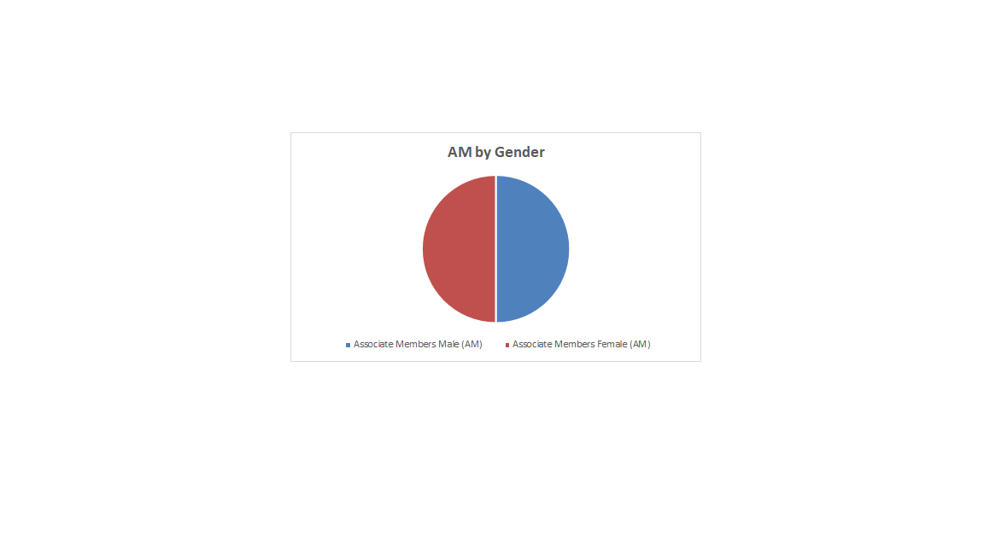

Slide 12
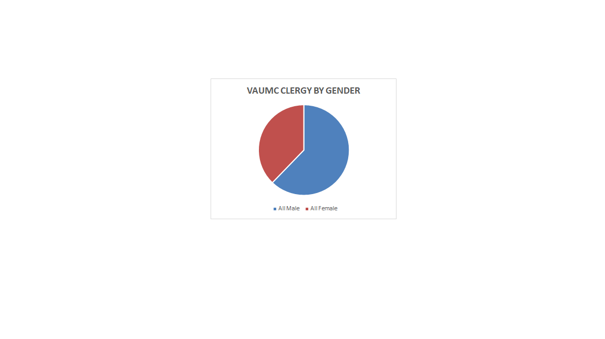

Slide 13
WHO WE ARE
BY GENDER
(OF 664 ACTIVE CLERGY)
Ordained Elder
250 (M)
126 (F)
Ordained Deacon
7 (M)
16 (F)

Slide 14
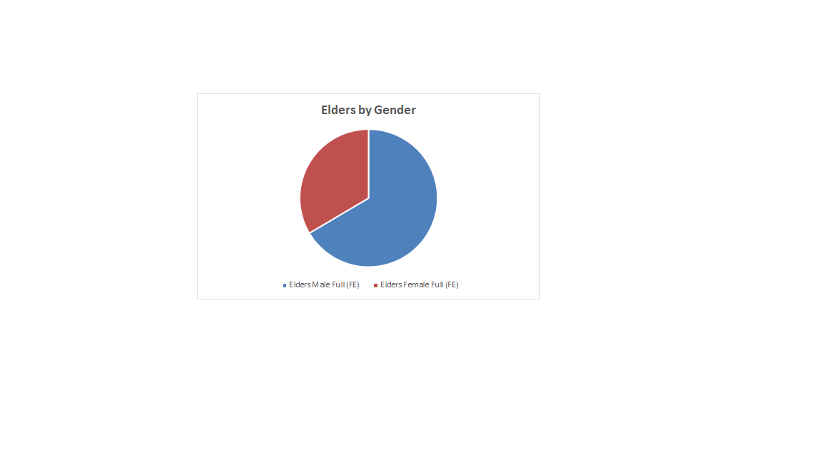

Slide 15
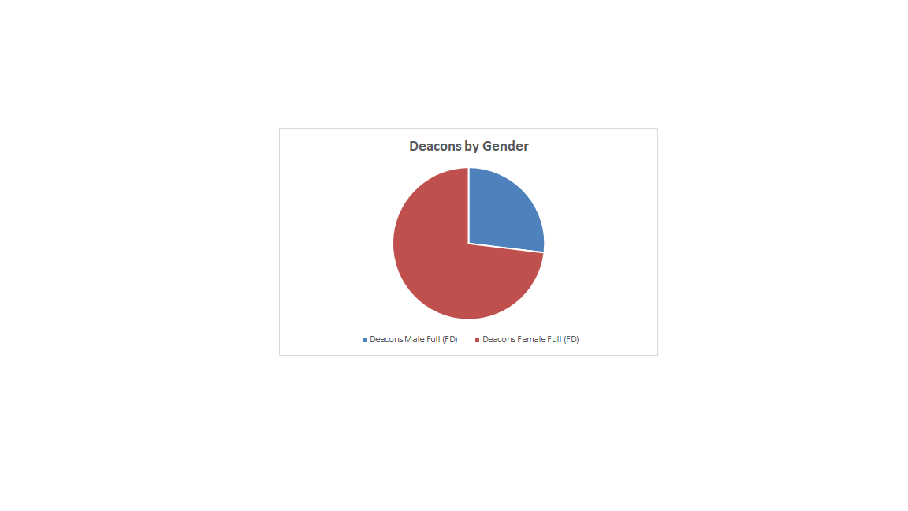

Slide 16
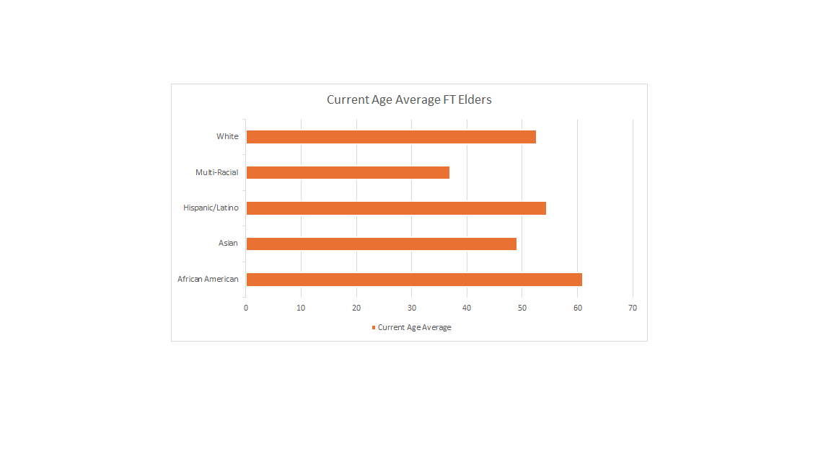
AVERAGE AGE FOR ELDERS VAUMC
BY ETHNICITY

Slide 17
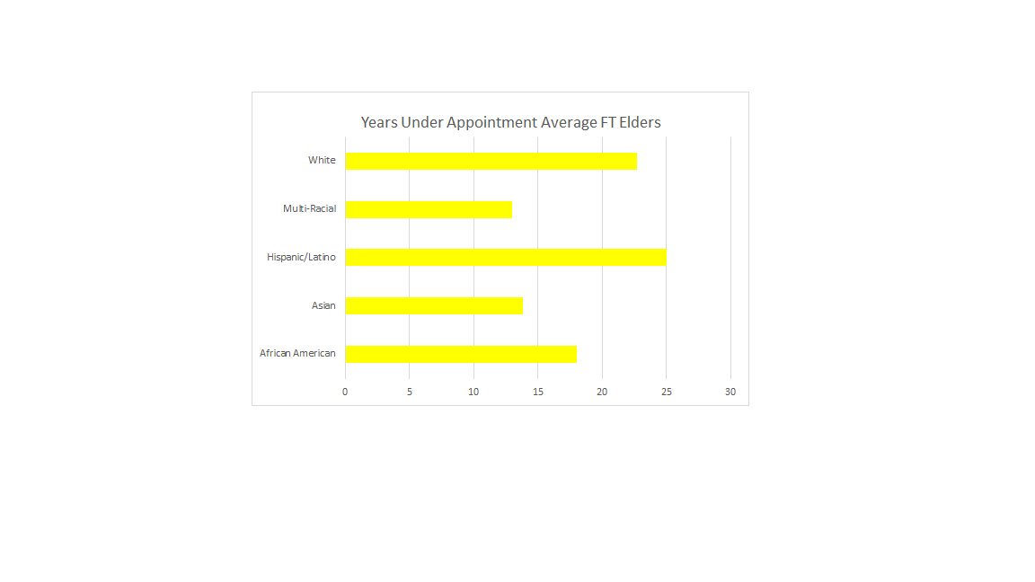
AVERAGE YEARS UNDER APPOINTMENT FOR ELDERS VAUMC
BY ETHNICITY

Slide 18
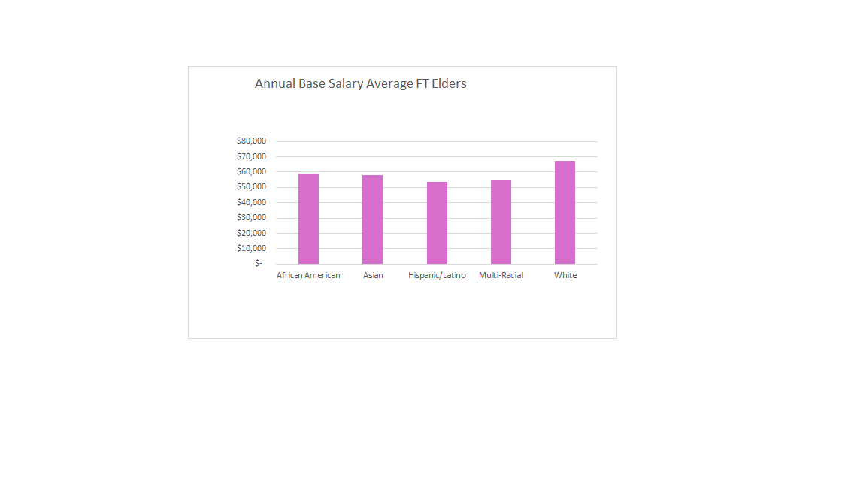
AVERAGE BASE SALARY FOR
ELDERS VAUMC
BY ETHNICITY

Slide 19
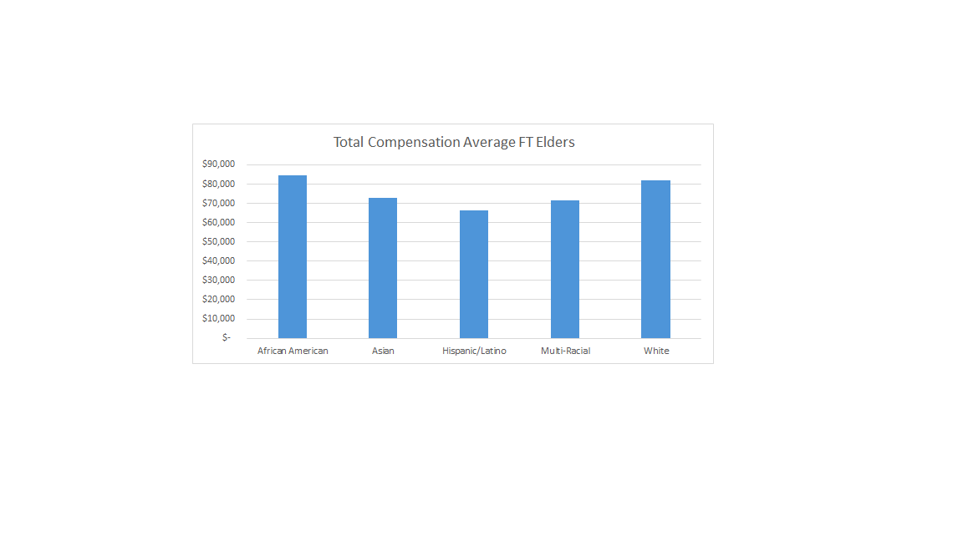
AVERAGE TOTAL COMPENSATION
FOR ELDERS VAUMC
BY ETHNICITY

Slide 20
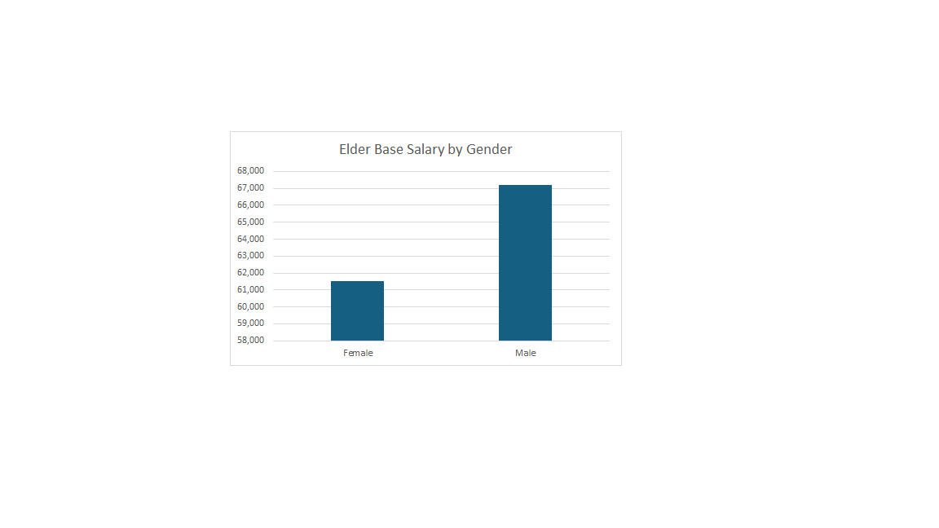
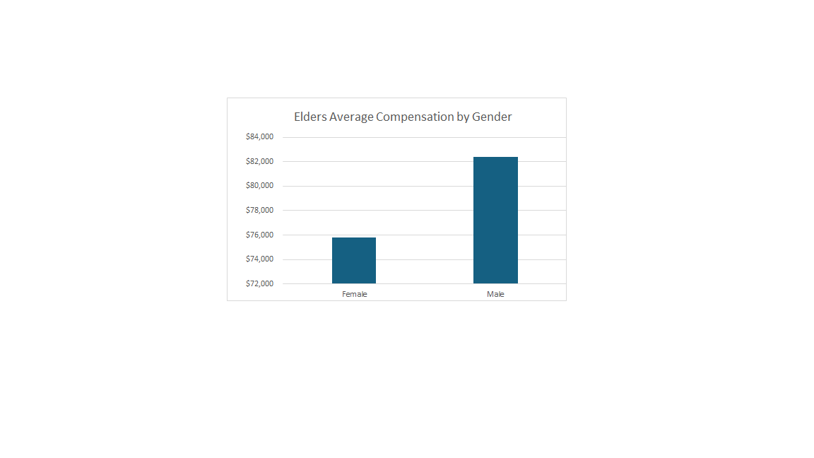
AVERAGE BASE SALARY
FOR ELDERS VAUMC
BY GENDER

Slide 21
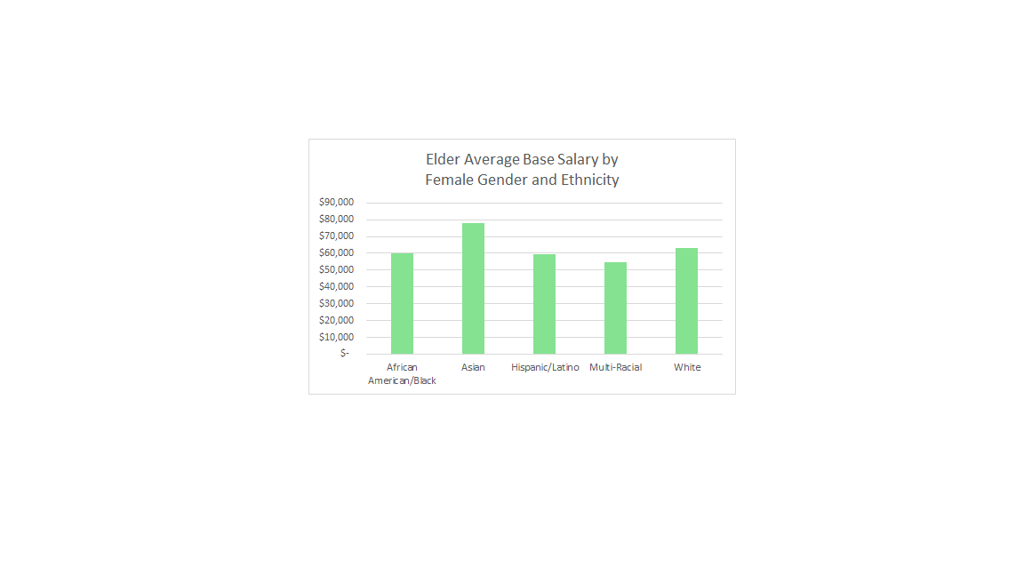
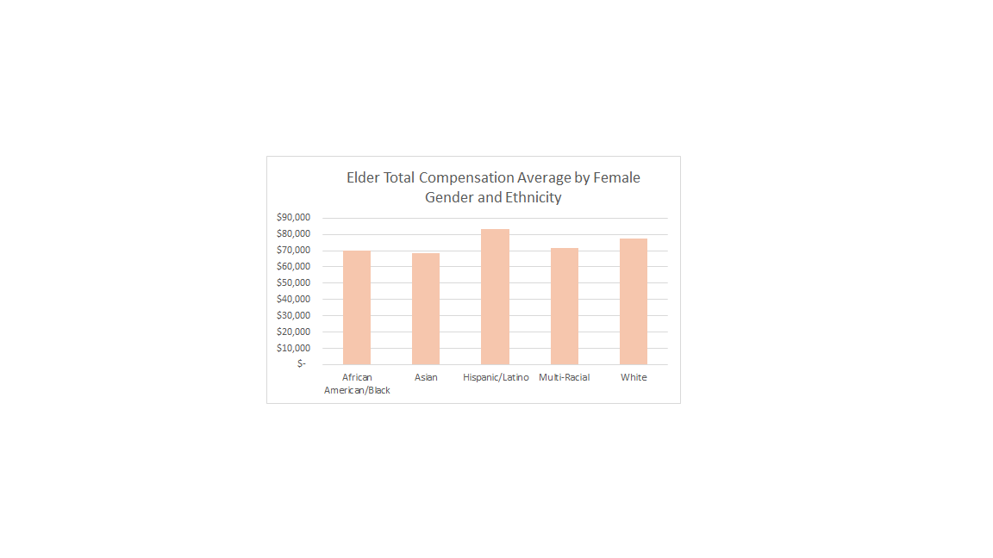
AVERAGES FOR ELDERS VAUMC
BY FEMALE GENDER AND ETHNICITY
RESULTS MAY BE SKEWED, ONLY 1 HISPANIC AND 1 MULTI-RACIAL FEMALE

Slide 22
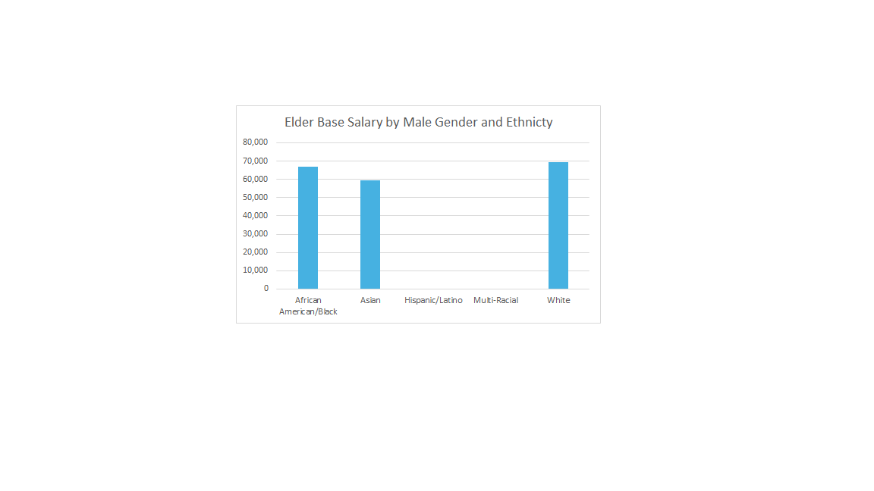
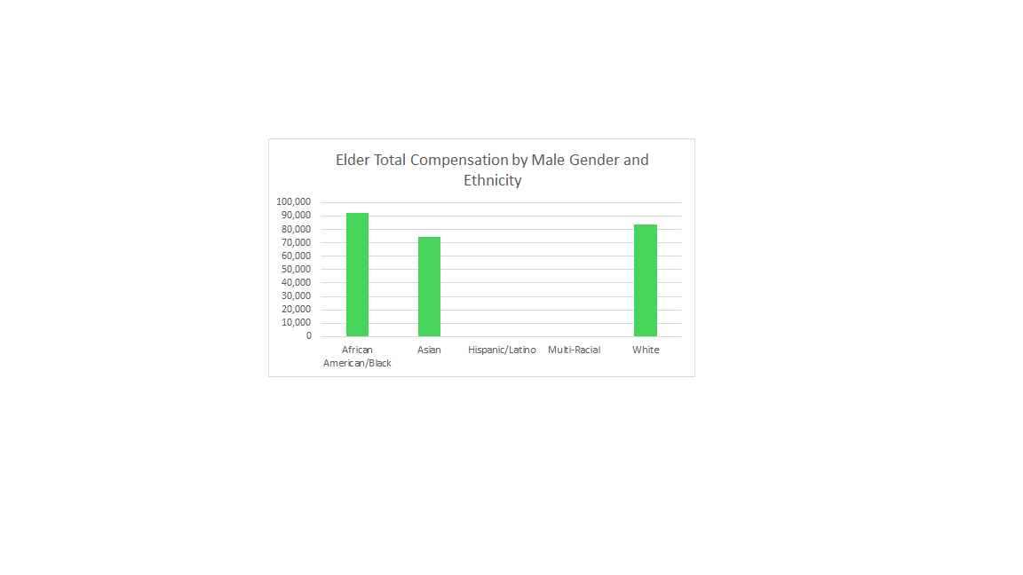
AVERAGES FOR ELDERS VAUMC
BY MALE GENDER AND ETHNICITY
RESULTS MAY BE SKEWED, 0 HISPANIC AND 0 MULTI-RACIAL

Slide 23
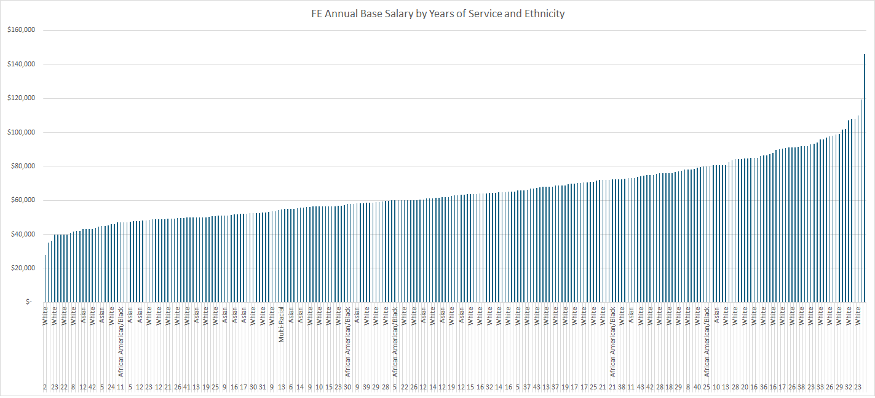
ELDERS VAUMC
YEARS OF SERVICE AND ETHNICITY

Slide 24
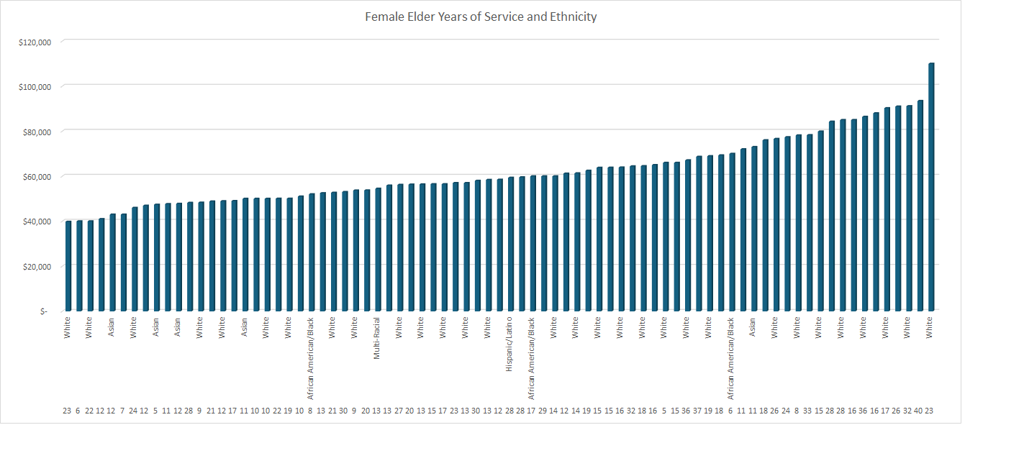
ELDERS VAUMC
YEARS OF SERVICE AND ETHNICITY AND FEMALE BASE SALARY

Slide 25
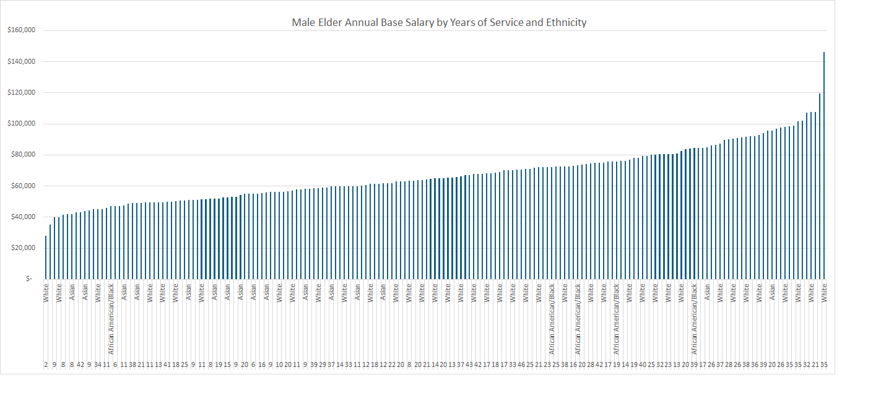
ELDERS VAUMC
YEARS OF SERVICE AND ETHNICITY AND MALE
BASE SALARY

Slide 26
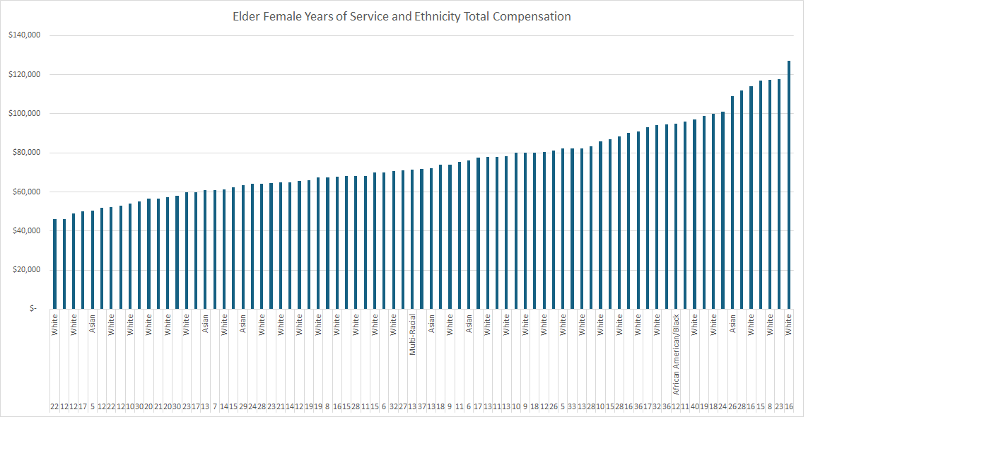
ELDERS VAUMC
YEARS OF SERVICE AND ETHNICITY AND FEMALE TOTAL COMPENSATION

Slide 27
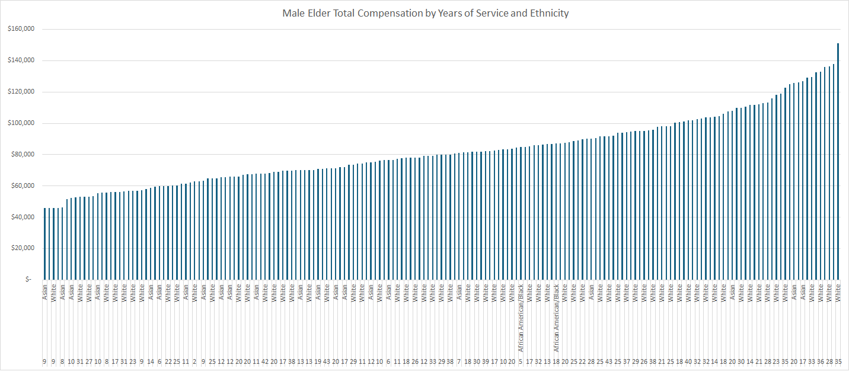
ELDERS VAUMC
YEARS OF SERVICE AND ETHNICITY AND MALE TOTAL COMPENSATION

Slide 28
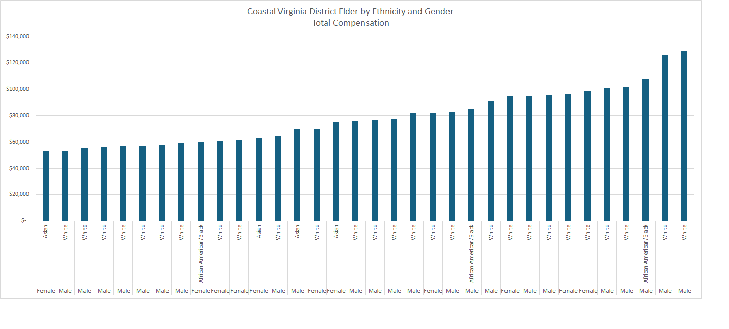
ELDERS VAUMC
TOTAL COMPENSATION BY DISTRICT
COASTAL VIRGINIA

Slide 29
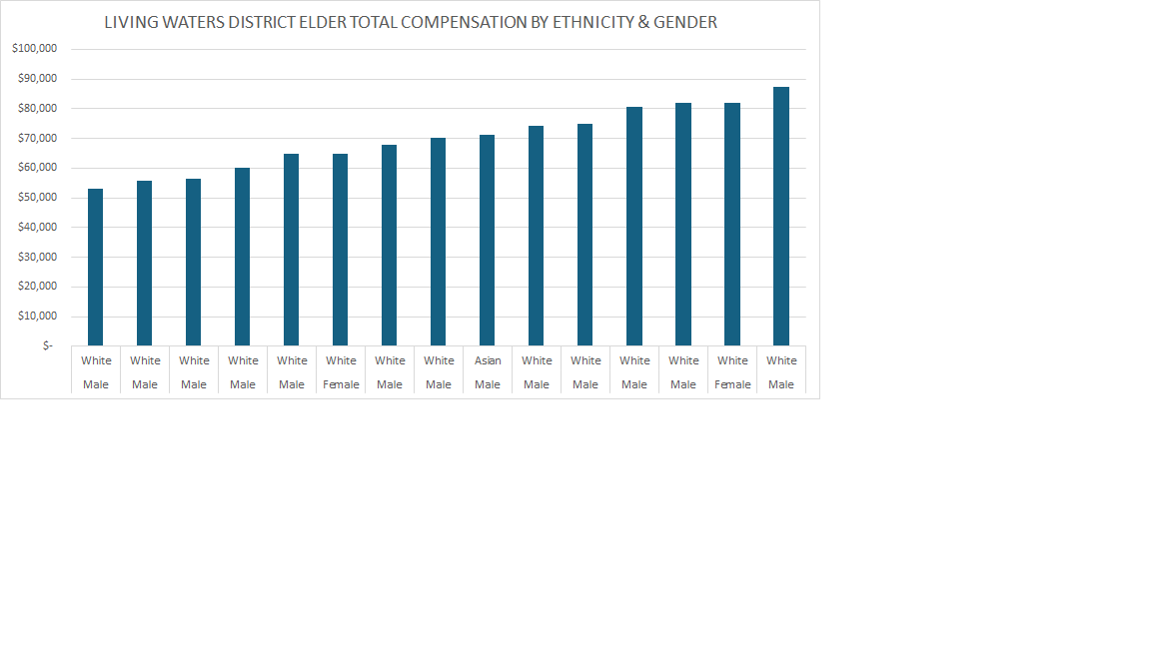
ELDERS VAUMC
TOTAL COMPENSATION BY DISTRICT
LIVING WATERS

Slide 30
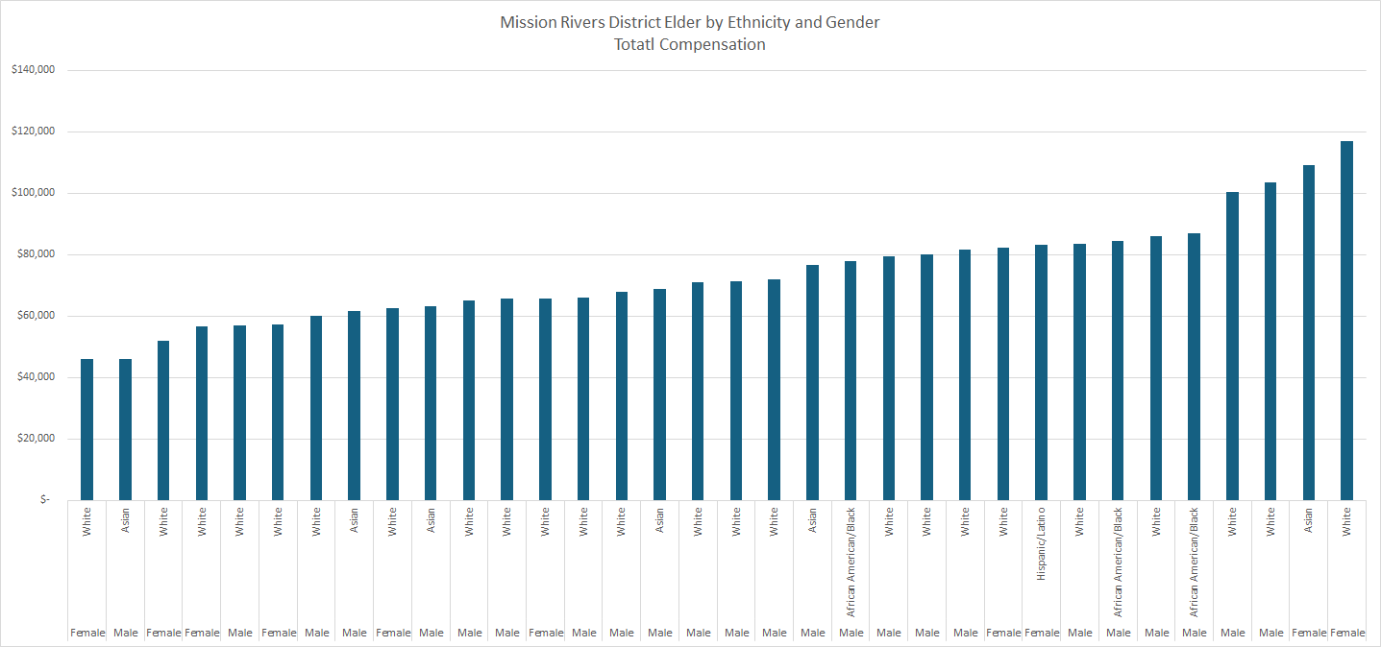
ELDERS VAUMC
TOTAL COMPENSATION BY DISTRICT
MISSION RIVERS

Slide 31
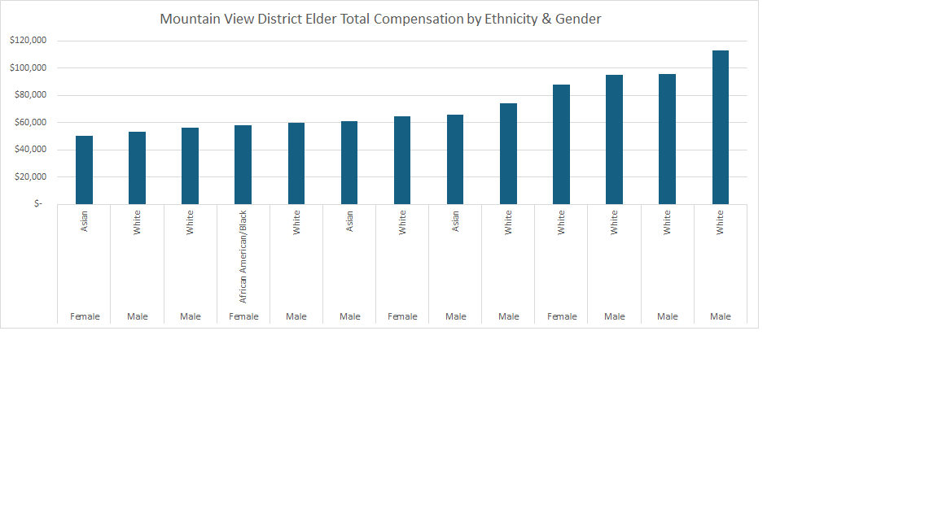
ELDERS VAUMC
TOTAL COMPENSATION BY DISTRICT
MOUNTAIN VIEW

Slide 32
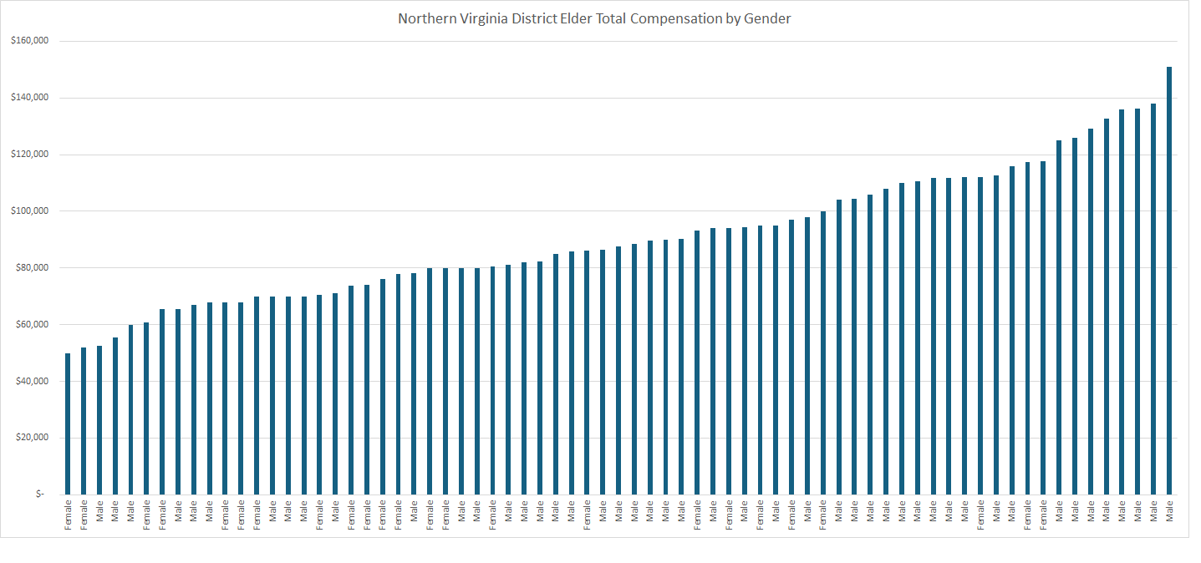
ELDERS VAUMC
TOTAL COMPENSATION BY DISTRICT
NORTHERN VIRGINIA

Slide 33
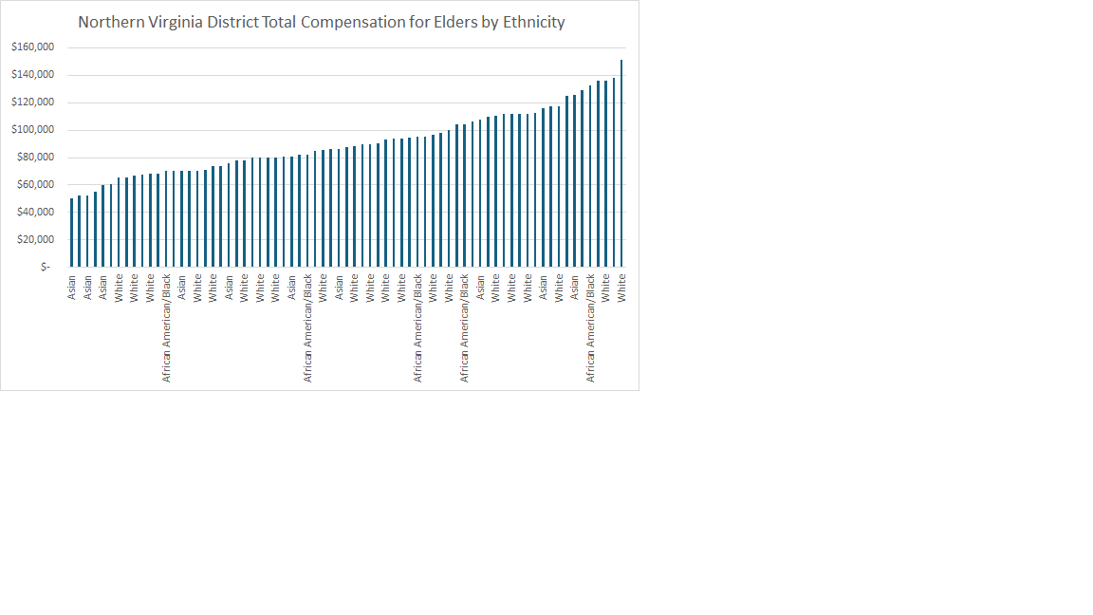
ELDERS VAUMC TOTAL COMPENSATION BY
NORTHERN VIRGINIA BY ETHNICITY

Slide 34
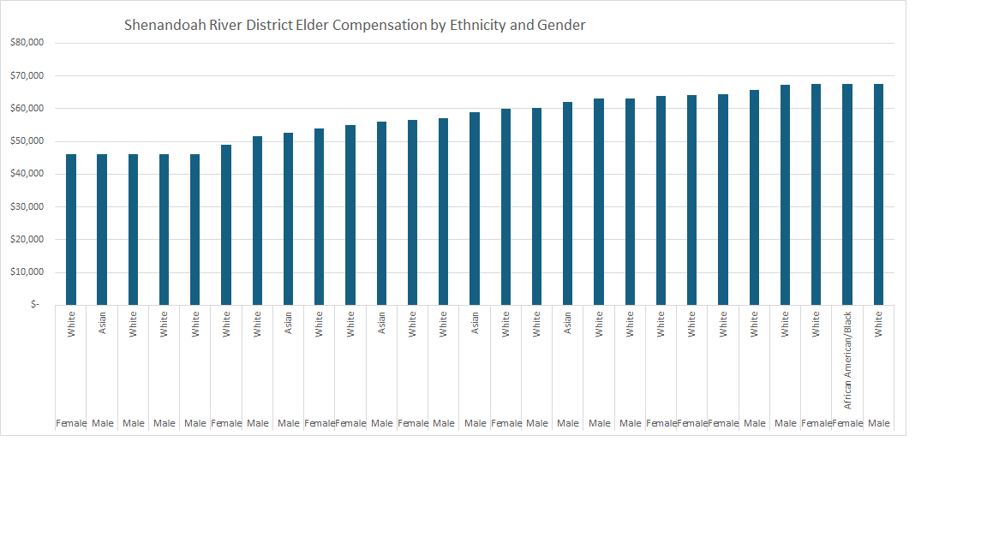
ELDERS VAUMC TOTAL COMPENSATION
SHENANDOAH RIVER DISTRICT

Slide 35
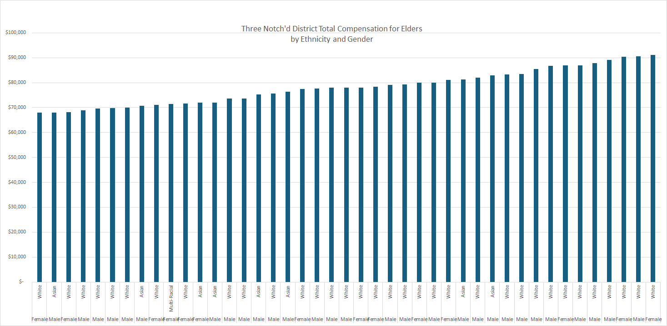
ELDERS VAUMC TOTAL COMPENSATION
THREE NOTCH’D DISTRICT

Slide 36
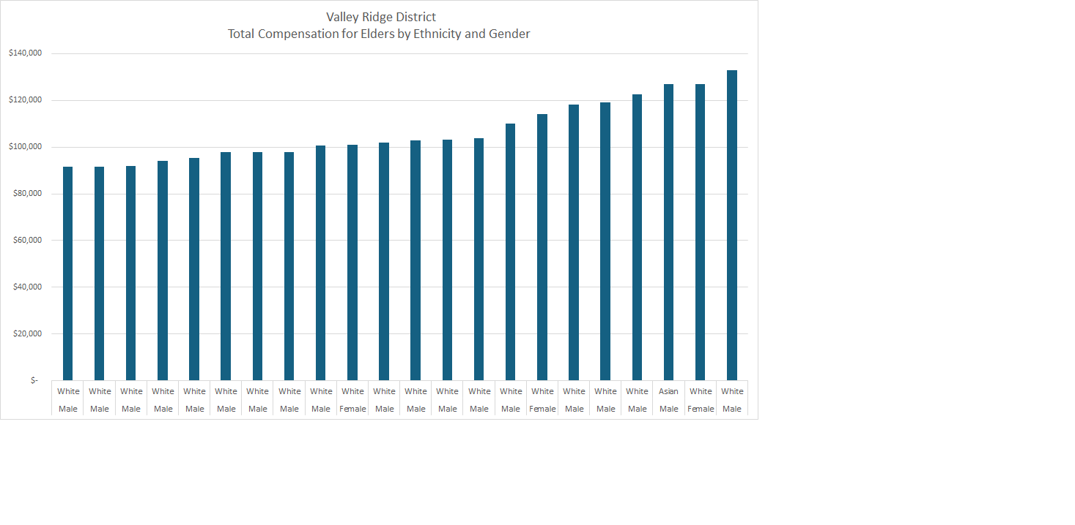
ELDERS VAUMC TOTAL COMPENSATION
VALLEY RIDGE DISTRICT

Slide 37
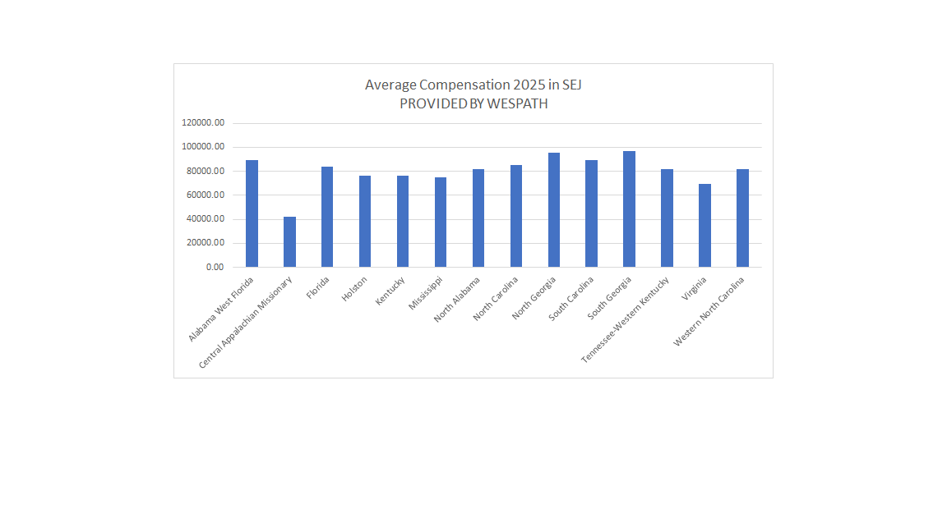
AVERAGE COMPENSATION ACROSS THE SEJ
Profit trend over the past four months.

Slide 38
AVERAGE COMPENSATION ACROSS THE SEJ
The VAUMC is the largest conference in the SEJ
with the second lowest average compensation.
Profit trend over the past four months.

Slide 39

VAUMC MINIMUM SALARIES

Slide 40
COMPARISONS TO OTHER A.C.’S
FLORIDA
FULL CONNECTION
49,000
PROVISIONAL
47,200
ASSOCIATE
45,800
LLP WITH MDIV/5 YR COS
44,400
LLP LESS THAN 5 YR COS
43,200

Slide 41
COMPARISONS TO OTHER A.C.’S
NORTH GEORGIA
FULL CONNECTION ELDER & DEACON, PROVISIONAL ELDER & DEACON, ASSOCIATE MEMBER
48,000
LLP WITH MDIV/ADV COS
46,700
LLP WITH 5 YR COS/EQUIVALENT
45,700
LLP
44,700
YEARS OF SERVICE
COMPLETION OF 3-5 $600
COMPLETION OF 6-10 1,200
COMPLETION OF 11-15 1,500
OVER 15 YEARS 2,000

Slide 42

COMPARISONS TO OTHER A.C.’S
WESTERN NORTH CAROLINA

Slide 43
COMPARISONS TO OTHER A.C.’S
HOLSTON
FE/FD 49,500
PE/PD/AM 45,900
FL/PL 1 (COMPLETED STUDIES) 42,800
FL/PL (NOT COMPLETED STUDIES 39,700

Slide 44
COMPARISONS TO OTHER A.C.’S
OUTSIDE SEJ
WESTERN
PENNSYLVANIA
Full Membership 45,065
Associate Membership 44,652
Provisional Membership 41,991
Full Time Licensed Local Pastor 41,730

Slide 45

NEXT STEPS
CONTINUE TO STUDY SALARIES BY STATUS, ETHNICITY, GENDER, AND DISTRICT

