Slide 1


JUST COMPENSATION TASK FORCE
AM, PE, AND FL ANALYSIS

Slide 2
Review: Through our Study of Ordained Elders’ Compensation We learned:
  Virginia has the second lowest compensation in the SEJ
  Years of Service do not always equate to higher total compensation for elders
  In 2/8 districts women are the highest paid
  African Americans have the highest base compensation of any ethnicity
  Men make more than women by a little over $10,000

Slide 3
Review: Through our Study of Ordained Elders’ Compensation We learned:
  Associates and Provisional Members had the same minimum salary, whereas Associates should have a higher minimum since it is a lifetime status.

Slide 4
Statistics We are Reviewing Today
  Associate Members (AM)
  Provisional Elders (PE)
  Full-Time Licensed Local Pastors (FL)

Slide 5
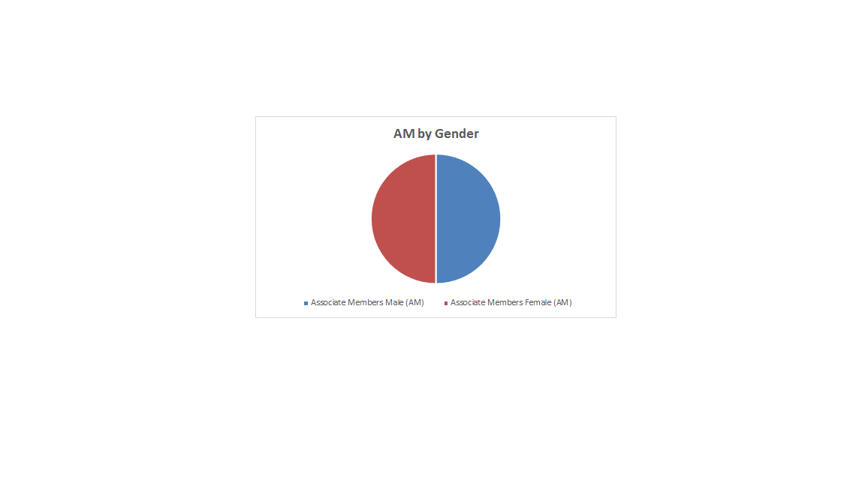

Slide 6
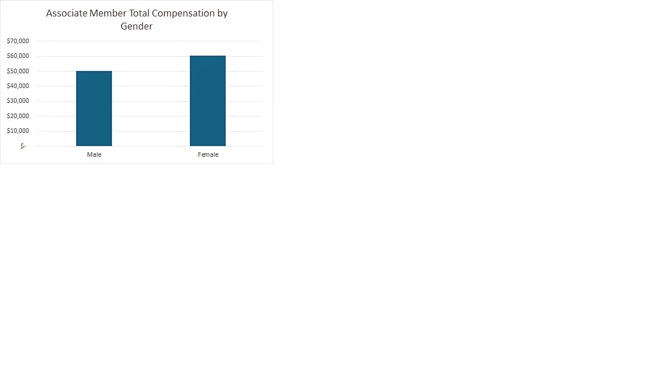
Age 65, 25 YOS,
Parsonage
Age 62, 9 YOS,
Housing Allowance

Slide 7
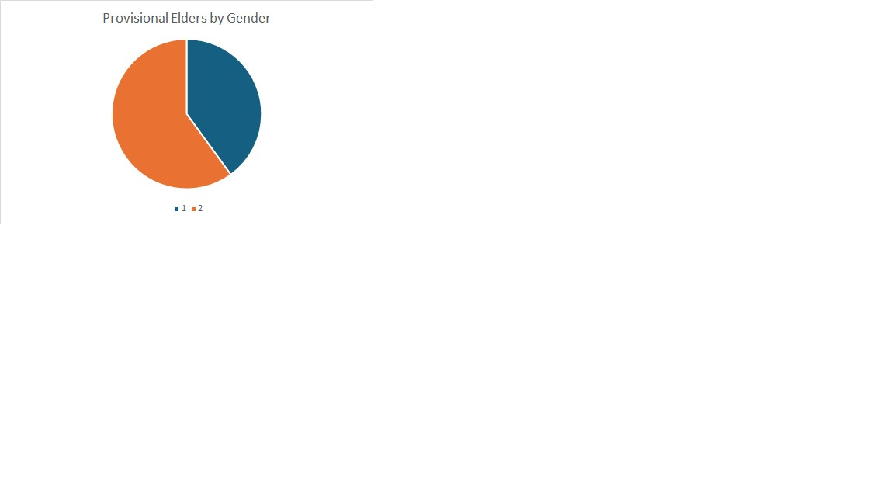
40%
Female
60% Male

Slide 8
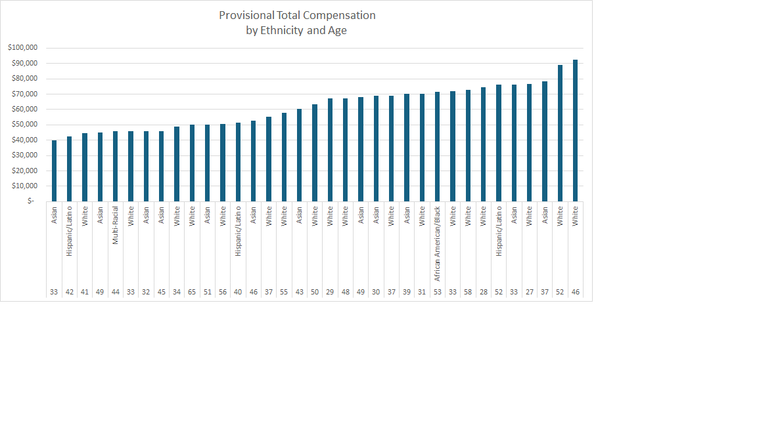

Slide 9
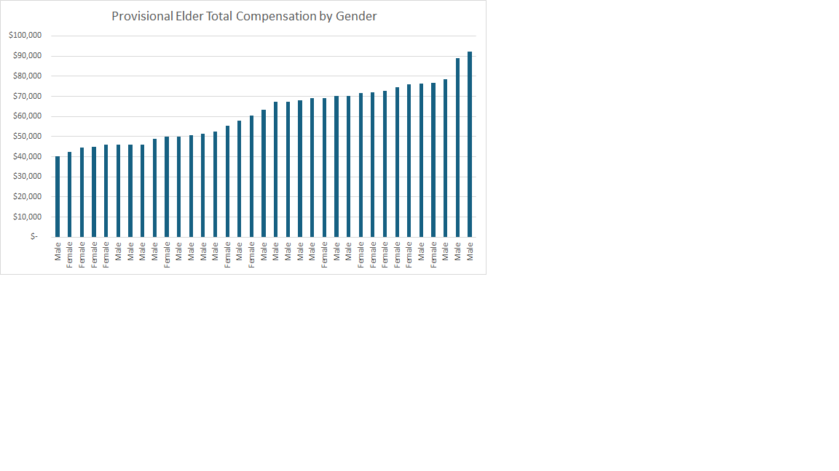

Slide 10
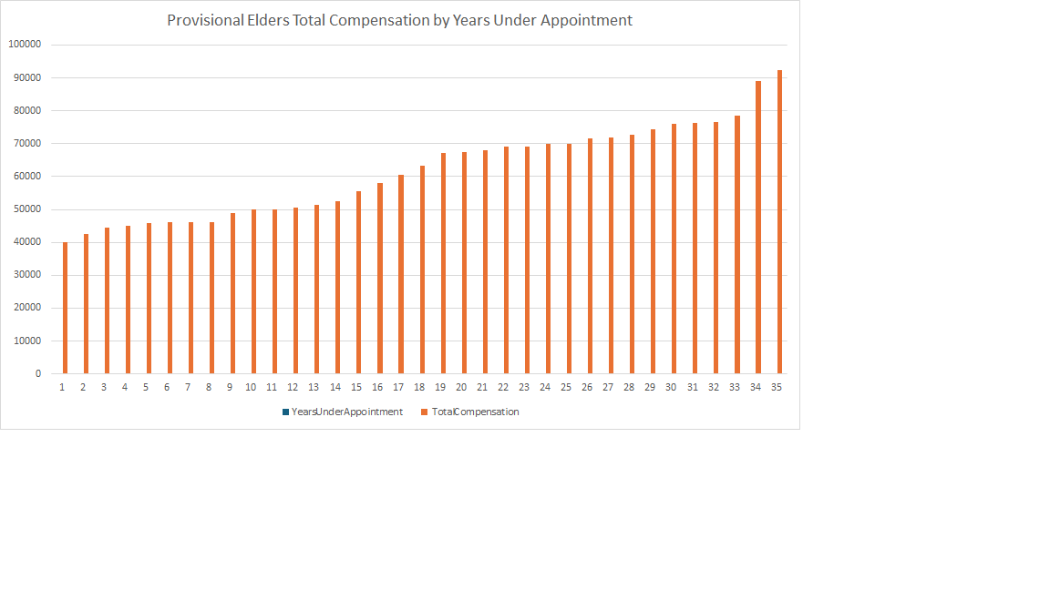
*** Provisional members total compensation is affected by years of service

Slide 11
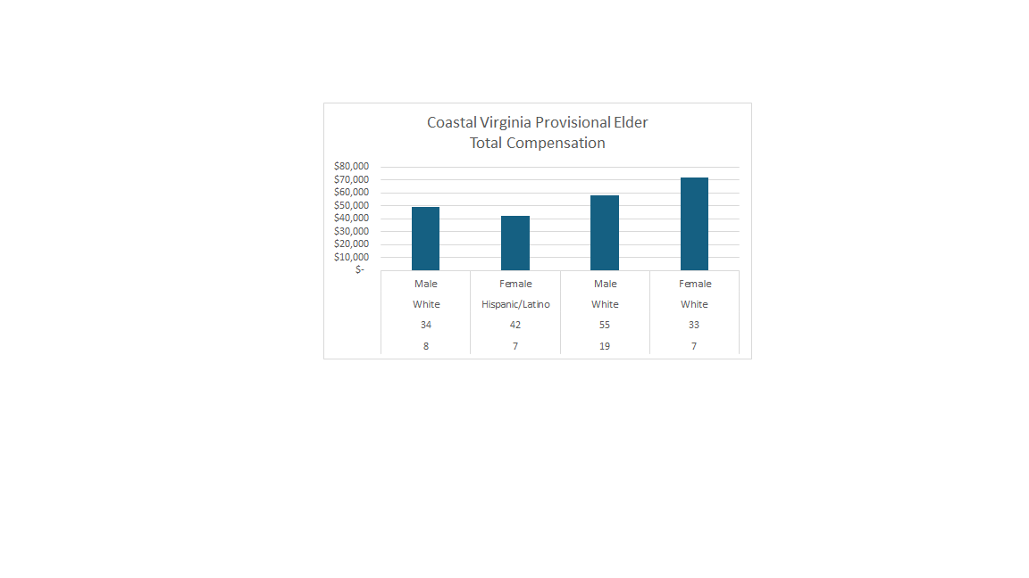
Gender
Ethnicity
Age
YOS

Slide 12
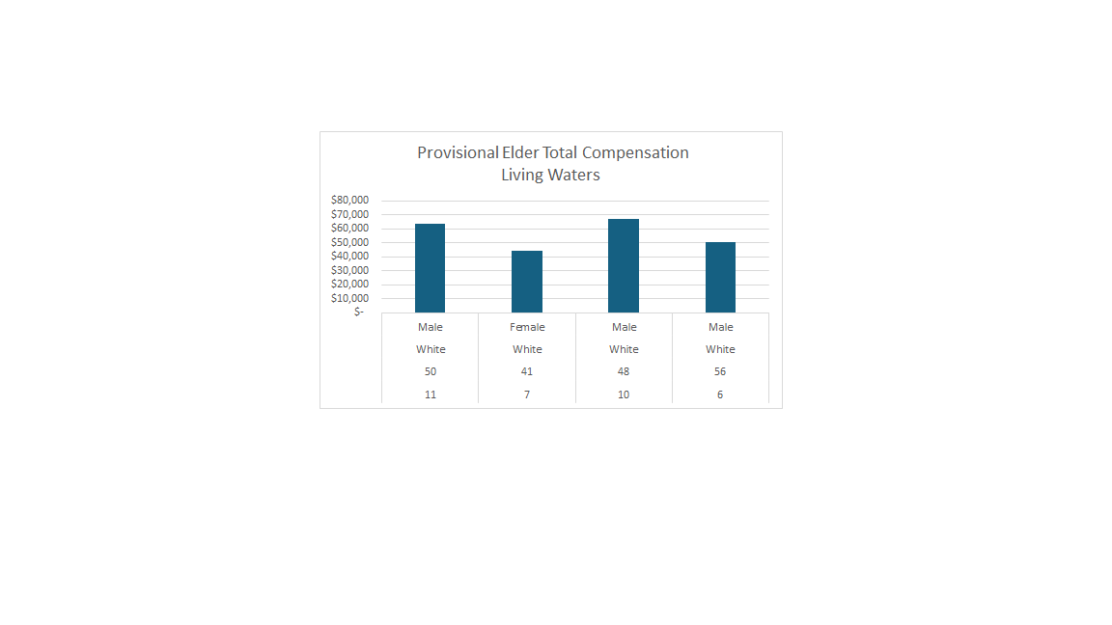
Gender
Ethnicity
Age
YOS

Slide 13
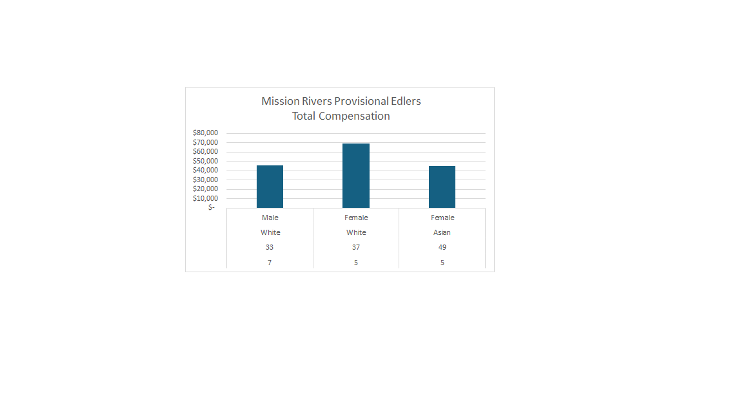
Gender
Ethnicity
Age
YOS

Slide 14
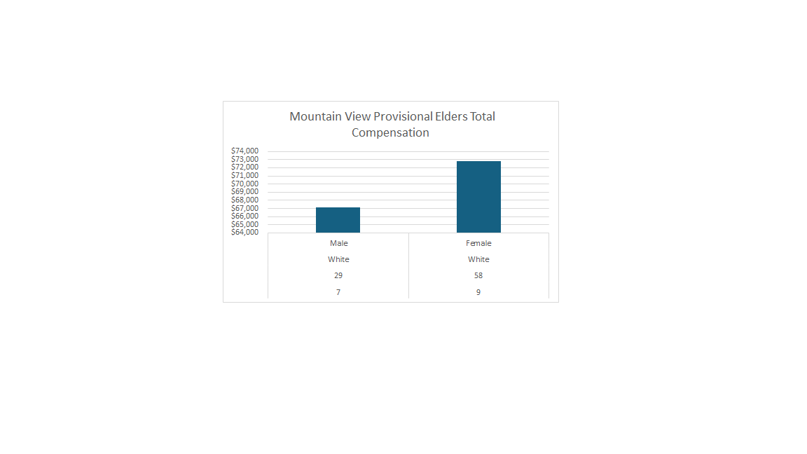
Gender
Ethnicity
Age
YOS

Slide 15
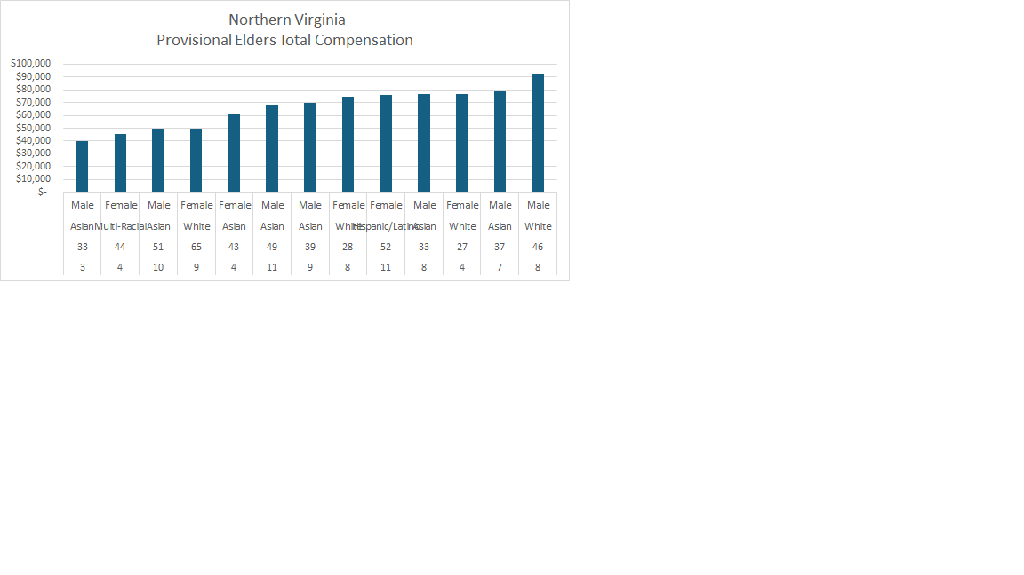
Gender
Ethnicity
Age
YOS

Slide 16
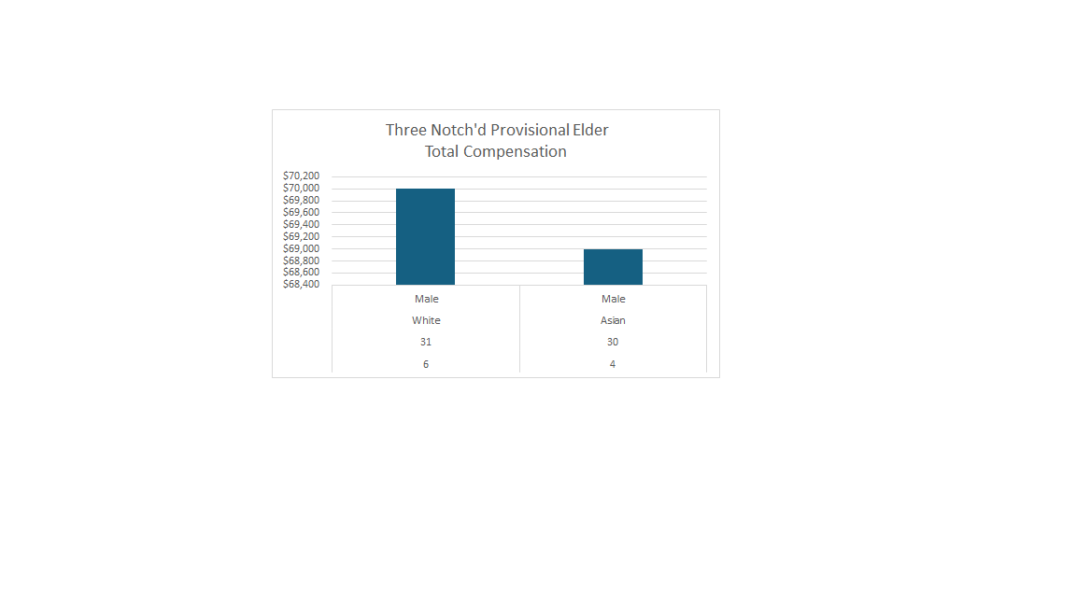
Gender
Ethnicity
Age
YOS

Slide 17
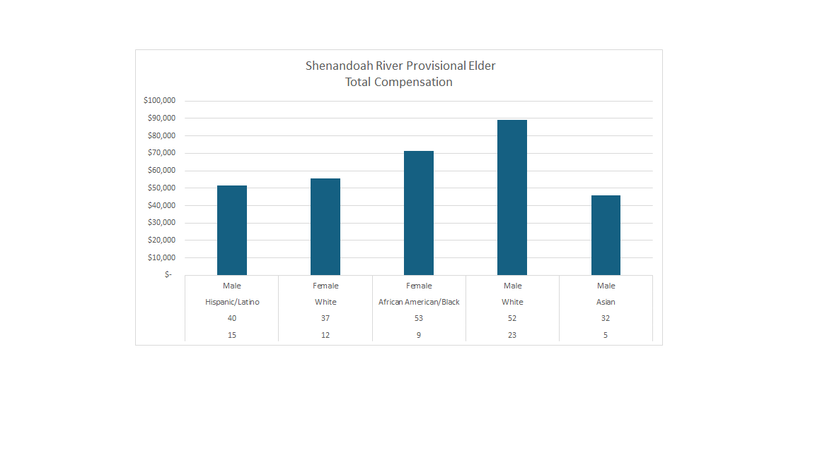
Gender
Ethnicity
Age
YOS

Slide 18
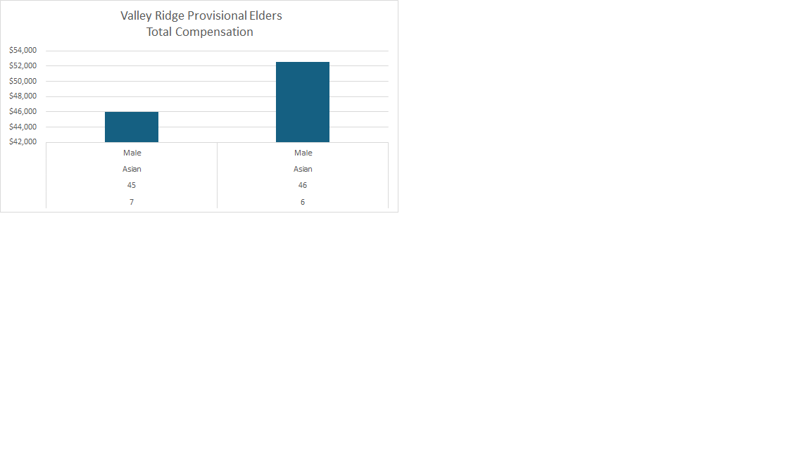
Gender
Ethnicity
Age
YOS

Slide 19
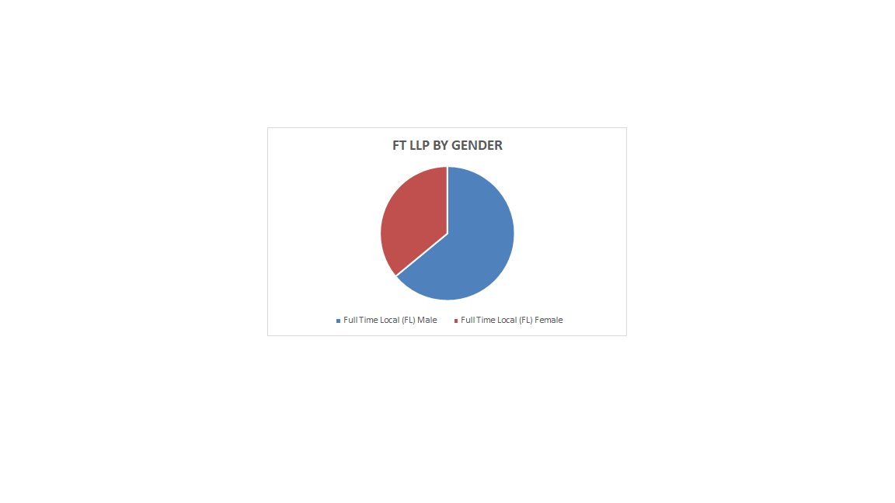
This number includes all FL appointed 100%, and that do not have a split percentage between more than one appointment
31
Female
64
Male

Slide 20
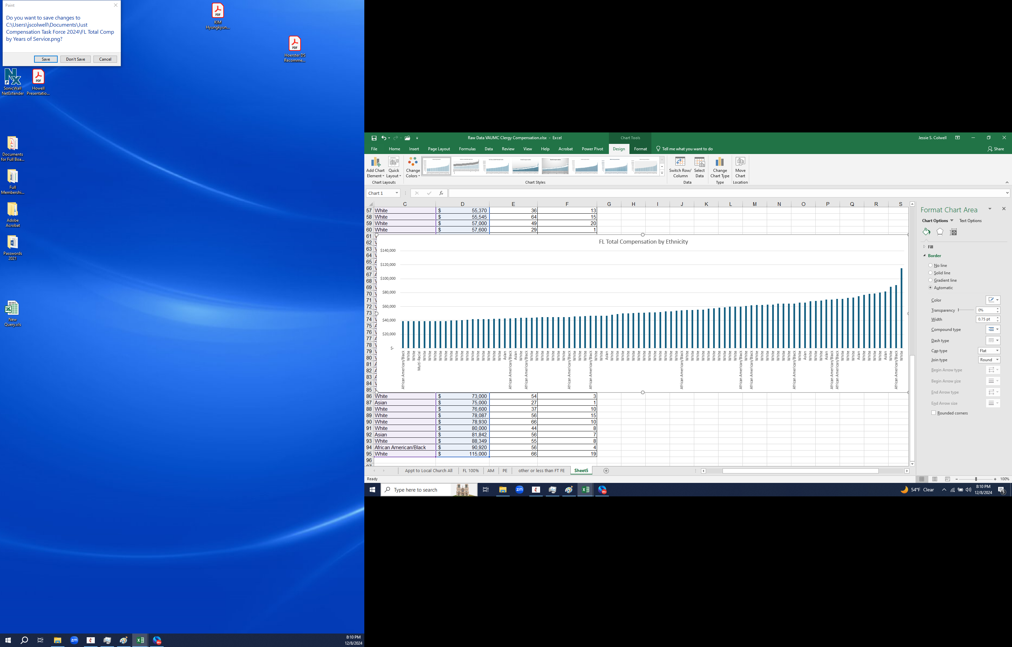
**African American has 2nd highest compensation for LLP

Slide 21
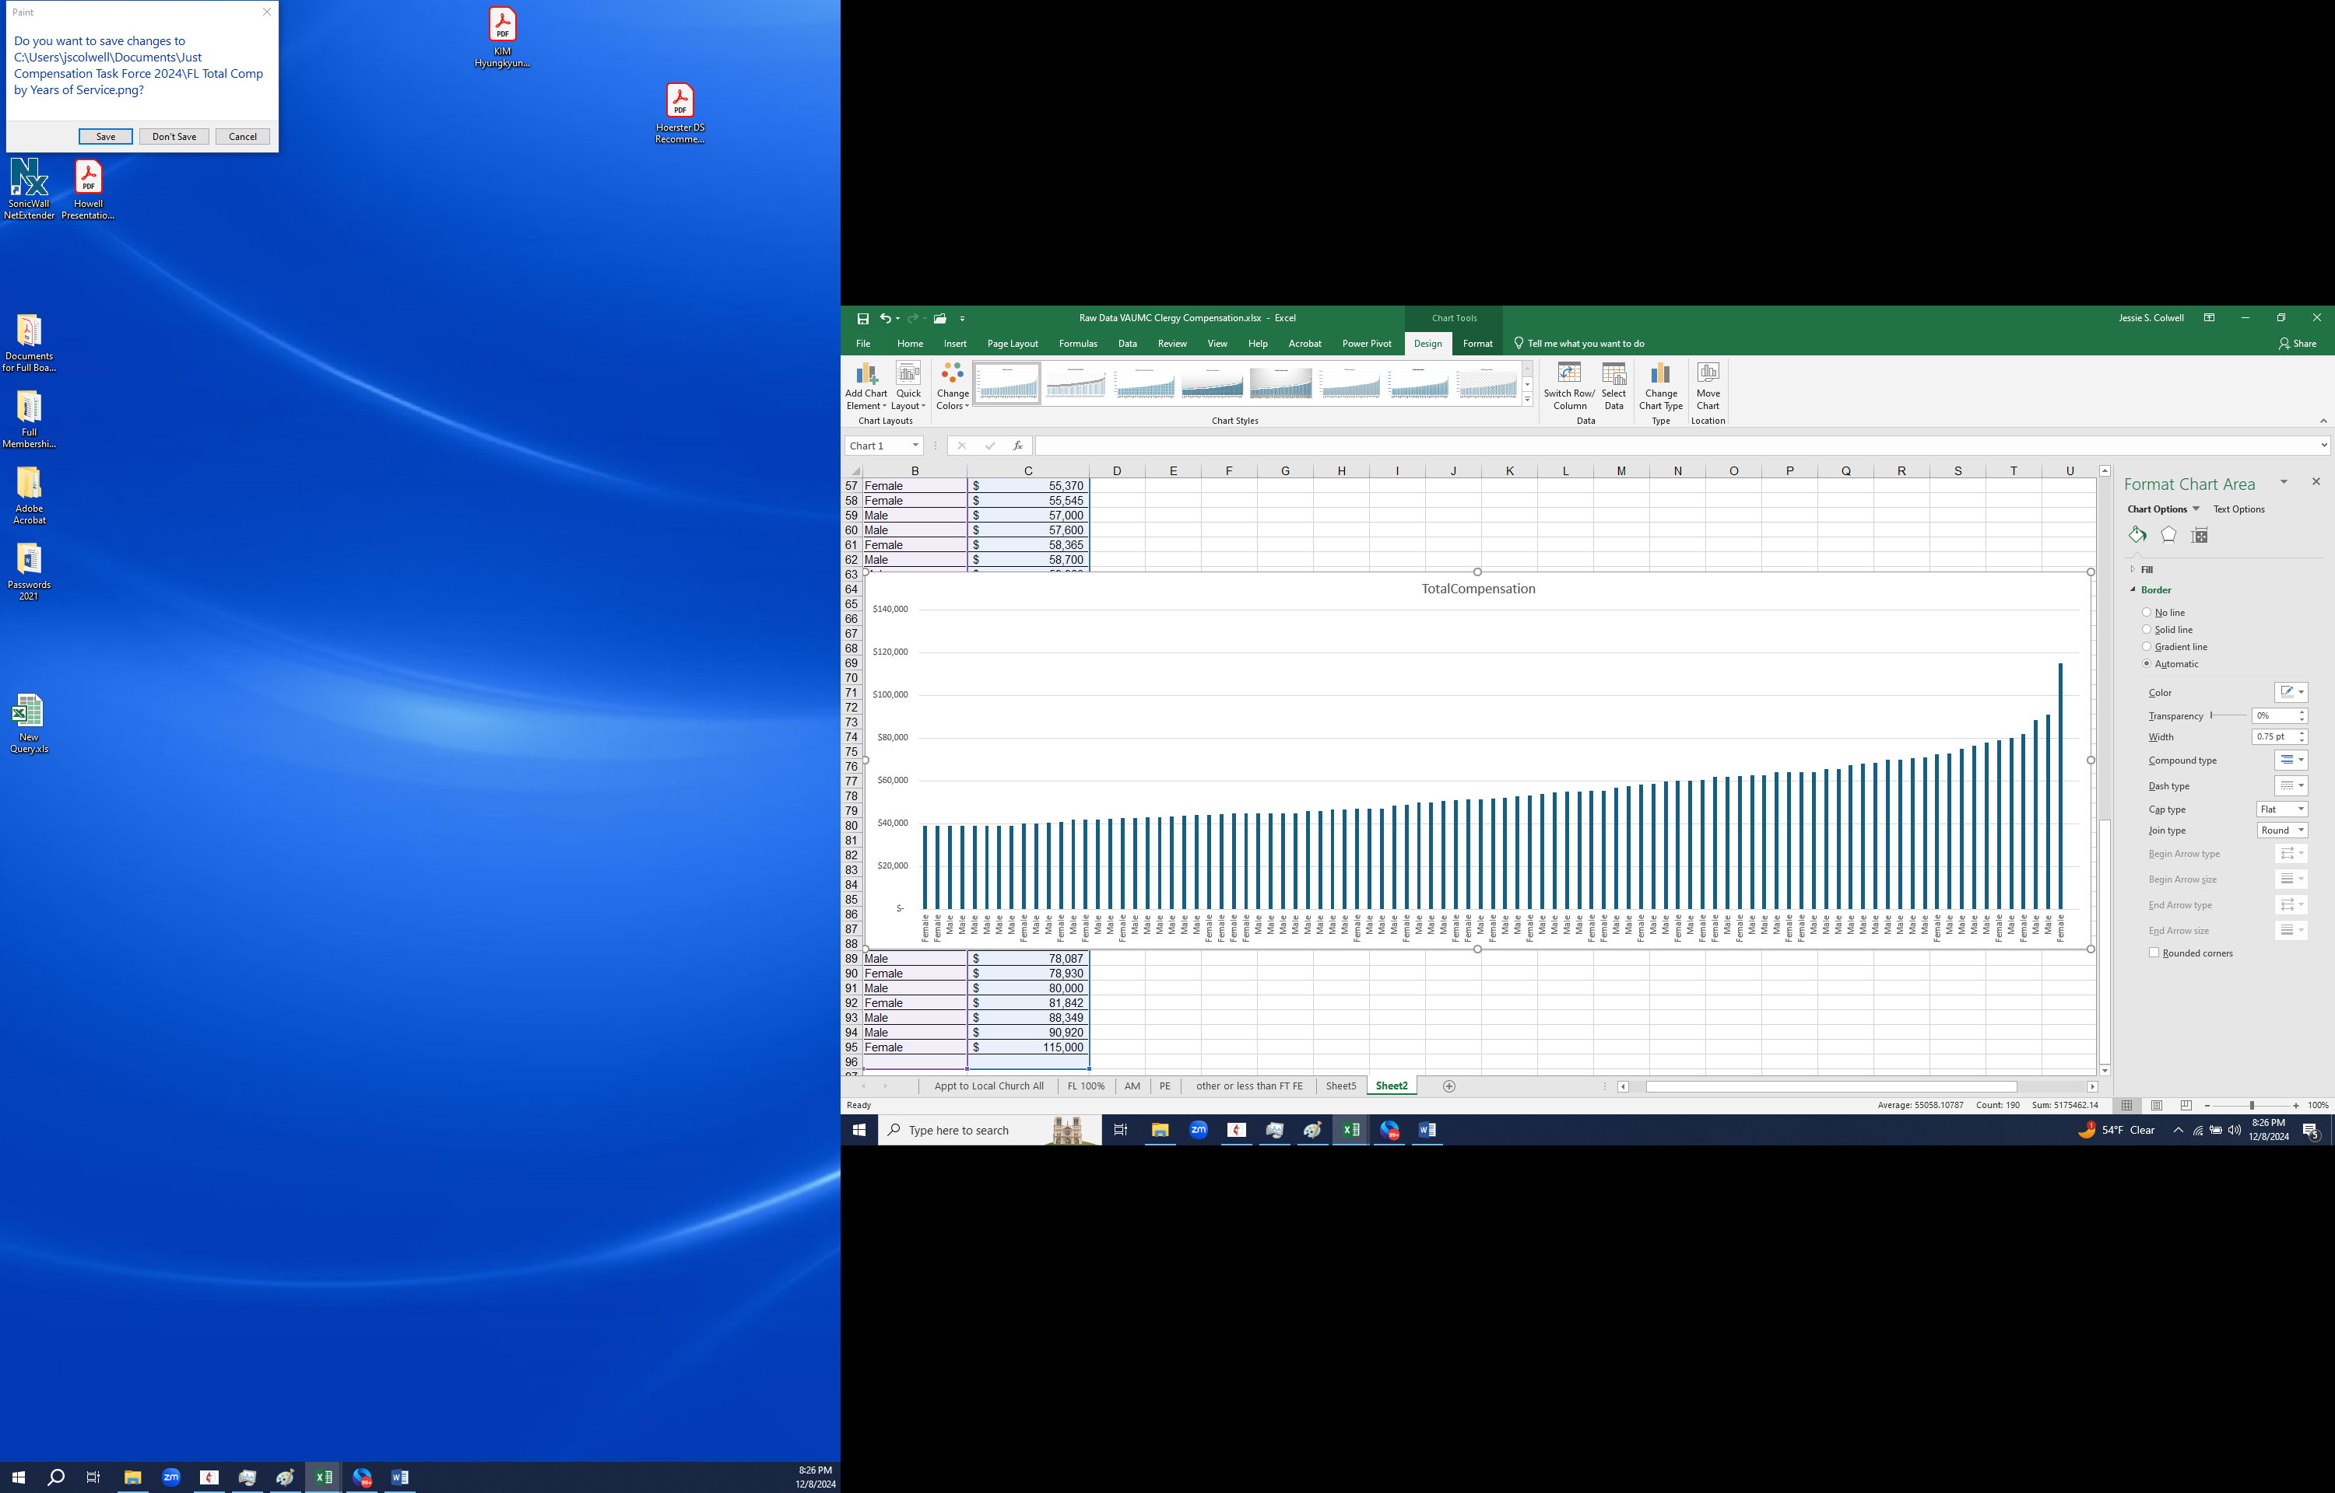
FL Total Comp by Gender

Slide 22
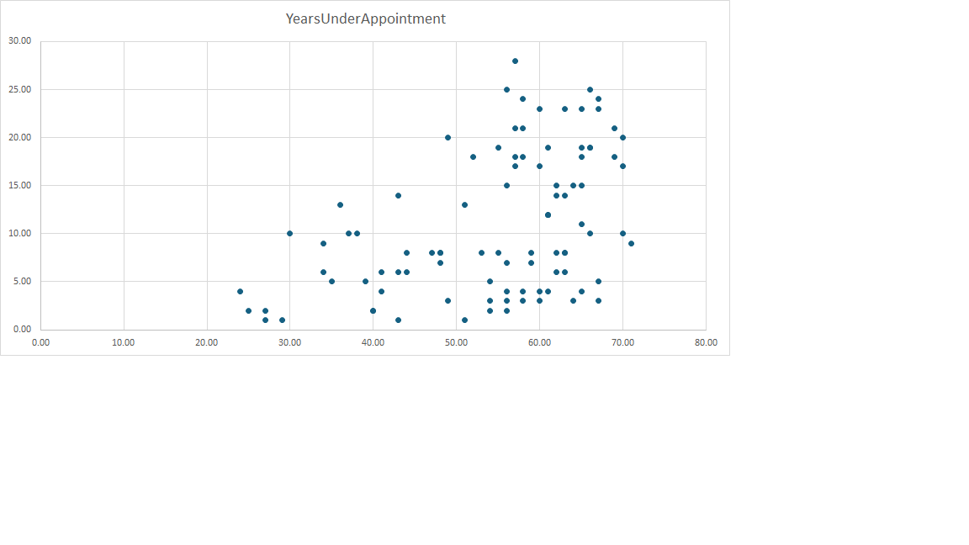
FL Total Compensation by Years Under Appointment
Years Under Appt.
Compensation

Slide 23
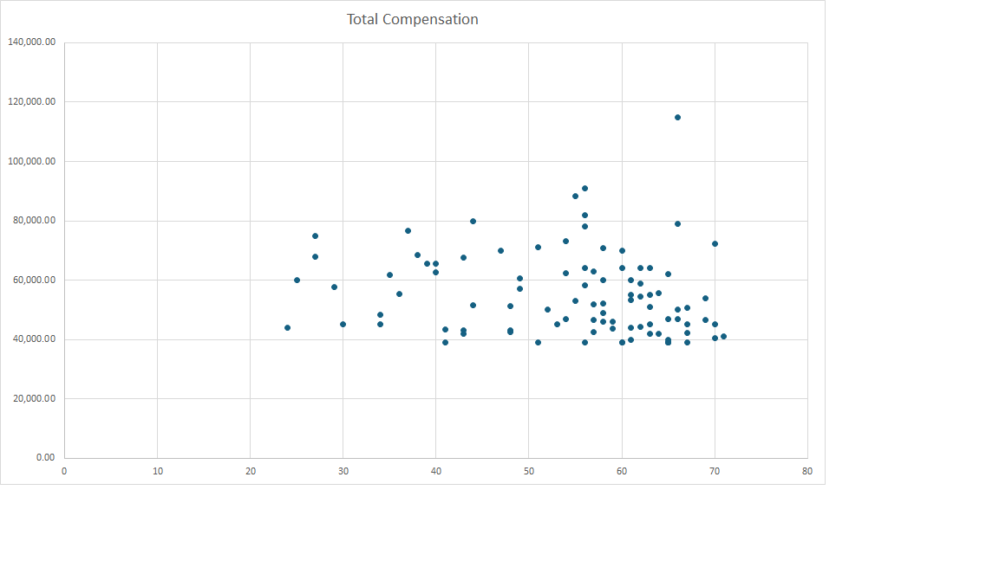
FL Total Compensation by Age
Total Compensation
Age

Slide 24
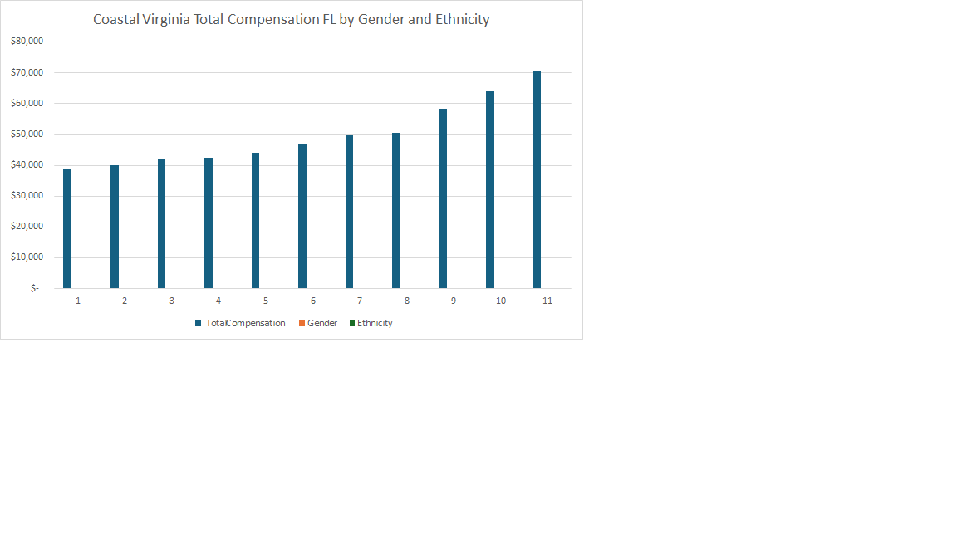
Multi-Racial White White White AA White White White White White AA
Male Female Male Male Male Female Male Male Female Female Male

Slide 25
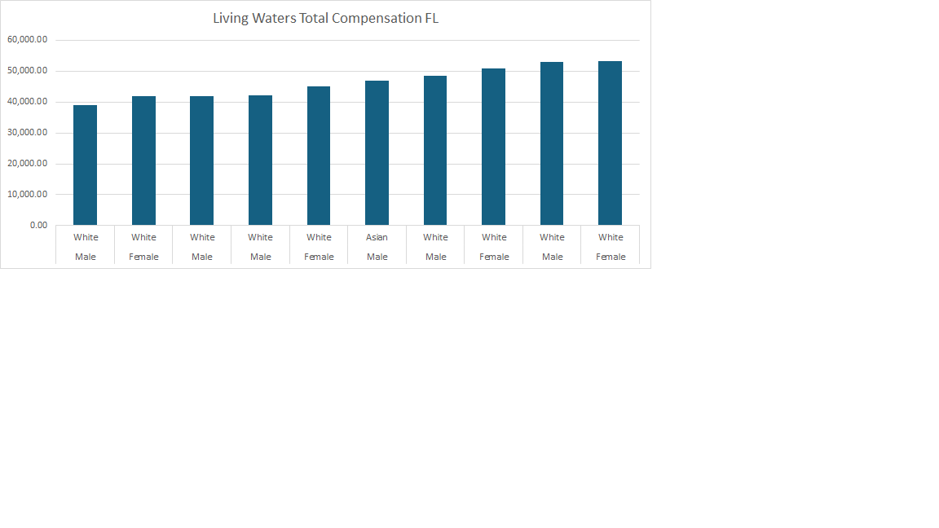

Slide 26
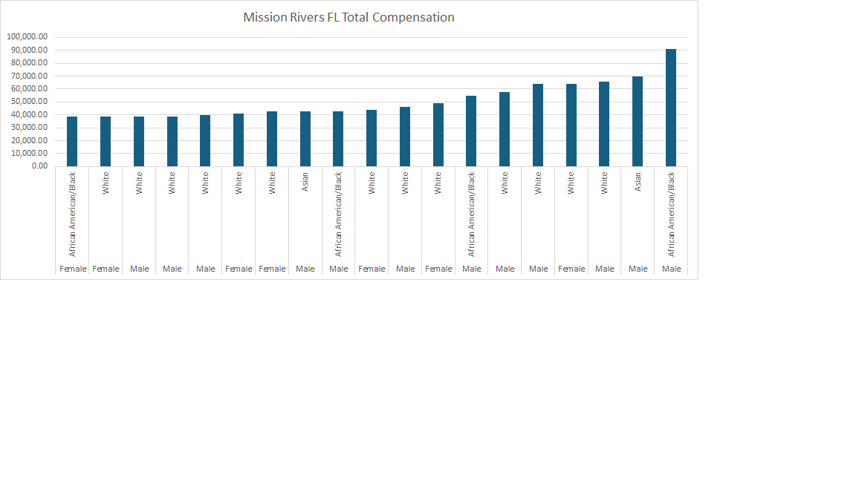

Slide 27
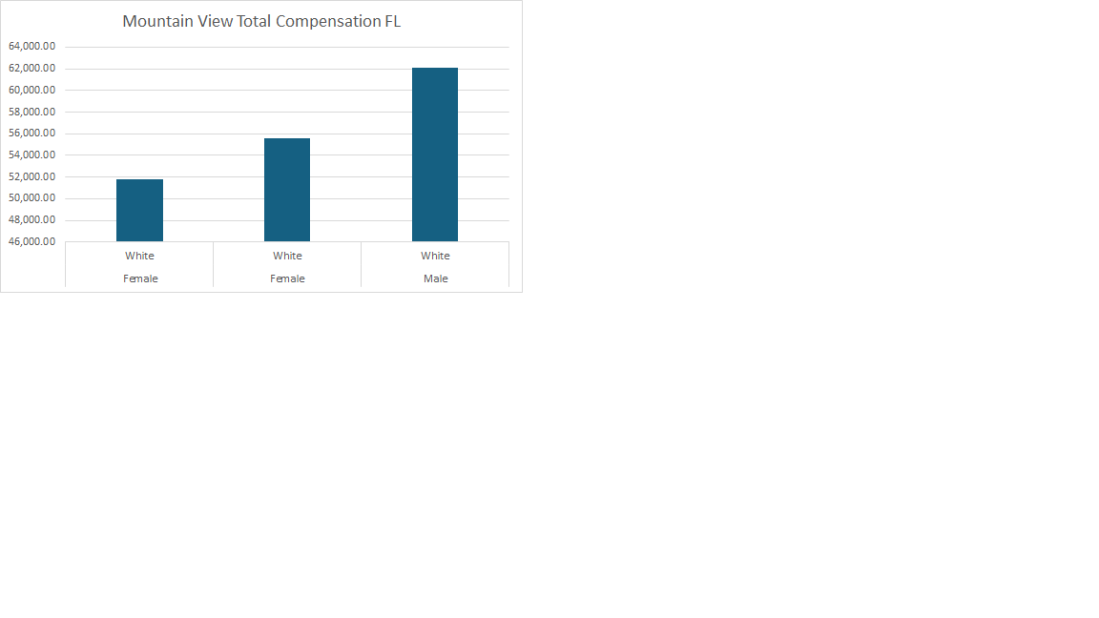

Slide 28
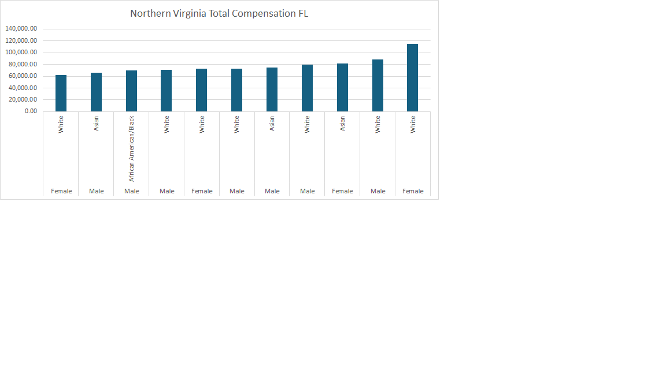

Slide 29
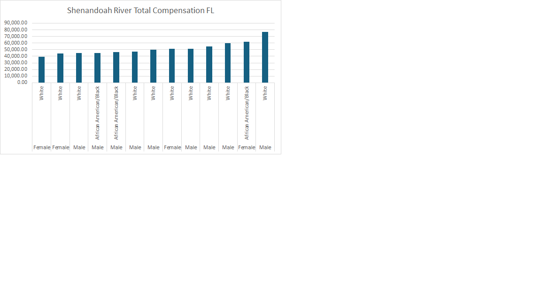

Slide 30
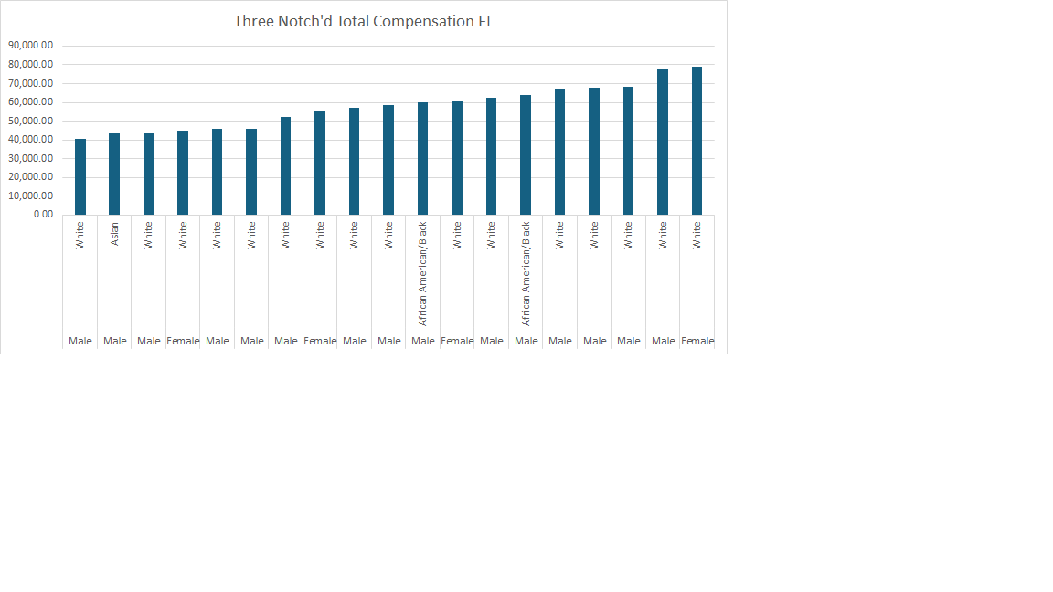

Slide 31
