Slide 1
Christian Theology
in 210 minutes
The Creed, The Sacraments, & The Word of God
in less time than it takes to roast a pork butt.

Slide 2
What does it mean to be a Christian?
(on an index card)

Slide 3
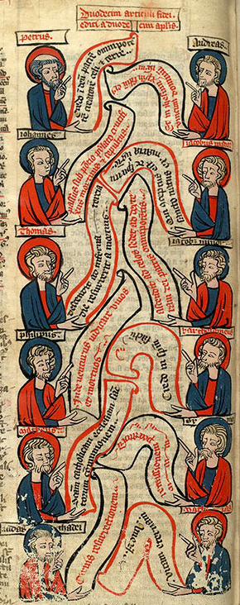
I believe in God, the Father Almighty,
creator of heaven and earth.
I believe in Jesus Christ, his only Son, our Lord,
who was conceived by the Holy Spirit,
born of the Virgin Mary,
suffered under Pontius Pilate,
was crucified, died, and was buried;
he descended to the dead.
On the third day he rose again;
he ascended into heaven,
is seated at the right hand of the Father,
and will come again to judge the living and the dead.
I believe in the Holy Spirit,
the holy catholic** church,
the communion of saints,
the forgiveness of sins,
the resurrection of the body,
and the life everlasting. Amen.

Slide 4
Why the Creed?

Slide 5
Why the Creed?
It’s because of Jesus

Slide 6
Why the Creed?
It’s because of Jesus
It’s been essential for Baptism

Slide 7
Why the Creed?
It’s because of Jesus
It’s been essential for Baptism
It’s the “bumpers” of Christian Faith.

Slide 8
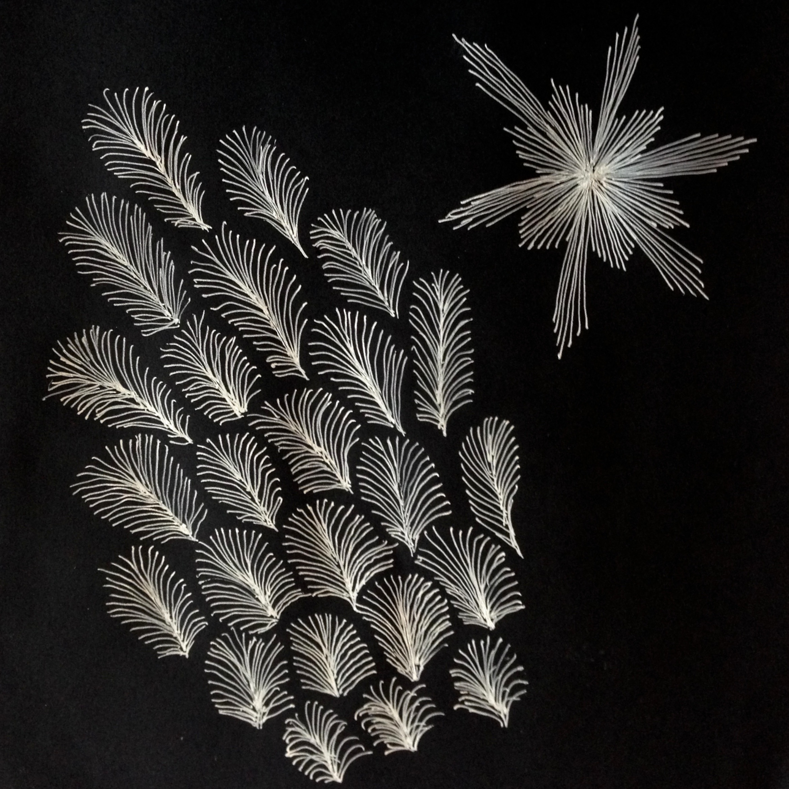
Doodle: What do you think about when you hear…
“I believe in God the Father Almighty,
maker of heaven and earth”

Slide 9
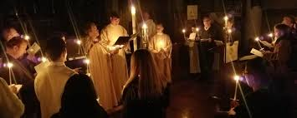
“I believe…”

Slide 10
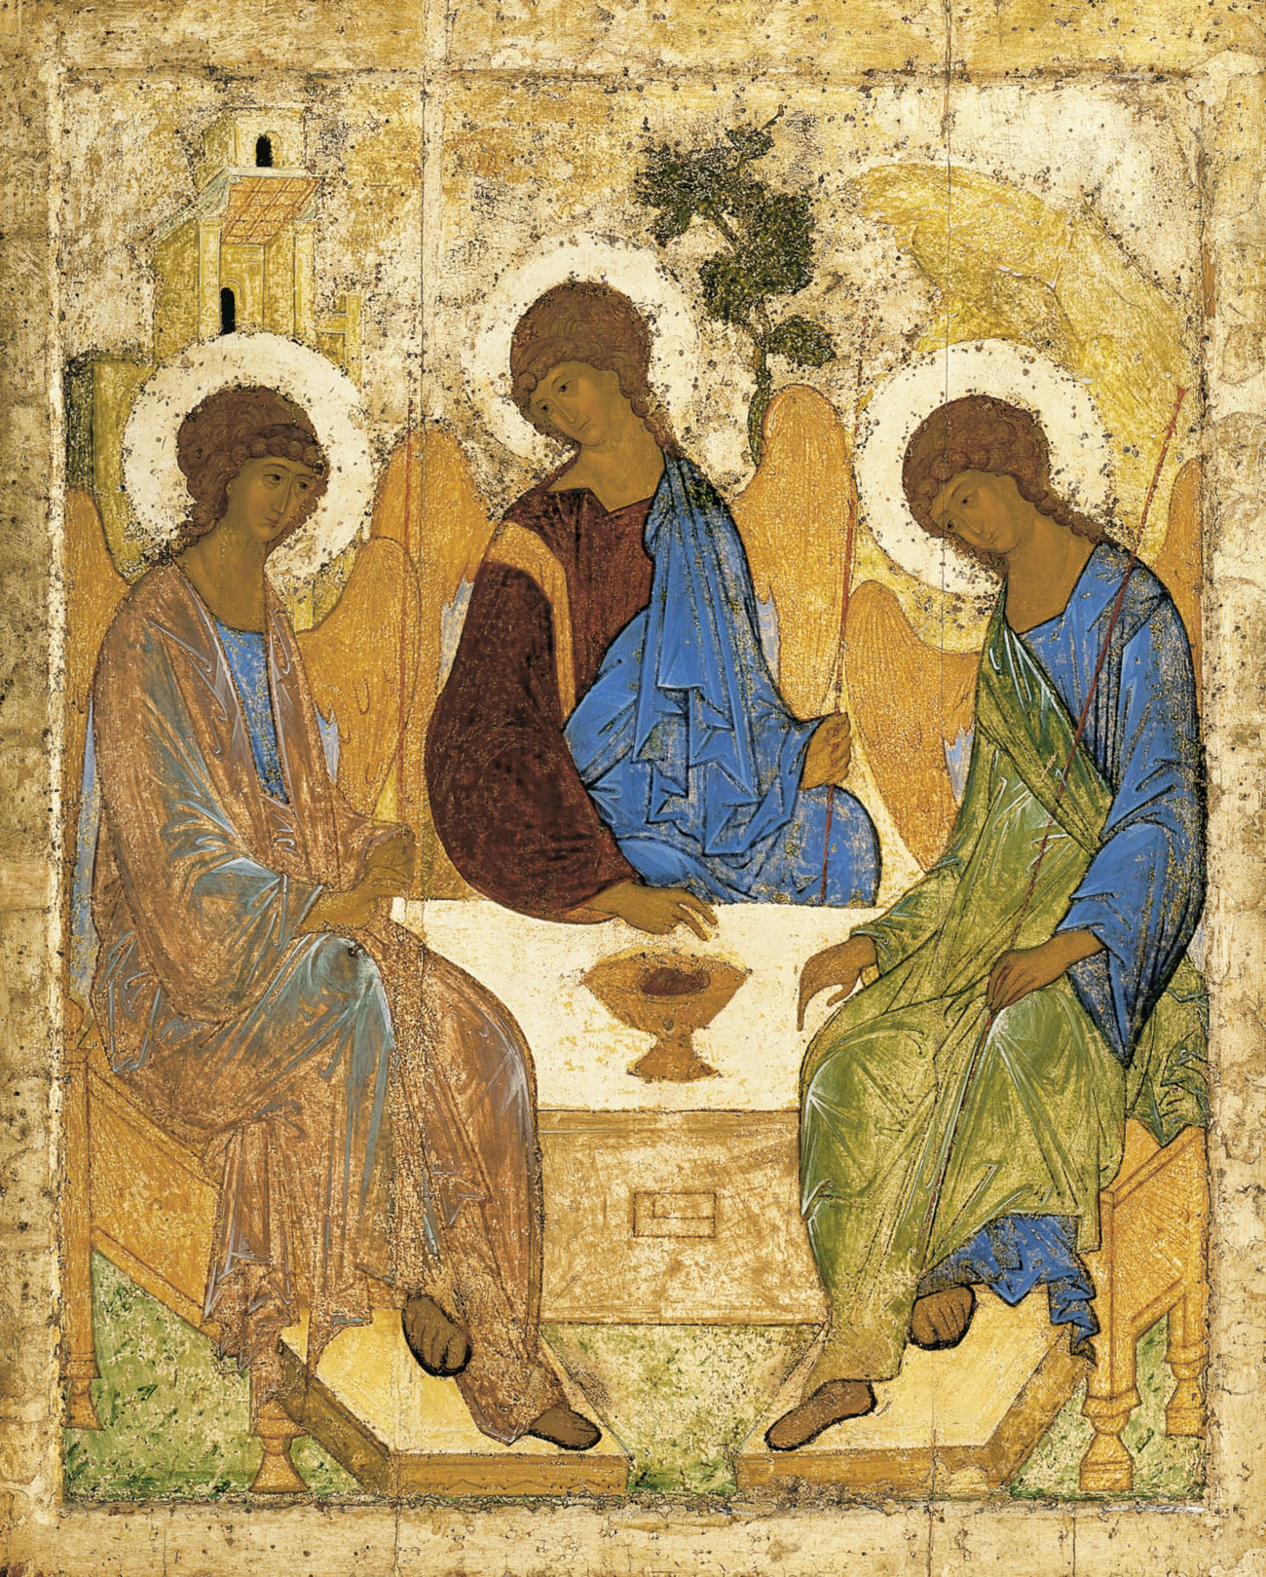
“…in God the Father Almighty”
What it means:
God is inherently relational
Within God’s self (the immanent Trinity)
WIth us (the economic Trinity)
God in three persons, blessed Trinity
The (immanent) Trinity is about relationship within God
What it doesn’t mean:
Deism (God without us)
Modalism (confusing the persons of the Trinity with the acts of God with us)

Slide 11
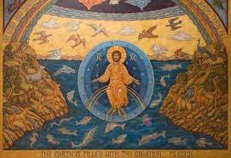
“...maker of heaven and earth”
In Scripture?
“Monarch,” “Source”
Not a creature

Slide 12
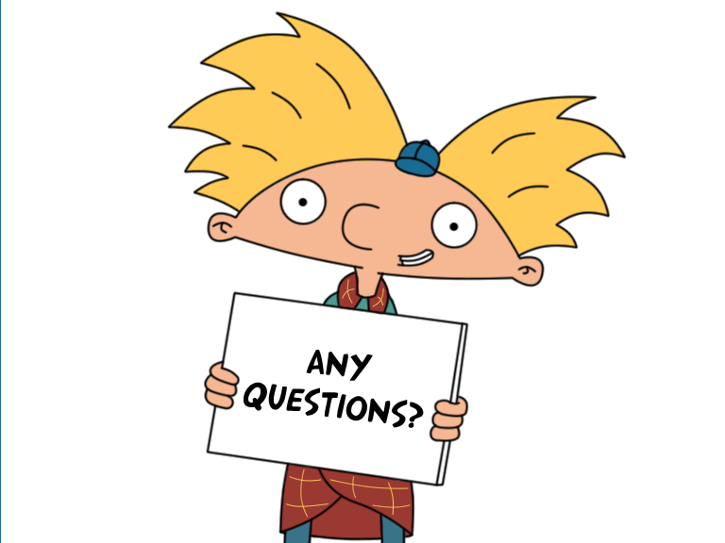
The First Article
“I believe in God the Father Almighty,
Maker of heaven and earth.”

Slide 13
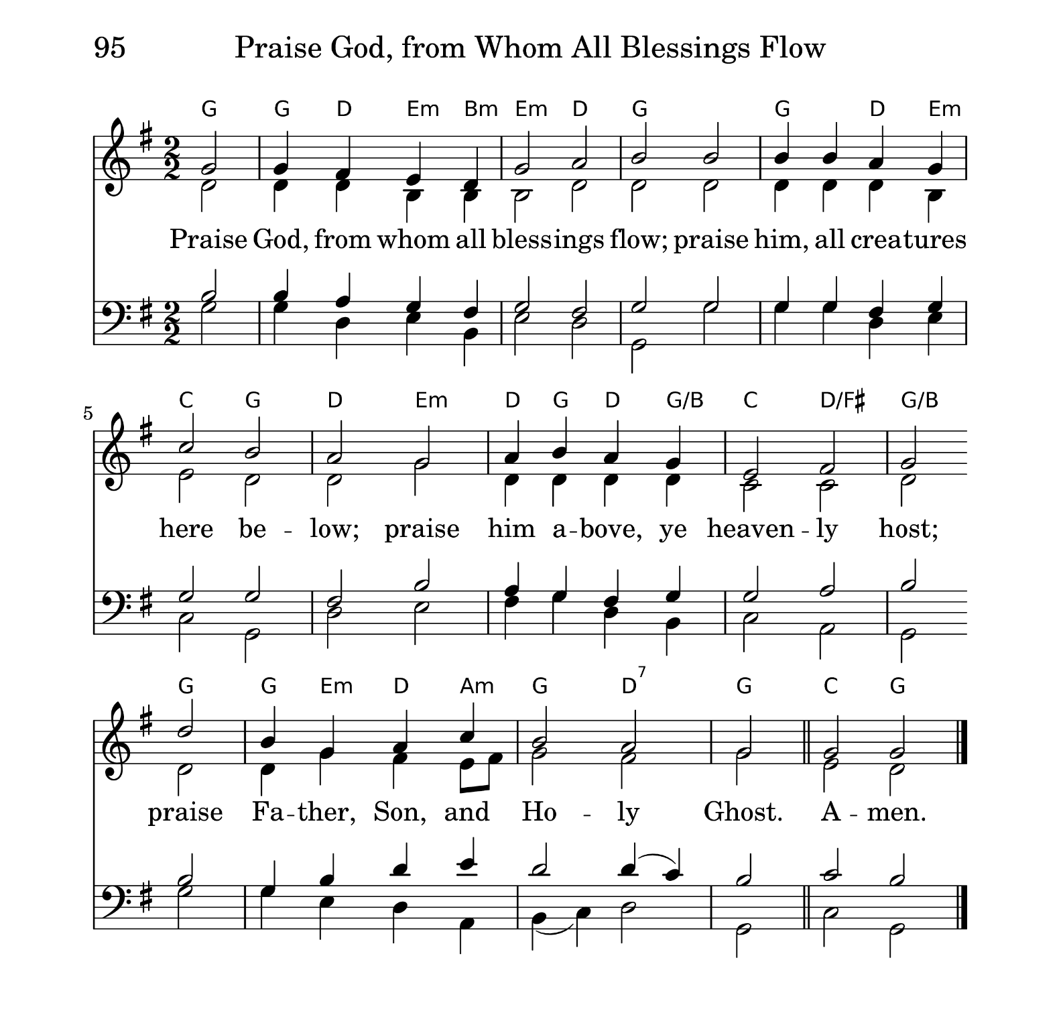
God
God

Slide 14
Doodle: What do you think about when you hear…
“I believe in Jesus Christ, his only Son, our Lord, who was conceived by the Holy Spirit, born of the Virgin Mary, suffered under Pontius Pilate,was crucified, died, and was buried; he descended to the dead.”

Slide 15
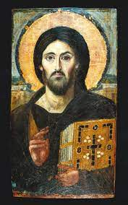
I believe in Jesus Christ, his only son, our Lord …
Saint Catherine's Monastery, Mount Sinai, 6th century

Slide 16
I believe in Jesus Christ, his only son, our Lord …
Jesus (of Nazareth)
Saint Catherine's Monastery, Mount Sinai, 6th century

Slide 17
I believe in Jesus Christ, his only son, our Lord …
Jesus (of Nazareth)
Christ (of the Bible)
Saint Catherine's Monastery, Mount Sinai, 6th century

Slide 18
I believe in Jesus Christ, his only son, our Lord …
Jesus (of Nazareth)
Christ (of the Bible)
His only Son (Not Caesar)
Saint Catherine's Monastery, Mount Sinai, 6th century

Slide 19
I believe in Jesus Christ, his only son, our Lord …
Jesus (of Nazareth)
Christ (of the Bible)
His only Son (Not Caesar)
Our Lord (Kyrios & YHWH)
Saint Catherine's Monastery, Mount Sinai, 6th century

Slide 20
I believe in Jesus Christ, his only son, our Lord …
Jesus (of Nazareth)
Christ (of the Bible)
His only Son (Not Caesar)
Our Lord (Kyrios & YHWH)
Possible Heresies
Only Human (Ebionitism)
Only God (Docetism)
Saint Catherine's Monastery, Mount Sinai, 6th century

Slide 21
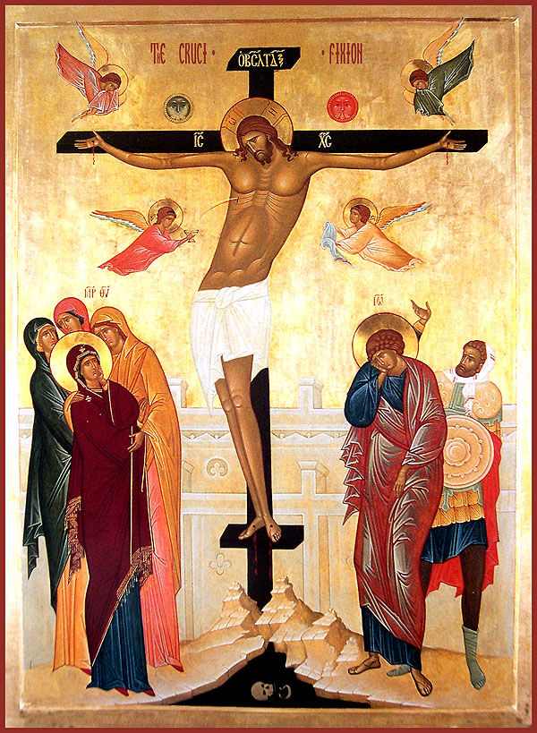
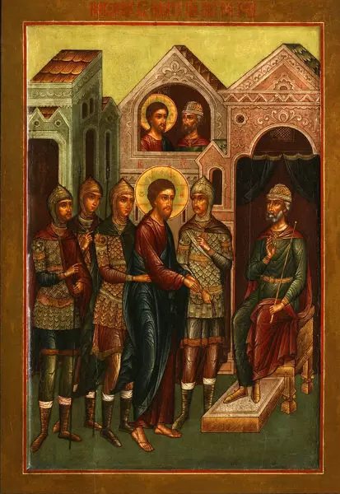
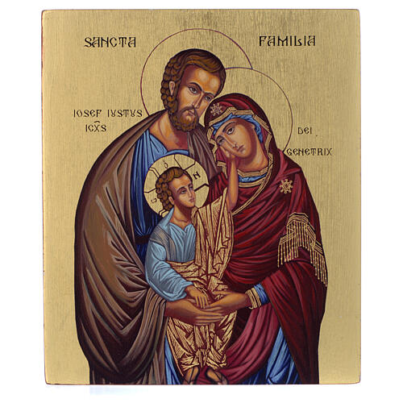
“Who was conceived by the Holy Spirit, Born of the Virgin Mary,
Suffered under Pontius Pilate,
Was crucified, dead, and buried.”
This is history!
This is the meaning of history!

Slide 22
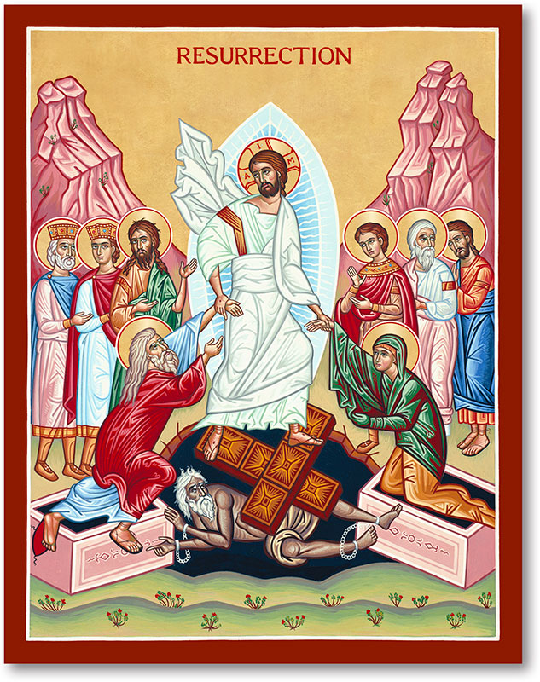
“He descended to the dead. The third day He rose from the dead. He ascended into heaven and sitteth at the right hand of God the Father Almighty. From thence he shall come to judge the quick and the dead…”
Icon of the Resurrection - The Harrowing of Hell, with Feasts. Yaroslavl. Ca. mid-17th century.

Slide 23
“He descended to the dead. The third day He rose from the dead. He ascended into heaven and sitteth at the right hand of God the Father Almighty. From thence he shall come to judge the quick and the dead…”
Soteriology
Icon of the Resurrection - The Harrowing of Hell, with Feasts. Yaroslavl. Ca. mid-17th century.

Slide 24
“He descended to the dead. The third day He rose from the dead. He ascended into heaven and sitteth at the right hand of God the Father Almighty. From thence he shall come to judge the quick and the dead…”
Soteriology
Doctrine of Salvation
Icon of the Resurrection - The Harrowing of Hell, with Feasts. Yaroslavl. Ca. mid-17th century.

Slide 25
“He descended to the dead. The third day He rose from the dead. He ascended into heaven and sitteth at the right hand of God the Father Almighty. From thence he shall come to judge the quick and the dead…”
Soteriology
Doctrine of Salvation
Eschatology
Doctrine of “the End”
Icon of the Resurrection - The Harrowing of Hell, with Feasts. Yaroslavl. Ca. mid-17th century.

Slide 26
The Second Article
“I believe in Jesus Christ, his only son, our Lord …Who was conceived by the Holy Spirit, Born of the Virgin Mary,
Suffered under Pontius Pilate,
Was crucified, dead, and buried. He descended to the dead. The third day He rose from the dead. He ascended into heaven and sitteth at the right hand of God the Father Almighty. From thence he shall come to judge the quick and the dead…”

Slide 27
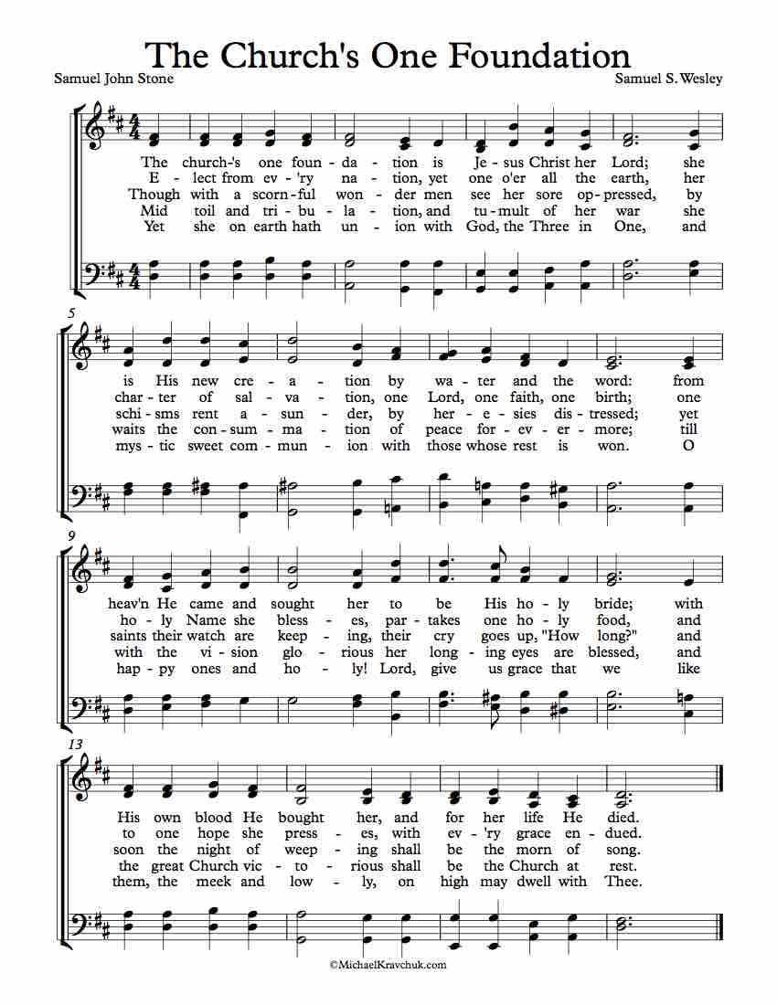

Slide 28
Enjoy your break

Slide 29
Doodle: What do you think about when you hear…
“I believe in the Holy Spirit,
The Holy Catholic Church,
The Communion of Saints,
The forgiveness of sins,
The resurrection of the body,
And the life everlasting.

Slide 30
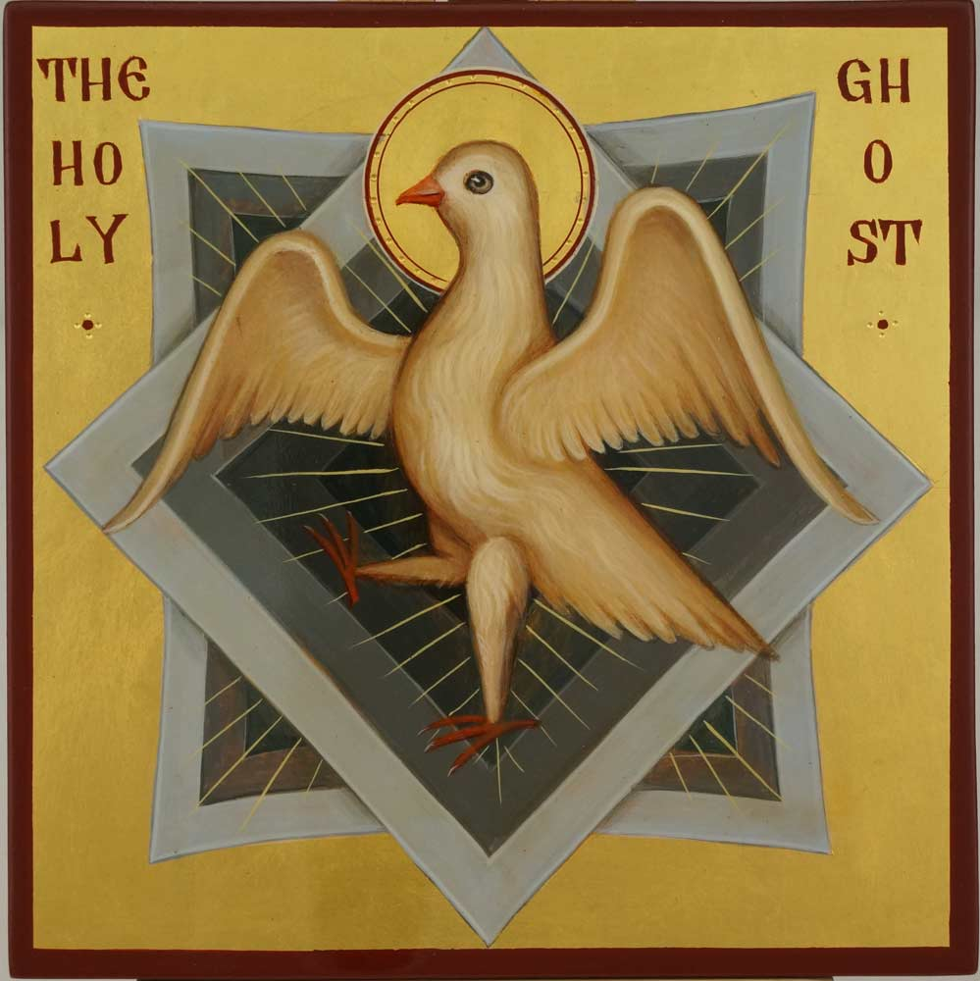
“I believe in the Holy Spirit”
What is the Spirit and what does she do? (The Spirit that was in Christ Jesus)
Allows for human participation within the divine life and divine action (ministry of reconciliation)
Why are we afraid of the Holy Spirit?

Slide 31
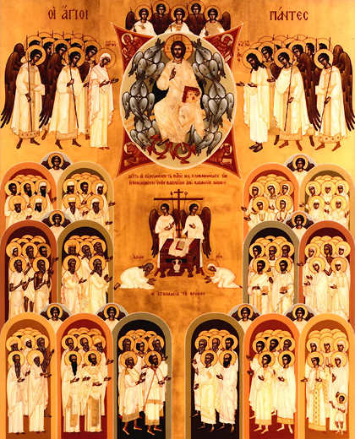
“The Holy Catholic Church”
Holy - Set apart
Synaxis of All Saints - Orthodox

Slide 32
“The Holy Catholic Church”
Holy - Set apart
Catholic - Universal
Synaxis of All Saints - Orthodox

Slide 33
“The Holy Catholic Church”
Holy - Set apart
Catholic - Universal
Ecclesiology
People of God
Body of Christ
Temple of the Holy Spirit
Preaching Communion
Word & Sacrament
“With God’s help, we will proclaim the good news, and live according to the example of Christ.”
Synaxis of All Saints - Orthodox

Slide 34
“The Communion of Saints”

Slide 35
“The Communion of Saints”
Trans-mortal communion
Sanctified Sinners
Whom God saves

Slide 36
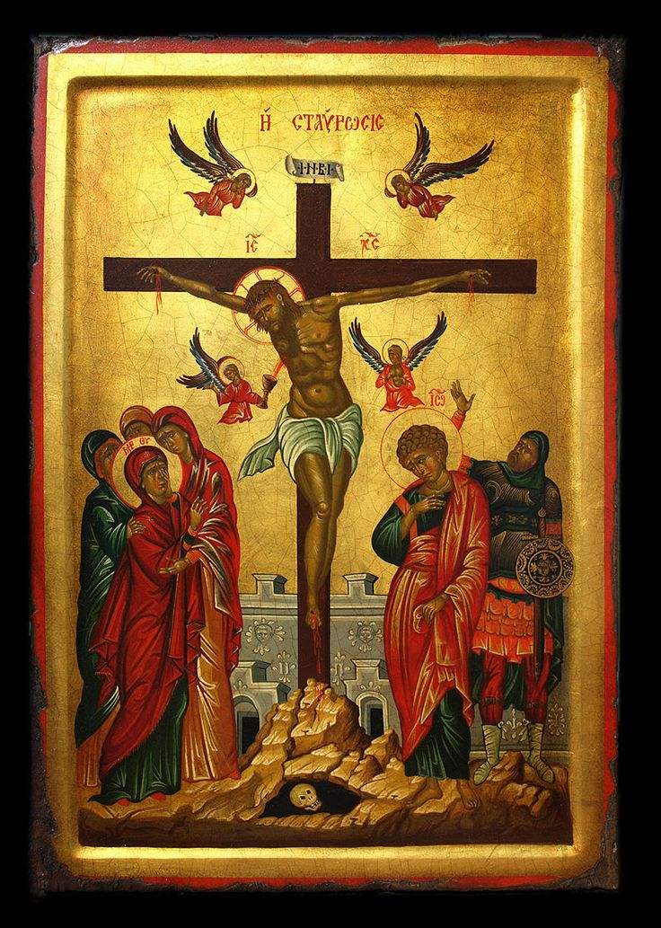
“The Forgiveness of Sins”
What God has done! (whether we like it or not…)
The story the church is charged to tell! (whether we like it or not…)

Slide 37
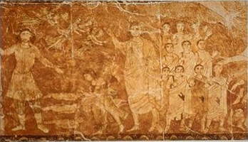
“The resurrection of the body and the live everlasting”
Vision of the Valley of Dry Bones, fresco from the Dura-Europos synagogue

Slide 38
“The resurrection of the body and the live everlasting”
What God has promised
Vision of the Valley of Dry Bones, fresco from the Dura-Europos synagogue

Slide 39
“The resurrection of the body and the live everlasting”
What God has promised
Not just souls
Vision of the Valley of Dry Bones, fresco from the Dura-Europos synagogue

Slide 40
“The resurrection of the body and the live everlasting”
What God has promised
Not just souls
Life Everlasting, Eternal Life =
Vision of the Valley of Dry Bones, fresco from the Dura-Europos synagogue

Slide 41
The Third Article
“I believe in the Holy Spirit, the holy catholic church, the communion of saints, the forgiveness of sins, the resurrection of the body and the live everlasting,”

Slide 42
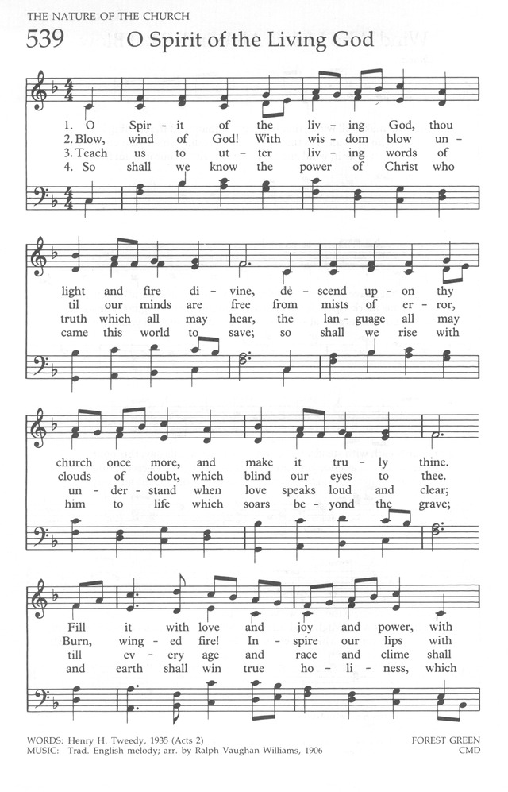

Slide 43
Operations of Grace
What is grace?
God’s unconditional, unmerited love

Slide 44
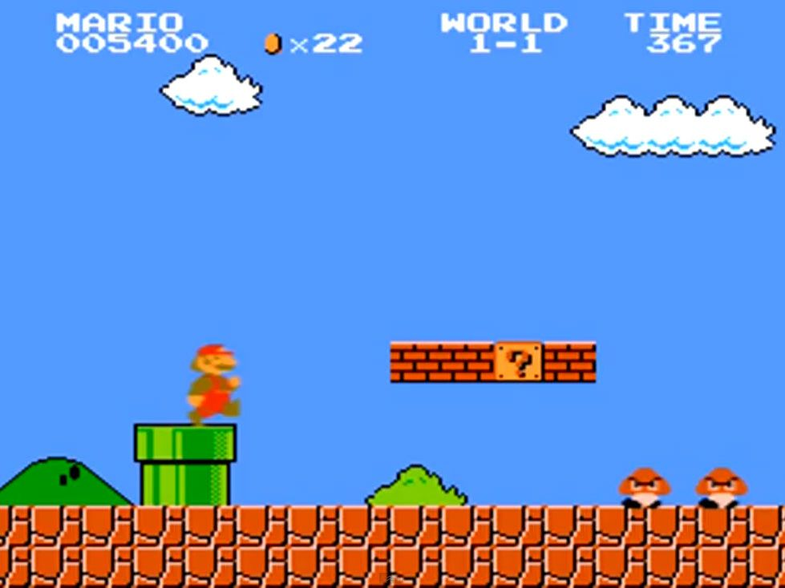
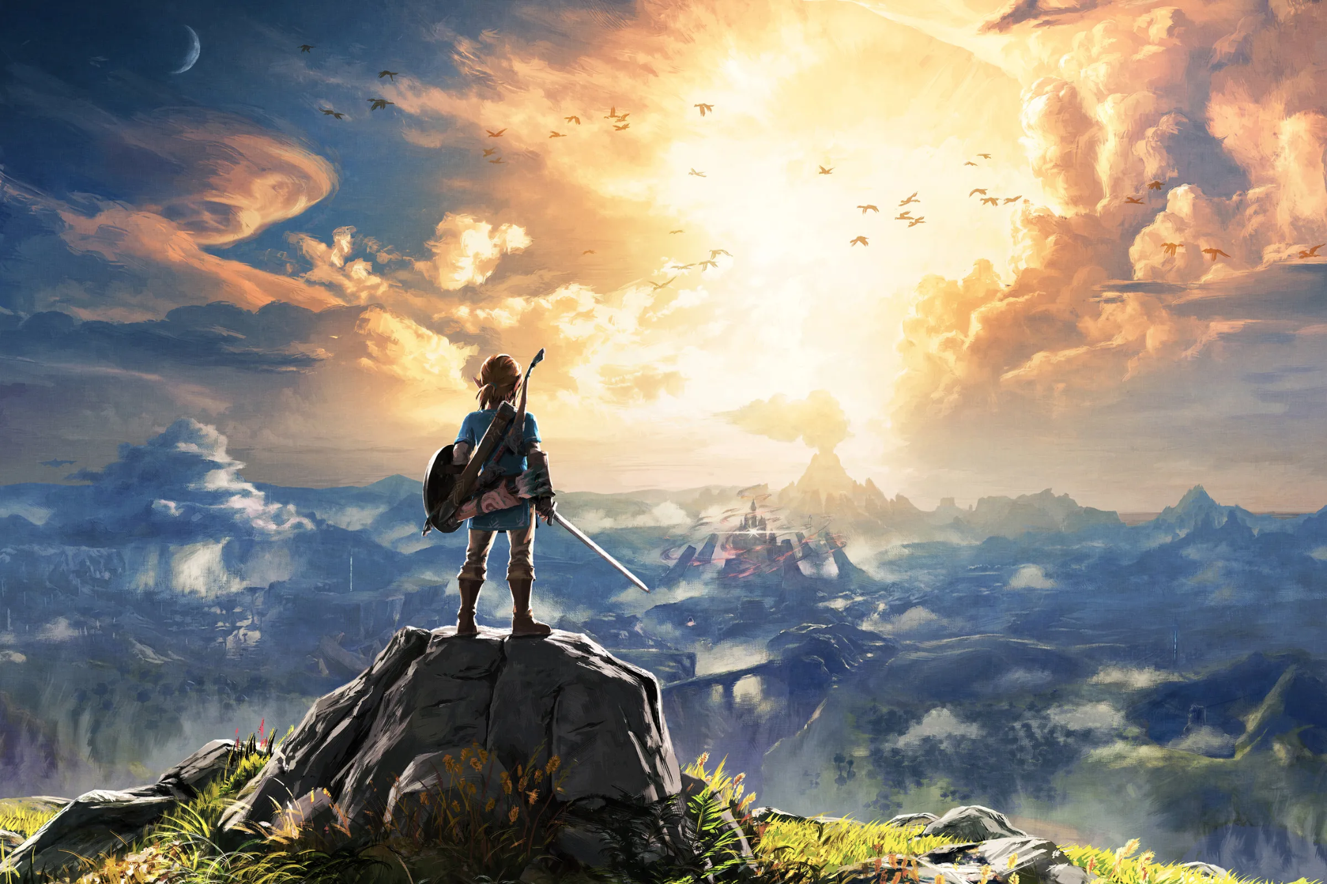
Types or operations?
Not this:
This:

Slide 45
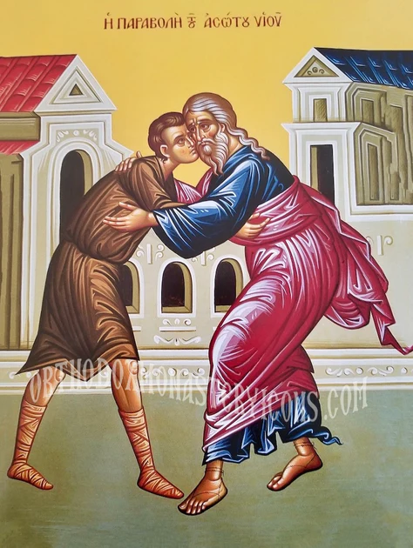
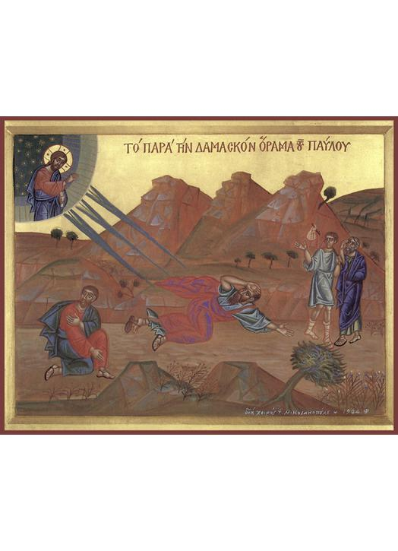
Three operations of Grace
Prevenient
Justifying
Sanctifying
Drew rap!

Slide 46
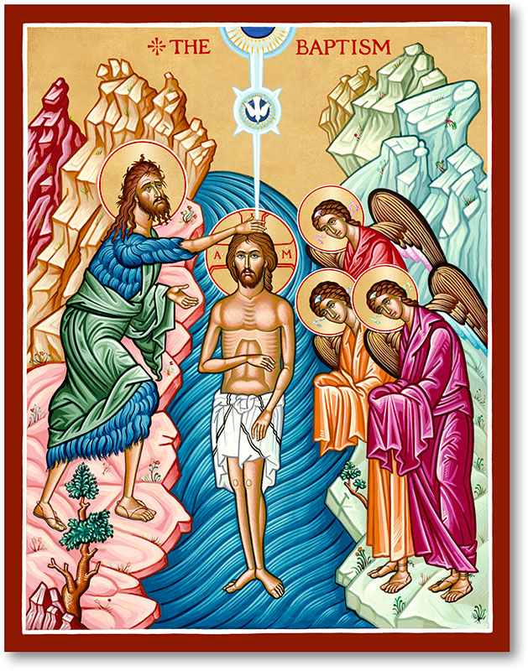
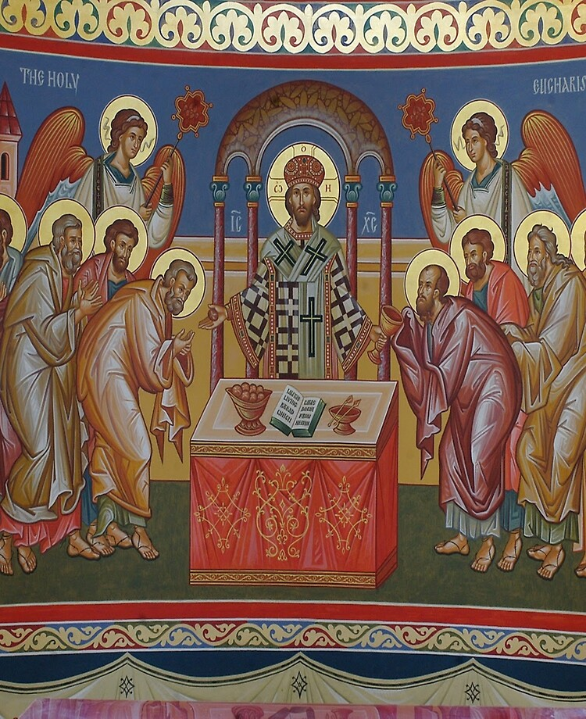

Slide 47
What is a sacrament?
Four Criteria:

Slide 48
What is a sacrament?
Four Criteria:
Instituted/Ordained/Ordered by Christ

Slide 49
What is a sacrament?
Four Criteria:
Instituted/Ordained/Ordered by Christ
Material

Slide 50
What is a sacrament?
Four Criteria:
Instituted/Ordained/Ordered by Christ
Material
Means of Grace

Slide 51
What is a sacrament?
Four Criteria:
Instituted/Ordained/Ordered by Christ
Material
Means of Grace
Open to All

Slide 52
What is a sacrament?
Four Criteria:
Instituted/Ordained/Ordered by Christ
Material
Means of Grace
Open to All
Therefore, we have two

Slide 53
What is a sacrament?
Four Criteria:
Instituted/Ordained/Ordered by Christ
Material
Means of Grace
Open to All
Therefore, we have two…
What to say to DCOM and BOOM?
Read the liturgy! It’s all in there!

Slide 54
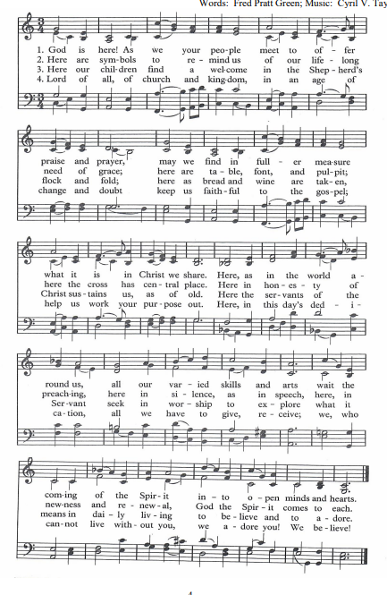

Slide 55
Baptism - the sacrament of Justification
Old Testament and New Testament Scripture references?
Sacrament of Justification
From the Hymnal (p. 32): “The Baptismal Covenant is God’s word to us, proclaiming our adoption by grace, and our word to God promising our response in faith and love.”
God’s word of grace is primary!
Our faith is a response!
Operations of grace in Baptism

Slide 56
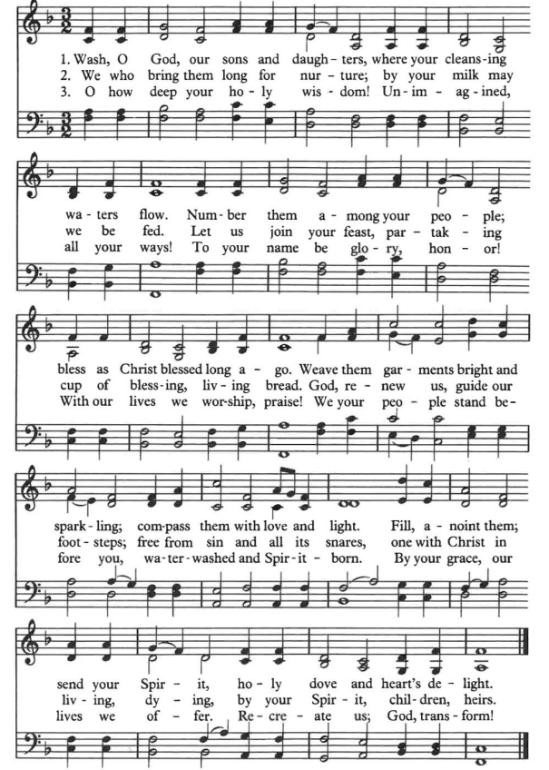

Slide 58
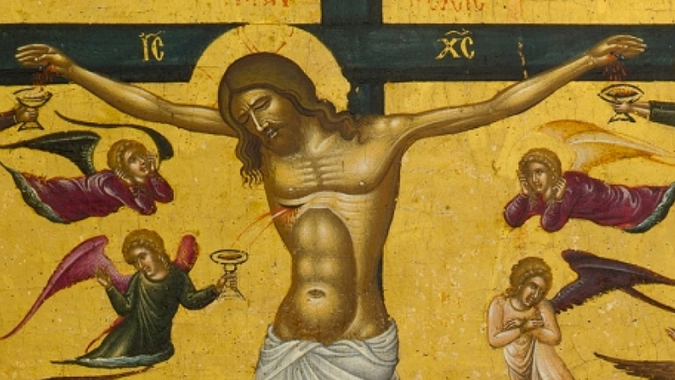
Holy Communion, Eucharist, the Lord’s Supper
Icon of the Crucifixion by Andreas Pavias, second half of the 15th century

Slide 59
Holy Communion, Eucharist, the Lord’s Supper
OT and NT?
Icon of the Crucixion by Andreas Pavias, second half of the 15th century

Slide 60
Holy Communion, Eucharist, the Lord’s Supper
OT and NT?
Read the liturgy!
Confirming and Converting (open table)
What happens to the elements?
Should follow confession and absolution
Icon of the Crucixion by Andreas Pavias, second half of the 15th century

Slide 61
Holy Communion, Eucharist, the Lord’s Supper
OT and NT?
Read the liturgy!
Confirming and Converting (open table)
What happens to the elements?
Should follow confession and absolution
Sacrament of the Cross and Resurrection
God provides what is necessary
It’s a gift.
Operations of grace in Holy Communion
Icon of the Crucixion by Andreas Pavias, second half of the 15th century

Slide 62
Sacraments,
Baptism & Eucharist

Slide 63
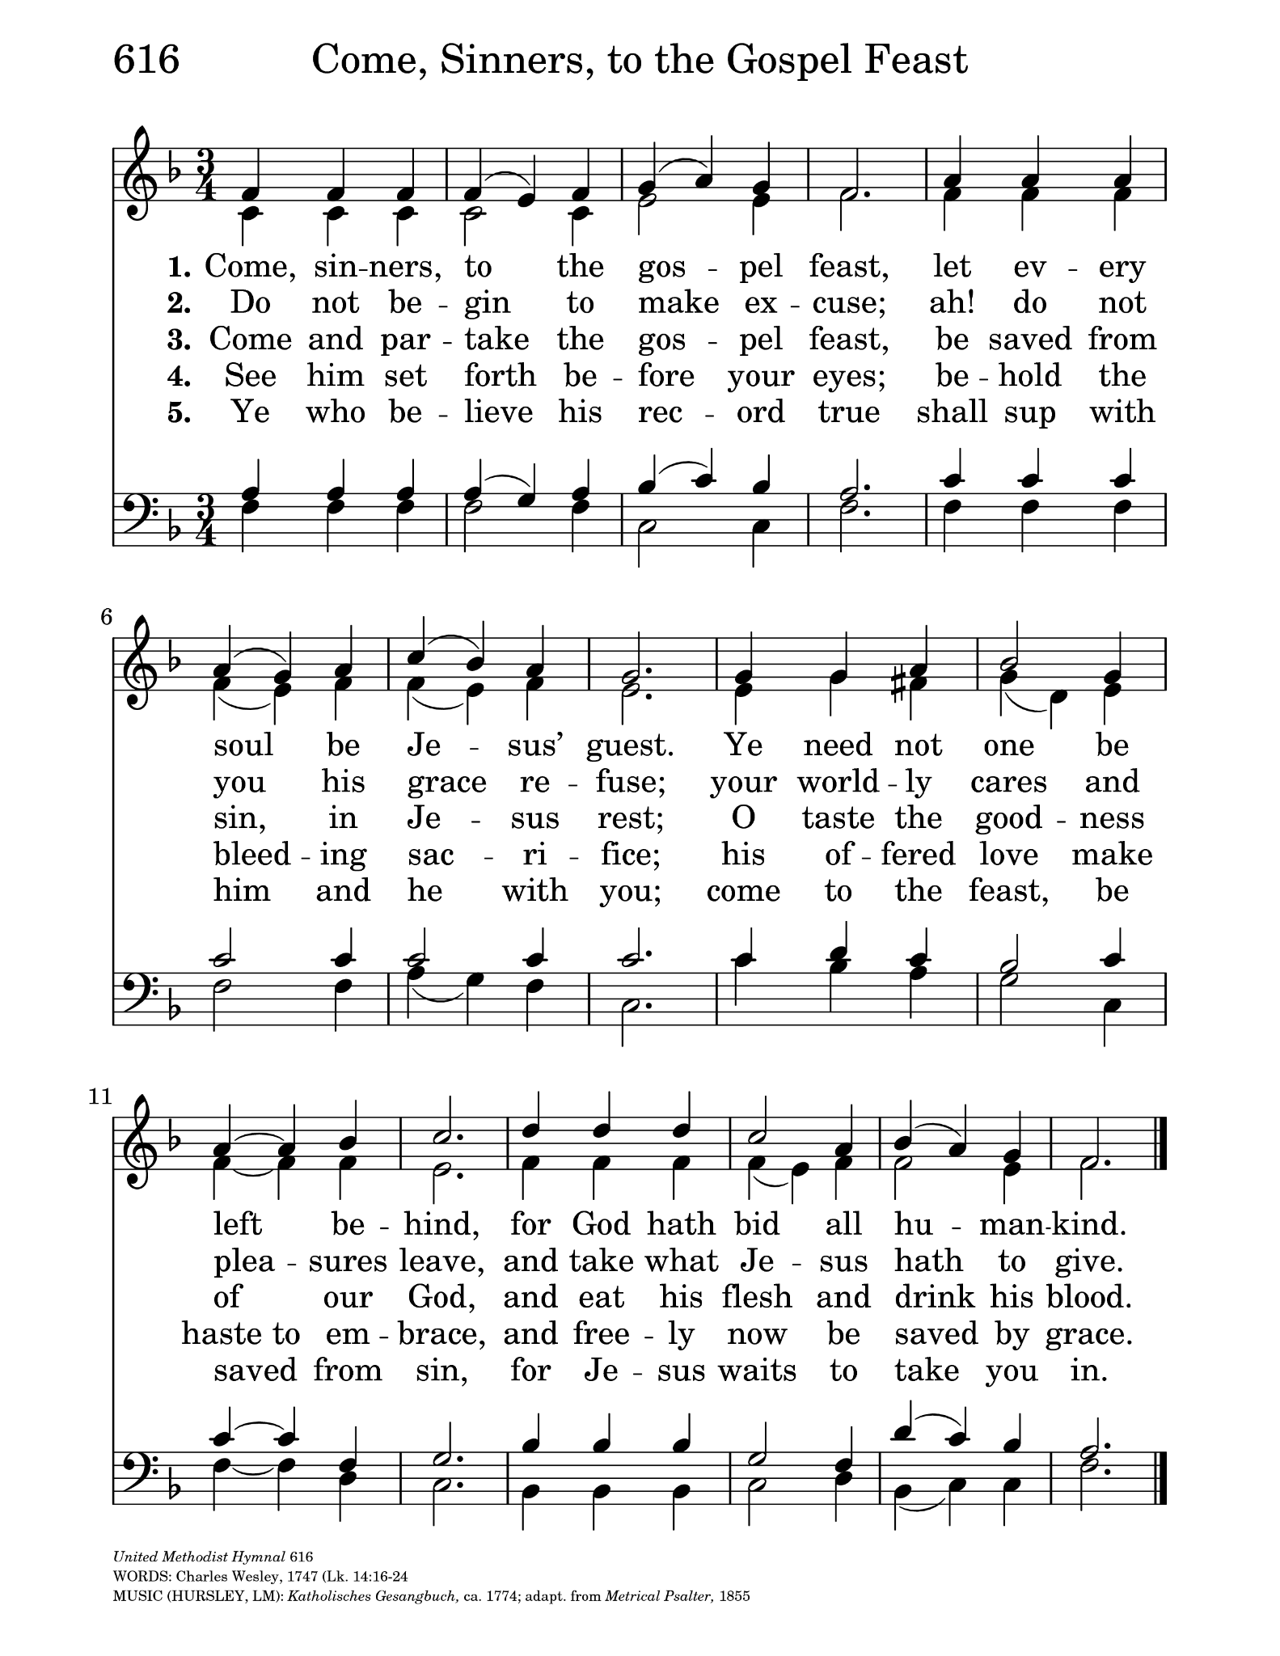

Slide 64
DO WE NEED A BREAK BEFORE THE LAST LAP?

Slide 65
Last Activity/Subject

Slide 66
Last Activity/Subject
-Pepsi or Coke?

Slide 67
Last Activity/Subject
-Pepsi or Coke?
-Is Die Hard a Christmas Movie?

Slide 68
Last Activity/Subject
-Pepsi or Coke?
-Is Die Hard a Christmas Movie?
-Hot dogs… Sandwich or Taco?

Slide 69
Last Activity/Subject
-Pepsi or Coke?
-Is Die Hard a Christmas Movie?
-Hot dogs… Sandwich or Taco?
-The Bible… Exact Divine Words or Ancient Human Document?

Slide 70
What is the Word of God?

Slide 71
What is the Word of God?
Jesus Christ - the Incarnate Word of God.
Fully Human, Fully Divine

Slide 72
What is the Word of God?
Jesus Christ - the Incarnate Word
Fully Human, Fully Divine
Scripture - Written Word of God
Human witness to the Word

Slide 73
What is the Word of God?
Jesus Christ - the Incarnate Word
Fully Human, Fully Divine
Scripture - Written Word of God
Human witness to the Word
Preaching of the Church
Proclaimed Word of God in word, sacrament, and ministry

Slide 74
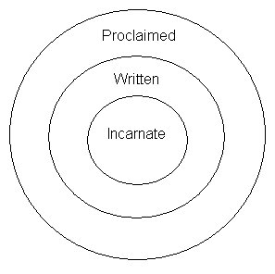
What is the Word of God?

Slide 77
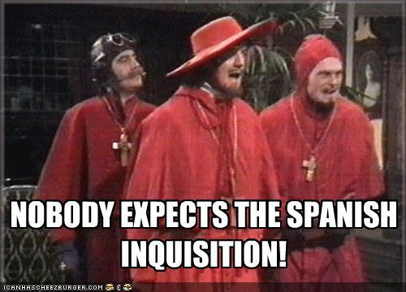
POP QUIZ!!!!!

Slide 78
I believe in God, the Father Almighty,
creator of heaven and earth.
I believe in Jesus Christ, his only Son, our Lord,
who was conceived by the Holy Spirit,
born of the Virgin Mary,
suffered under Pontius Pilate,
was crucified, died, and was buried;
he descended to the dead.
On the third day he rose again;
he ascended into heaven,
is seated at the right hand of the Father,
and will come again to judge the living and the dead.
I believe in the Holy Spirit,
the holy catholic** church,
the communion of saints,
the forgiveness of sins,
the resurrection of the body,
and the life everlasting. Amen.

Slide 79
