Slide 1
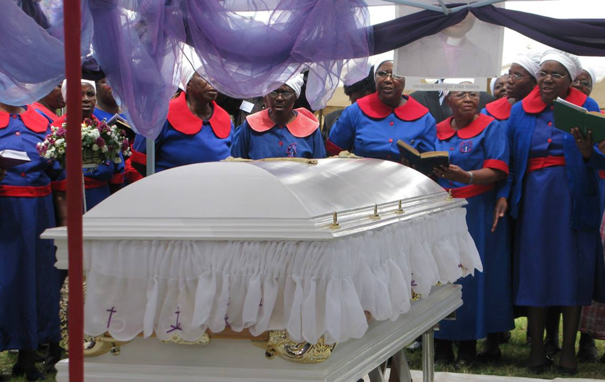
Funerals
A Service of Death and Resurrection
Women gather near the casket of United Methodist Bishop Abel T. Muzorewa in Mutare, Zimbabwe, in May of 2010. Some 5,000 people attended Bishop Muzorewa's funeral. Photo by Tafadzwa Mudambanuki, UM News.

Slide 2
“The United Methodist Service of Death and Resurrection and Service of Committal focus on the proclamation of the Christian hope in the resurrection of the dead and in Christ’s resurrection as pledge for that hope. Within these services United Methodists also acknowledge death, support family and friends in their grief, remember the deceased, and pledge to continue to be a source of strength and comfort to all who mourn.”
https://www.umc.org/en/content/ask-the-umc-what-is-the-purpose-of-a-christian-funeral

Slide 3
The point… is that a proper grasp of the (surprising) future hope held out to us in Jesus Christ leads directly and, to many people, equally surprisingly, to a vision of the present hope that is the basis of all Christian mission. To hope for a better future in this world – for the poor, the sick, the lonely and depressed, for the slaves, the refugees, the hungry and homeless, for the abused, the paranoid, the downtrodden and despairing, and in fact for the whole wide, wonderful, and wounded world – is not something else, something extra, something tacked on to the gospel as an afterthought. And to work for that intermediate hope, the surprising hope that comes forward from God’s ultimate future into God’s urgent present, is not a distraction from the task of mission and evangelism in the present. It is a central, essential, vital, and life-giving part of it (pp. 191-2).
N.T. Wright “Surprised by Hope”

Slide 4
https://www.umc.org/en/content/ask-the-umc-death-and-resurrection
https://www.umcdiscipleship.org/content-library/tags/funerals-and-memorial-services
https://www.umcdiscipleship.org/book-of-worship/a-service-of-death-and-resurrection

Slide 5
Be Prepared on Day one to Lead a service of Death and Resurrection!

Slide 6
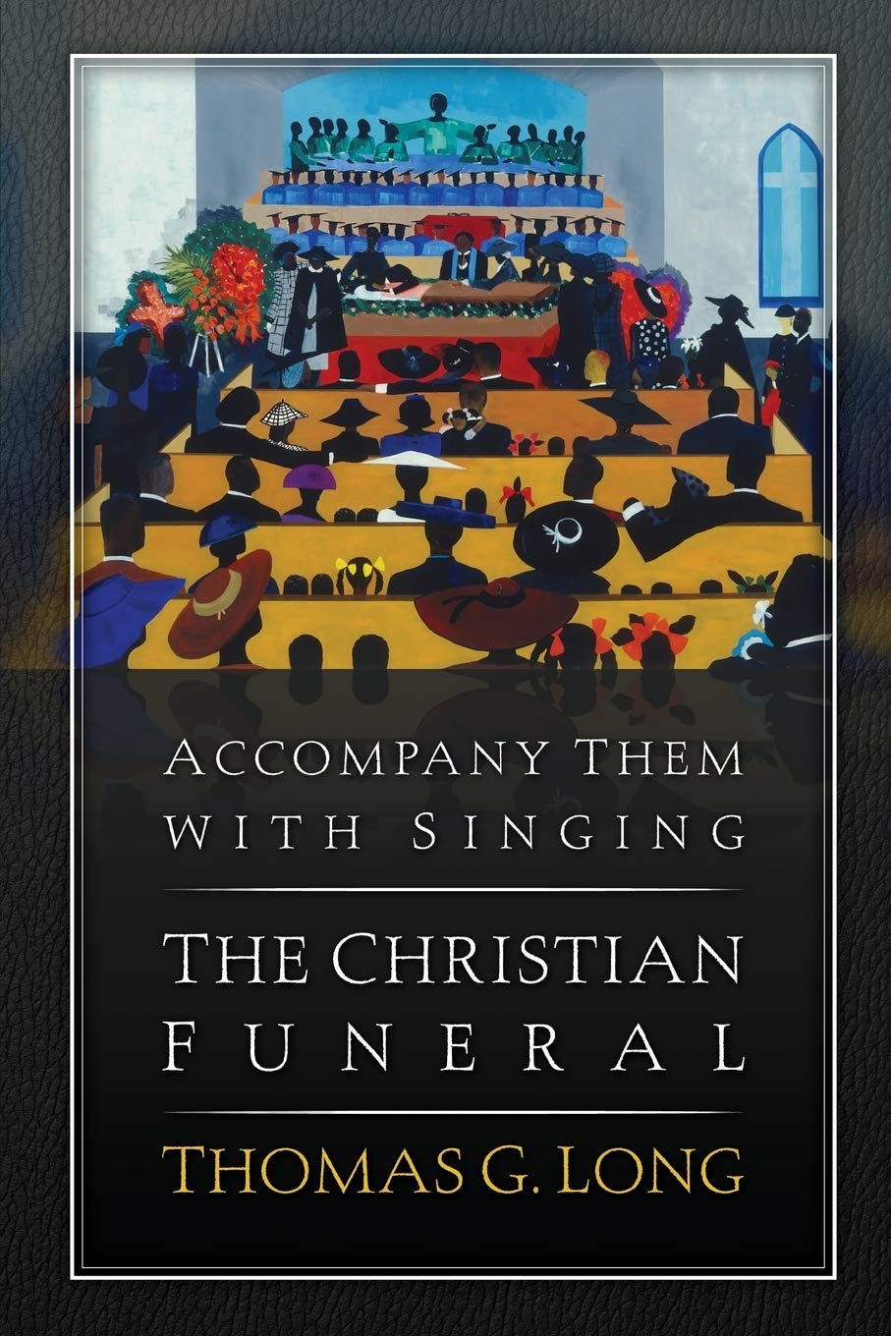
Long claims that, ultimately, “A pastor, no matter how wise or pastorally sensitive, cannot alone make a ‘good’ funeral. A good funeral is something the people of God must do together” (122). The faithful funeral, Long argues, includes four key elements.
a holy person (the deceased),
a holy or sacred place,
holy people (the believers),
and a holy script (the gospel narrative).

Slide 7
“A Holy PERSON/People”
Preservice visitations (Known and yet-to-know):
You are a Pastor of a community. There is no such thing as small church pastor. The church to which you are appointed may have only a few gathered on Sunday Morning, but every pastor must be the pastor of the community.
Ask for favorite hymns, scripture passages, poems, literature, pictures, etc.
Steer the conversation about the persons’ faith
Have a draft of the bulletin with you, so that when you talk about the funeral, the family can see the various parts.
Schedule the service (Depending on availability of accompanist, musician, a/v tech.
If you are to preach a sermon, proclaim the gospel! Proclaim resurrection! Proclaim hope! Proclaim the Good News of Jesus Christ!

Slide 8
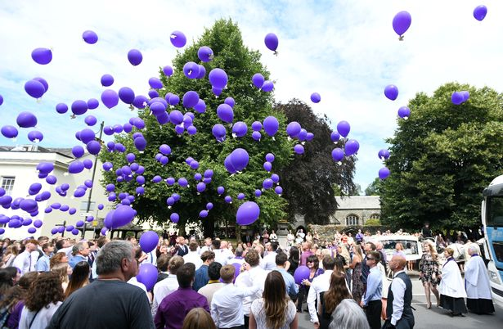
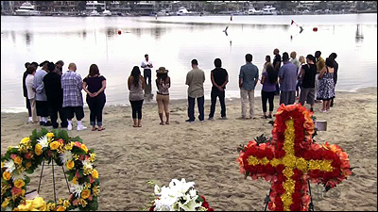
“A Holy Place”
Church or Funeral Home or other? “Church if at all possible..”
Can be in someone’s home. Can be in the mountains, or alongside a lake or river. Make it a Holy place! Bring as many symbols of the church as possible. In so far as you can; wear a robe. Bring a cross. A table. A chalice. A paten.

Slide 9
People/Groups to know
Funeral Homes and the Directors in the area
Chaplin's of area hospitals, rehabs, and extended living facilities
Local Sherriff or FIRE Department (Chaplin?)
Other voluntary associations (VFW, American Legion,
Have their numbers/contacts on hand so that if the family needs their services, you can direct them.

Slide 10
A Service of Committal
“Primarily intended for the burial into the ground, but can be adopted for cremation or internment of ashes, burial above ground or at sea, or for donation of body for medical purposes”
“Military and/or fraternal rites are an addition to the service, only approval of the pastor and usually at the end of the service.”

Slide 11
Follow-up
I will usually follow up with the family 1 month (Take Holy Communion), 6 months and on the anniversary. Letting them know that I’m thinking of them and praying for them
Continue to support the family in their long-term grieving process
All Saints Day!

Slide 12
Misc. Notes
Pray with the family prior to the service
Suggestion: Have your worship script with you, and stick to it. Try to write down every word of the service that you will speak. This may not be the time to be extemporaneous or to improvise.
Funeral length will vary depending on parts and especially on the “Witness” portion. My general rule is to have the “witness(s)” pre-selected. I do not have an “open” mic.
Check schedules and availability of all persons assisting in the service. Musicians, accompanist, AV Tec.

Slide 13
PRACTICE!
BOW 139
UMH 870

