Slide 1
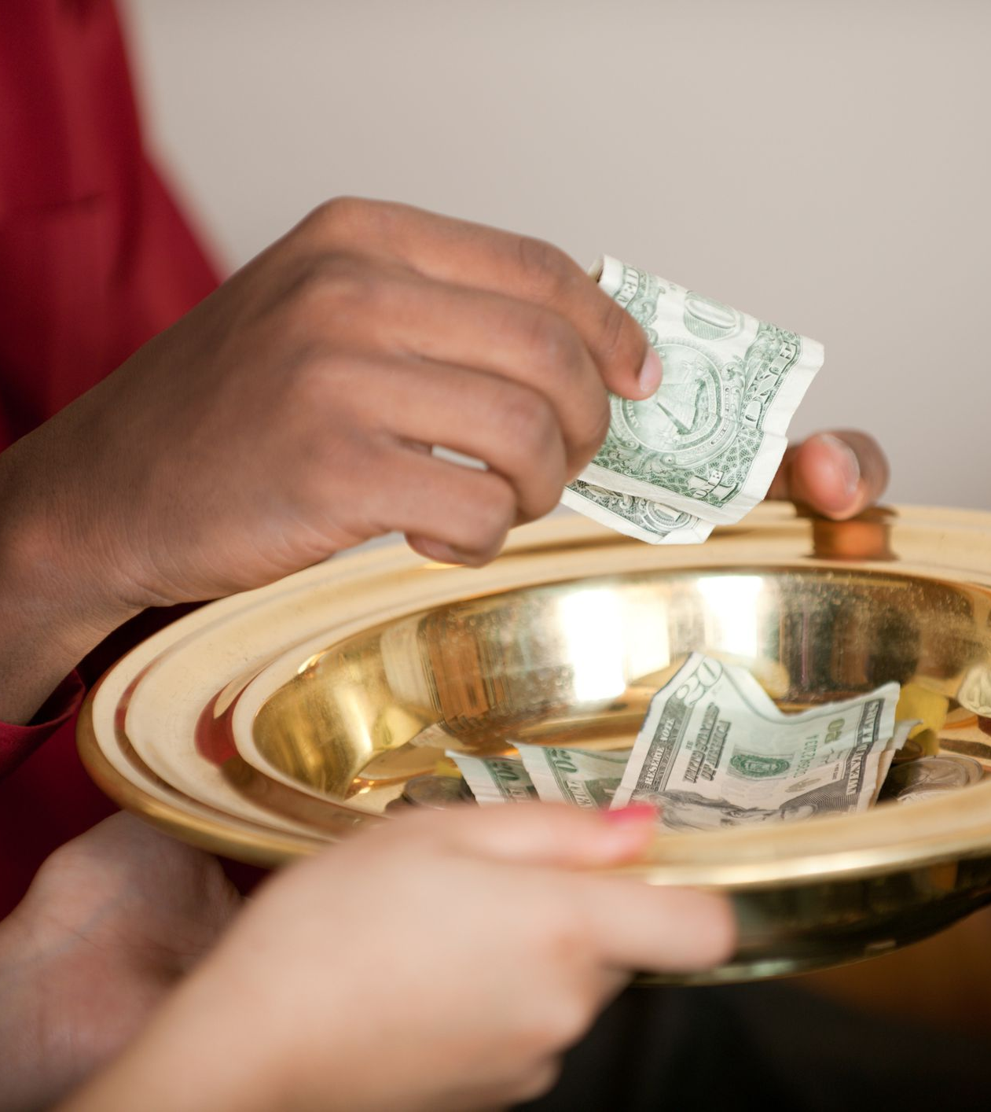
STEWARDSHIP
Rev. John Obeng
What is Stewardship
Spiritual & Theological Basis
Practical Ways to Encourage Giving
Stewardship at New Life

Slide 2
Stewardship?
Steward- one who oversees or manages household or civic affairs (Expository Dic)
Steward- a person who oversees the possessions or interest of an owner or master (Harper Collins Bible Dic)
Stewardship- the act of managing or overseeing possession or interest of a person or an entity
WHAT WE DO WITH WHAT GOD HAS ENTRUSTED TO US (Time, Talent, Treasure)

Slide 3
Stewardship Cont.
We do this:
Not as an Obligation or Force or Coercion
But: In Response to God’s Gifts
To Bless Others

Slide 4
Could you imagine a church that understands stewardship from this perspective?
The Fellowship of the Believers
⁴² They devoted themselves to the apostles’ teaching and to fellowship, to the breaking of bread and to prayer. ⁴³ Everyone was filled with awe at the many wonders and signs performed by the apostles. ⁴⁴ All the believers were together and had everything in common. ⁴⁵ They sold property and possessions to give to anyone who had need. ⁴⁶ Every day they continued to meet together in the temple courts. They broke bread in their homes and ate together with glad and sincere hearts, ⁴⁷ praising God and enjoying the favor of all the people. And the Lord added to their number daily those who were being saved.

Slide 5
God is A Giver
1. Creation Story- Genesis 1
Adam, the first created person had everything at his disposal
All the animals and pets that you can think of
Beautiful vegetation; wonderful gardens you can think of, he had the trees and the flowers and all sorts of plants
The sea and the rivers were teeming with fish and other sea animals
Mineral resources like gold, diamond, oil and all the resources of this world

Slide 6
God is A Giver
2. Atonement & Eternal Life – John 3:16
¹⁶ For God so loved the world that he gave his one and only Son, that whoever believes in him shall not perish but have eternal life.

Slide 7
Humanity Struggle with Giving
Why People Don’t Give
Don’t have local church
Don’t understand the concept of giving
Not committed to the mission and vision of the church
Bad church experience
Don’t agree with how finances are managed
Unemployment
Support other ministries
Think others will do it

Slide 8
Why Give to an All-Sufficient God?
Psalm 50:9-12
⁹ I have no need of a bull from your stall or of goats from your pens, ¹⁰ for every animal of the forest is mine, and the cattle on a thousand hills. ¹¹ I know every bird in the mountains, and the insects in the fields are mine. ¹² If I were hungry I would not tell you, for the world is mine, and all that is in it.

Slide 9
Giving Opens Doors for Blessings
a. “Give and it shall be given to you. A good measure, pressed down, shaken together and running over, will be poured into your lap” Luke 6:38a.
Prophet Malachi even presents the benefits of giving in more graphical terms
b. “Bring the full tithe into the storehouse so that there will be food in my house, and thus put me to test says the Lord of hosts; see if I will not open the windows of heaven and pour down for you an over flowing blessings” Malachi 3:10 .
Our finite and meager giving, give us full access into the unlimited and the infinite resources of God.

Slide 10
Giving Opens Doors for Blessings Cont.
Genesis 22:15-18
The Reward given to Abraham
¹⁵ The angel of the Lord called to Abraham from heaven a second time ¹⁶ and said, “I swear by myself, declares the Lord, that because you have done this and have not withheld your son, your only son, ¹⁷ I will surely bless you and make your descendants as numerous as the stars in the sky and as the sand on the seashore. Your descendants will take possession of the cities of their enemies, ¹⁸ and through your offspring all nations on earth will be blessed, because you have obeyed me.”

Slide 11
Giving Open Doors for Intimacy
In Proverbs 18:16 the scriptures declare that “A gift opens the way for the giver and ushers him into the presence of the great”. Cornelius a Gentile God-fearer became one of the early recipients of the Holy Spirit because of his devotion to God and gifts to the poor.
Acts 10:4
⁴ Cornelius stared at him in fear. “What is it, Lord?” he asked.
The angel answered, “Your prayers and gifts to the poor have come up as a memorial offering before God.
Mark 14:8-9- Jesus’ response to a sinful woman’s Gift
⁸ She did what she could. She poured perfume on my body beforehand to prepare for my burial. ⁹ Truly I tell you, wherever the gospel is preached throughout the world, what she has done will also be told, in memory of her.”

Slide 12
Giving Opens Doors for Transformation
Luke 5:8-11
⁸ When Simon Peter saw this, he fell at Jesus’ knees and said, “Go away from me, Lord; I am a sinful man!” ⁹ For he and all his companions were astonished at the catch of fish they had taken, ¹⁰ and so were James and John, the sons of Zebedee, Simon’s partners.
Then Jesus said to Simon, “Don’t be afraid; from now on you will fish for people.” ¹¹ So they pulled their boats up on shore, left everything and followed him.

Slide 13
Giving Opens Doors for Transformation
John 4:10
¹⁰ Jesus answered her, “If you knew the gift of God and who it is that asks you for a drink, you would have asked him and he would have given you living water.”
²⁸ Then, leaving her water jar, the woman went back to the town and said to the people, ²⁹ “Come, see a man who told me everything I ever did. Could this be the Messiah?” ³⁰ They came out of the town and made their way toward him.

Slide 14
Ways to Encourage Stewardship
Preach/Teach Stewardship
Lead the Way
Let the Church know the impact of their Giving
Tell the Stewardship Stories of your Church
Show Gratitude

Slide 15
MEMBERS EXPECTATIONS- THE S.E.W. CRITERION
S- Stewardship- every member is expected to use their time, talent and treasure to support the church in some way
E- Evangelism-every member is expected to invite at least one person to worship or any activity of the church at least once a quarter. I mostly encourage once a month invitation.
W- Worship- members are expected to join any of our worship activities; Bible study, prayer meeting, Sunday Service at least once a week. Some members work on weekends, and they can choose to attend a weekday prayer meeting or Bible Study that week.

Slide 16
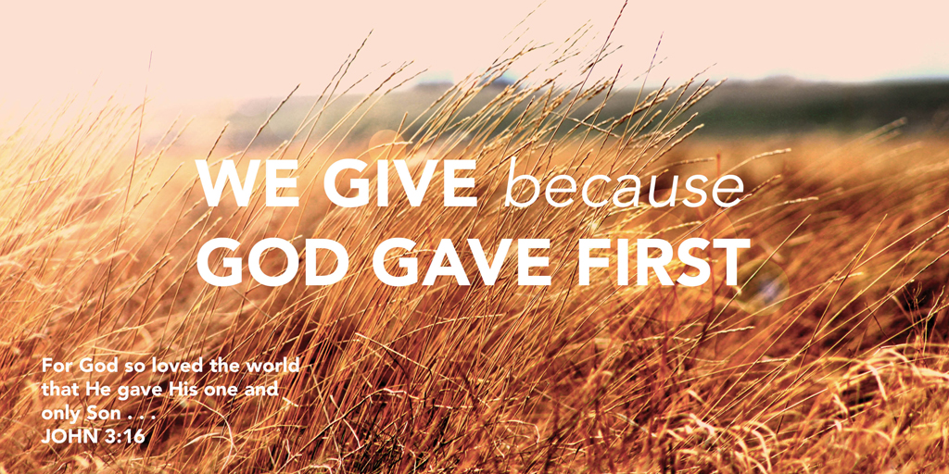
Q&A

