Slide 1
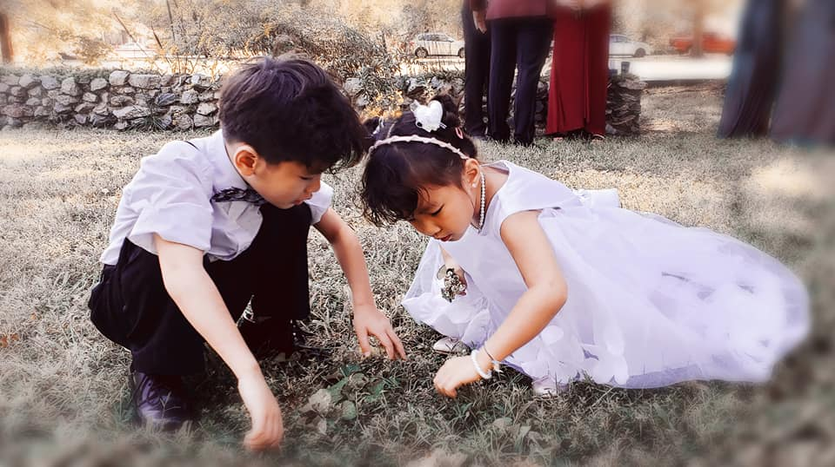
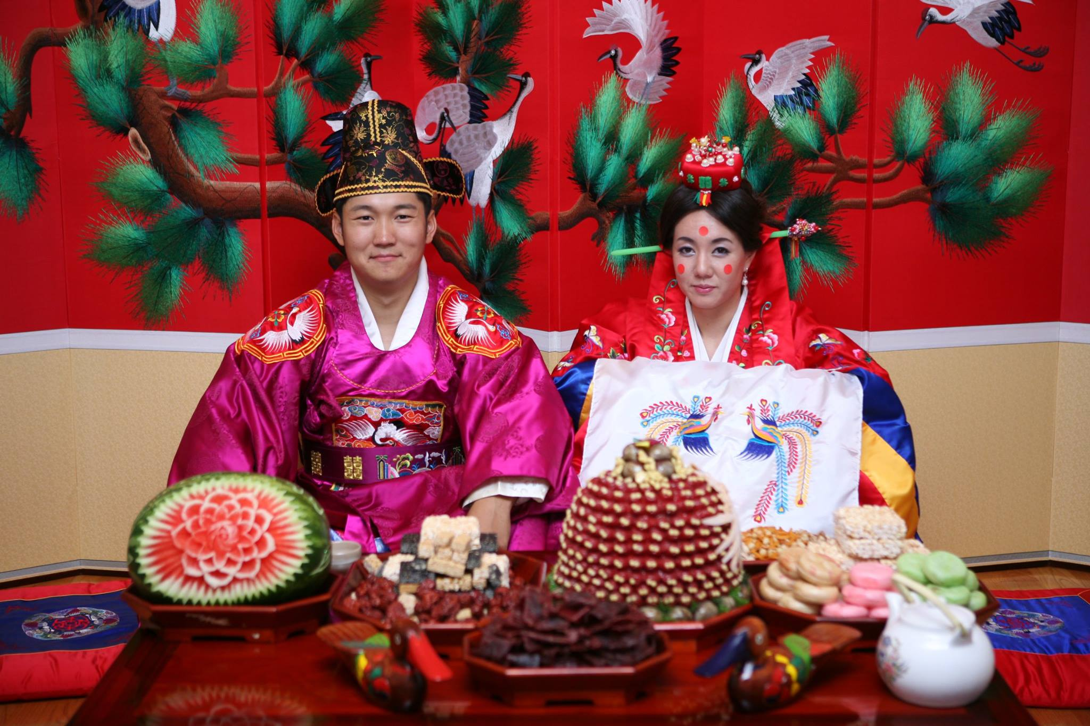
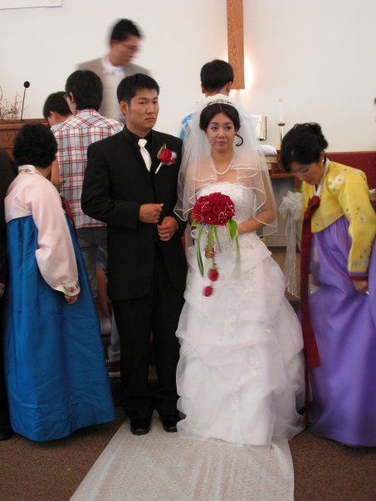
Weddings
VAUMC Licensing School 2023
Dan Kim

Slide 2
Wedding Bloopers!

Slide 3
#1: Be in prayerful discernment
This is a Holy and public worship of God. Make it worshipful!
You aren’t merely an officiant. You are the pastor! You are the preacher! Even if its only once. Even its only for a short time. Maybe their ONLY pastor. Maybe the ONLY time someone gets to hear the Gospel. Maybe the ONLY time they have a pastor in their life.
Each wedding is a disciple-making opportunity.
Each wedding is an evangelistic opportunity.
Each wedding is a means of grace.

Slide 4
#2: Get registered with Virginia
Registering as an officiant in the state of VA (Only Valid in VA)
Register with the county of the church/ministry in which you are appointed. (Call the county clerk).
Appear in person and provide documents
Bring your license certificate
Bring proof of appointment (The Advocate or A Letter from the DS )
Proof of practice no less than 30 days old (church bulletin, church newsletter,
Pay a Fee
Successful registration with any county gives you permission to officiate weddings in every county in VA.
Sign Marriage License of couple (2 copies) *AT REHERSEAL*
Officiant must complete and sign both copies of the marriage license and forward to the Clerk of the Court that issued the license within (5)five days after the ceremony is performed
Marriage has to take place in VA.

Slide 6
#3: Wedding and Building Policy
Have the wedding policy be the first piece of information you give the engaged couple
Have the wedding policy do a lot of the initial talking for you. The better and more comprehensive your wedding policy, the easier time you’ll have organizing the wedding
A good wedding policy will have:
ALL FEES UPFRONT (Officiant, musician, AV, building usage, room usage, clean-fees, security deposits)
Congregational Liaison (GUM SPRING UMC)

Slide 7
#4: Pre-Martial counseling
According to the BOD, a UM officiant is “To perform the marriage ceremony after due counsel with the parties involved and in accordance with the laws of the state and rules of the UMC. The decision to perform the ceremony shall be the right and responsibility of the pastor.” Paragraph 340 (A)
I have 3 pre-martial counseling sessions, and 1 rehearsal.
Further counseling is to be referred to professionals (VIPCARE).
My primary purpose is to get to know them, get them to communicate openly about their relationship and faith, and make connections from their marriage to the Love of God. I pray, I teach about Christian Marriage, and I get them to open up more about their faith to one another.

Slide 8
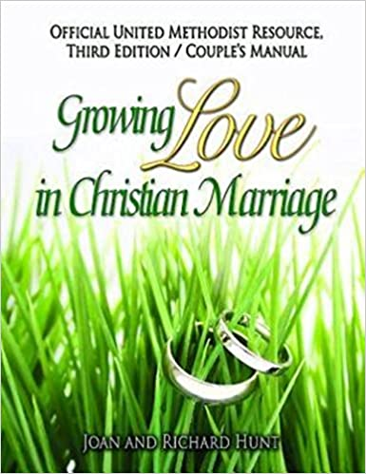
Pre-Martial counseling Resources
Better Marriages – (formerly ACME): www.bettermarriages.org
FOCCUS(Premarital and Marital Inventories) www.foccusinc.com
Growing Love in Christian Marriage -
Engaged Encounter United Methodist
www.encounter.org
Marriage Mentors - www.marriagementors.org
Marriage Savers - www.marriagesavers.org
Mastering the Mysteries of Love - www.nire.org
PREP and C-PREP (Christian PREP)– www.prepinc.com
PREPARE/ENRICH – www.lifeinnovation.com
The Five Love Languages - www.5lovelanguages.com/
Jane P. Ives, United Methodist Marriage and Family Ministries Consultant 10 Quaker Lane, Portland, ME 04103, 207-797-8930 JaneIves@aol.com Copyright United Methodist Discipleship Ministries, www.umcdiscipleship.org -Used by Permission

Slide 9
Take thou authority on Rehearsal and wedding day
You are in charge of the service, because this is a Christian worship service and you are a Christian minister!
Command the rehearsal. Know all of the parts.
“Ethnic and cultural traditions are encouraged and may be incorporated into the service at the discretion of the pastor.”

Slide 10
A SERVICE OF CHRISTIAN MARRIAGE (PRACTICE)
BOW 115
UMH 864
CHRISTIAN MARRIAGE 1

