Slide 1
Christian Leadership in the Local Church
Rev. Dr. Jonathan Page
2024 Licensing School

Slide 2
Who is a leader you hope to emulate? Why?

Slide 3
“Leadership is a process whereby an individual influences a group of individuals to achieve a common goal.”
Peter Northouse

Slide 4
Structure for this session
Part 1: the nuts and bolts of what you are required to do.
“The process of the UMC”
Part 2: the nuts and bolts of what you have the opportunity to do.
“The process of Christian leadership”

Slide 5
Requirements of Leadership

Slide 6
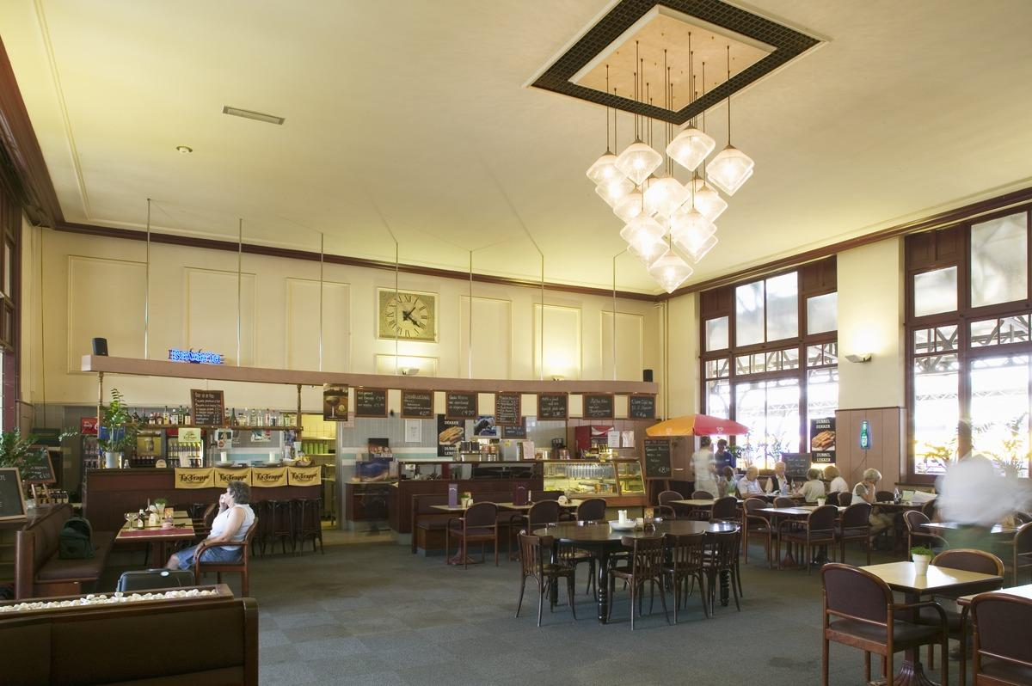

Slide 7
The “Expediter”
You provide oversight to the other people working behind the scenes.
You dictate what happens when.
You present to guests at times.
Maybe most importantly, you have a vision for how the meal will unfold.

Slide 8
Basic Responsibilities (¶243)
Planning and implementing a program of nurture, outreach, and witness for persons and families within and without the congregation
Providing for effective pastoral and lay leadership
Providing for financial support, physical facilities, and the legal obligations of the church
Utilizing the appropriate relationships and resources of the district and annual conference
Providing for the proper creation, maintenance, and disposition of documentary record material of the local church
Seeking inclusiveness in all aspects of life

Slide 9
Charge Conference (¶244)
Sets leadership for the church
Sets compensation for pastor
Offers directional aims for the church

Slide 10
Church Council/Leadership Board (¶252)
Stewarding the vision of the church between charge conference sessions.
Meets at least quarterly
Voting should be done by consensus when possible; quorum
Membership includes:
Chair; lay leader; rep from SPRC, Finance, Trustees; Treasurer; lay member to conference; rep from UMM and UWIF; young adult rep; UMYF rep; clergyperson

Slide 11
The Four “Basic” Teams

Slide 12
SPRC (Staff/Pastor-Parish Relations Committee)
Supports and advises clergy and staff
Makes salary and CEU recommendations
Evaluates clergy (twice annually), including Annual Preference
Communicates and interprets the role of the pastor to the congregation
Lay Servant approval and renewal
Identifies potential candidates for ordained/licensed ministry
Parsonage review (w/trustees)

Slide 13
Nominations + Leadership Development
Chaired by the pastor
But please make sure others are involved
Identify and develop leaders
Note the second word – development is key. Build your bench.
Support leaders through prayer, training, affirmation
Membership divided into 3 “class years”

Slide 14
Finance
Coordinate budget process
Receive money from offerings and other sources, using best practices (financial secretary)
Disburse money, including apportionment payments and clergy salary
Provide for an annual audit
Provide financial reporting to Council/Board and members
May include stewardship/pledge campaign

Slide 15
Trustees
Property matters, including parsonage and personal property
Carries out function under direction of the Charge Conference
Localities have their own guidelines for registering trustees with the court – always check in to obtain these
Pastor may call meetings but is not typically a voting member
One exception to quorum rule – needs to be a majority present for binding decisions
May not interfere with pastor in use of property for worship, meetings, etc.
Shares annual parsonage review with SPRC

Slide 16
Another way: Simplified Accountability Structure (SAS)

Slide 17
Other teams/committees
There will likely be other committees in the life of the church.
Remember your role – expediter.
You don’t need to attend every meeting that happens in your church.
You need to be aware of how these other committees interface with the four basic ones.
“Vigilance without skepticism”

Slide 18
Connectional Responsibilities
Financially – Apportionments
In accountability – Reporting
In mission – the “main thing”
You are never alone in this work
DS/District office
Conference staff
Collegial connections

Slide 19
Q+A

Slide 20
Break

Slide 21
“Leadership is a process whereby an individual influences a group of individuals to achieve a common goal.”
Peter Northouse

Slide 22
“Leadership is a process whereby an individual influences a group of individuals to achieve a common goal.”
Peter Northouse

Slide 23
Christian Leadership
The center of our process is the narrative of Jesus Christ. You are leading from the leadership of Christ.
What does this mean for you?
Your work is never your own.
You are a follower before you are a leader and throughout your leadership.
Consistent reflection on the beatitudes as a starting point for how you are leading from your faith.

Slide 24
Orchestrating the
Leadership Event

Slide 25
Foundational Elements
How are you setting a foundation for leadership to take root?
There is no job/task that is beneath you AND everything is not yours to do.
If someone else can be doing what you are doing at least 50% as well as you can, they should be doing it, not you.
Get to know your people – without them there is no such thing as leadership.
Your people are in your building AND outside of it. Consider leaders on your first day (church council plus mayor/city council/school leaders and area business people).

Slide 26
Foundational Elements
Exhibit a sustainable rhythm in your first 90 days.
This is the time that people will develop expectations around your availability and connection.
Take a day off every week. No questions asked.
Take a week of vacation.
Make space for your family, friends, and self/spiritual care.
Otherwise strategically work your tail off.

Slide 27
Ongoing responsibility – steward the mission/vision

Slide 28
Vision leaks.
“Culture eats strategy for breakfast”. –Peter Drucker – how are you assessing organizational culture?
Ensure you are getting to know people in all corners of your church and community.
Listen for common language.
Listen for what you are being told, not just what you want to hear.
Don’t be afraid to say the thing and do the thing.

Slide 29
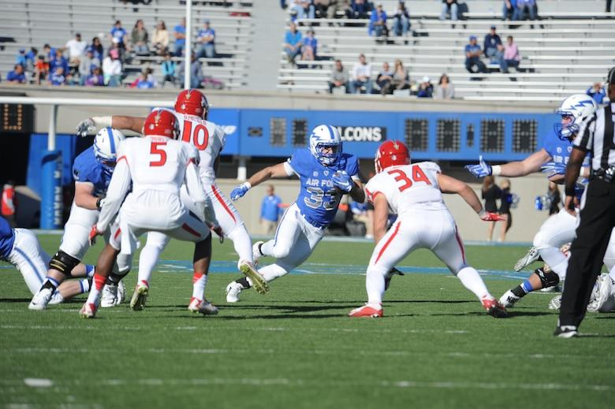

Slide 30
Growth beyond the start

Slide 31
Amongst colleagues
Find your covenant group – fellow clergy journeying on the way
Staying grounded in your calling
Edifying and challenging each other
Avoid this turning into a “moan and groan” or a “gossip” space.

Slide 32
In your appointment
Find your four – people who will speak into you on a quarterly basis to give you perspective on your leadership
These should be people connected to your community

Slide 33
In your appointment
Ongoing continuing education
Reading as a part of this – consider the source
“Look at your library and see when your brain died.”
Events are great but be sure to attend to a diversity of education.
360 evaluations – consider this from time to time

Slide 34
Q+A

Slide 35
Vision Mapping

Slide 36
jonathanpage@vaumc.org
(757) 748-4785 (text)

