Slide 1
The Ministry of Soul / Pastoral / Spiritual /Congregational Care
VAUMC Licensing School 2024

Slide 2
Howdy
Bias
Recovering Baptist
Recovering Psychologist
Practicing Pastor and Doctoral Student in Soul Care
Assumptions
You have been exposed to care
You will continue to be in training and formation.
Plan
Brief, Practical Overview
Not So Master Class

Slide 3
Learn More and Stay in Touch at
soulcare.substack.com

Slide 4
Daniel
the Stylite
409-493
33 years on a pillar near the city of Constantinople

Slide 5
God
Person in need of Care
Daniel

Slide 6
Where you stand
as a pastor:
Reaching to God
Rooted in Earth

Slide 7
The Work of Soul / Pastoral / Spiritual/ Congregational Care
The work of care is concern and action for the well-being of souls. The soul includes the totality of a person, including their spiritual, physical, psychological, and relational health and well-being.

Slide 8
Continued…
Soul care providers help and collaborate but can’t fix or save. Providers participate in God’s encounter with suffering and evil, which takes many forms, such as trauma, grief, anxiety, sadness, illness, isolation, anger, injury, instability, and more.
Soul care can be healing, comforting, and clarifying, but not necessarily curative. It is an openness to healing and wholeness that God chooses to offer, and people choose to receive and share.

Slide 9
The Primary Tasks for Caregivers
Show Up
Show Up – physically, relationally, and spiritually
Pay Attention
Pay Attention - listen, pray, and reflect theologically
Collaborate with God
Bring and Offer what God has given you to offer: Faith, Hope, and Love.
Release the Outcome
Connect care within the web of community.
Adapted from Elaine Heath

Slide 10
Web of Community Care
Person or System
Pastoral
Clinical
Peer
Adapted from individual work by
Bonnie Miller-McLemore &
Laura Howe

Slide 11
And Now For Something Completely Different: You Are Not…
Hero with a Cape
The On-Demand Pastoral Machine
The Failure, the Monster, the Incompetent

Slide 12
Guidelines for Counseling by Clergy of the Virginia Annual Conference
“Pastoral Counseling” is different from Pastoral “Counseling”
‘Stay in Your Lane’ by offering listening ministry, brief supportive ‘counseling’ and refer to other care providers as appropriate.
Set a personal policy limiting counseling relationship to three session of 60-90 minutes per concern.
Develop a referral network and continue to care when seeing other care providers.
Maintain confidentiality, except where legally or ethically mandated to report
Keep Boundaries

Slide 13
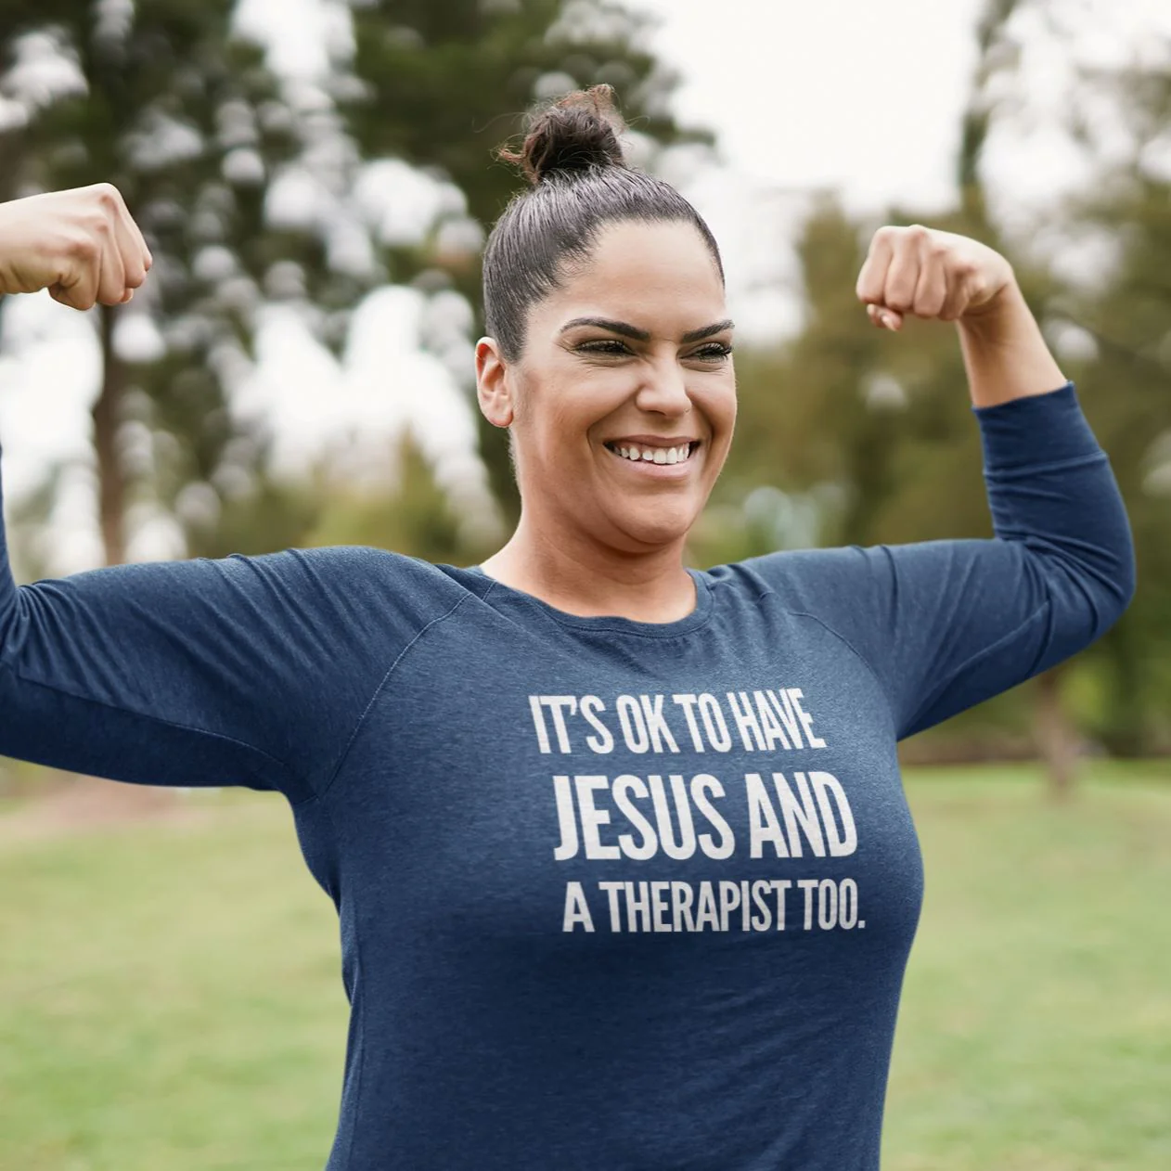
Take Care of Yourself as part of the Web of Care.
We take turns in caring for each other.
We are connected with the people that we serve.
But, as care provider, don’t meet your needs with people you are providing care.
thehappygivers.com

Slide 14
scottericksonart.com
Notes:
Saving Prayer by Scott Erickson
Even the saviors need saving.
Even the healers need healing.
Even the holders need holding.
Even the beings need being.

Slide 17
Not So

Slide 18
Learn More and Stay in Touch at
soulcare.substack.com

Slide 19
A blessing for us all…
everymomentholy.com

