Slide 1
Licensing School May 28, 2022 Rev. Charles F. Ledlum-Bates, Ph. D. District Superintendent Rappahannock River & York River

Slide 2
Ephesians 4:11-12 (GNT) ¹¹ It was he who “gave gifts to people”; he appointed some to be apostles, others to be prophets, others to be evangelists, others to be pastors and teachers. ¹² He did this to prepare all God's people for the work of Christian service, in order to build up the body of Christ.
Introductions

Slide 3
Pastoral Intelligence Change Theory

Slide 4
Five Discoveries
Call & Self-Identity
Spiritual Gift & Grace
A Learning Agenda & Plan
Being Coached
Developing Trust & Deep Relationships

Slide 5
Spiritual Gifts & Grace
1 Peter 4:10
Easy-to-Read Version
God has shown you his grace in many different ways. So be good servants and use whatever gift he has given you in a way that will best serve each other.
Where do they come from?
God
Individual Setting
How do you know?
Assessment of strengths & weaknesses (personal balance sheet)

Slide 6
Personal Balance Sheet
Strengths | Weaknesses
1. | 1.
2. | 2.
3. | 3.
4. | 4.
5. | 5.

Slide 7
A Learning Agenda & Plan
Mark 9:23
The Message
Jesus said, “If? There are no ‘ifs’ among believers. Anything can happen.”
Understanding Self
Understanding Congregation
Understanding Community Systems

Slide 8
Being Coached
Practice:
New behavior (Conduct)
Practice summons the idea that we can grow better over time. (Don Underwood, Pray Like Jesus)

Slide 9
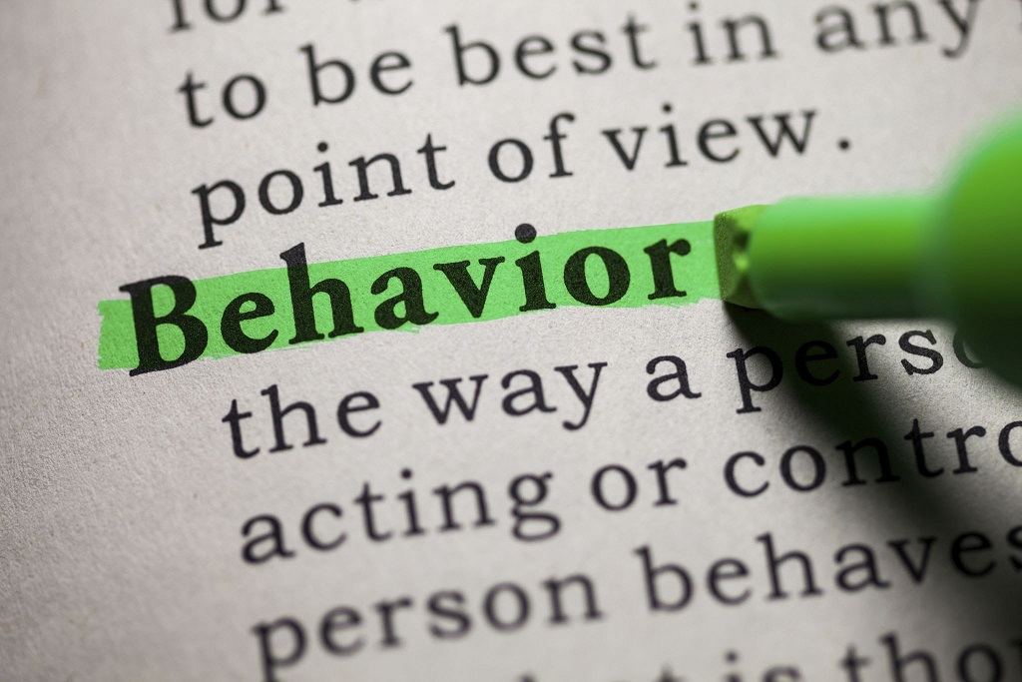
Old & New Behaviors
Old Behaviors | New Behaviors
1. | 1.
2. | 2.
3. | 3.
4. | 4.
5. | 5.

Slide 10
Being Coached
Practice:
New thoughts (Worldview)
Practice acknowledges that we are all amateurs attempting to grow and progress. (Don Underwood, Pray Like Jesus)

Slide 11
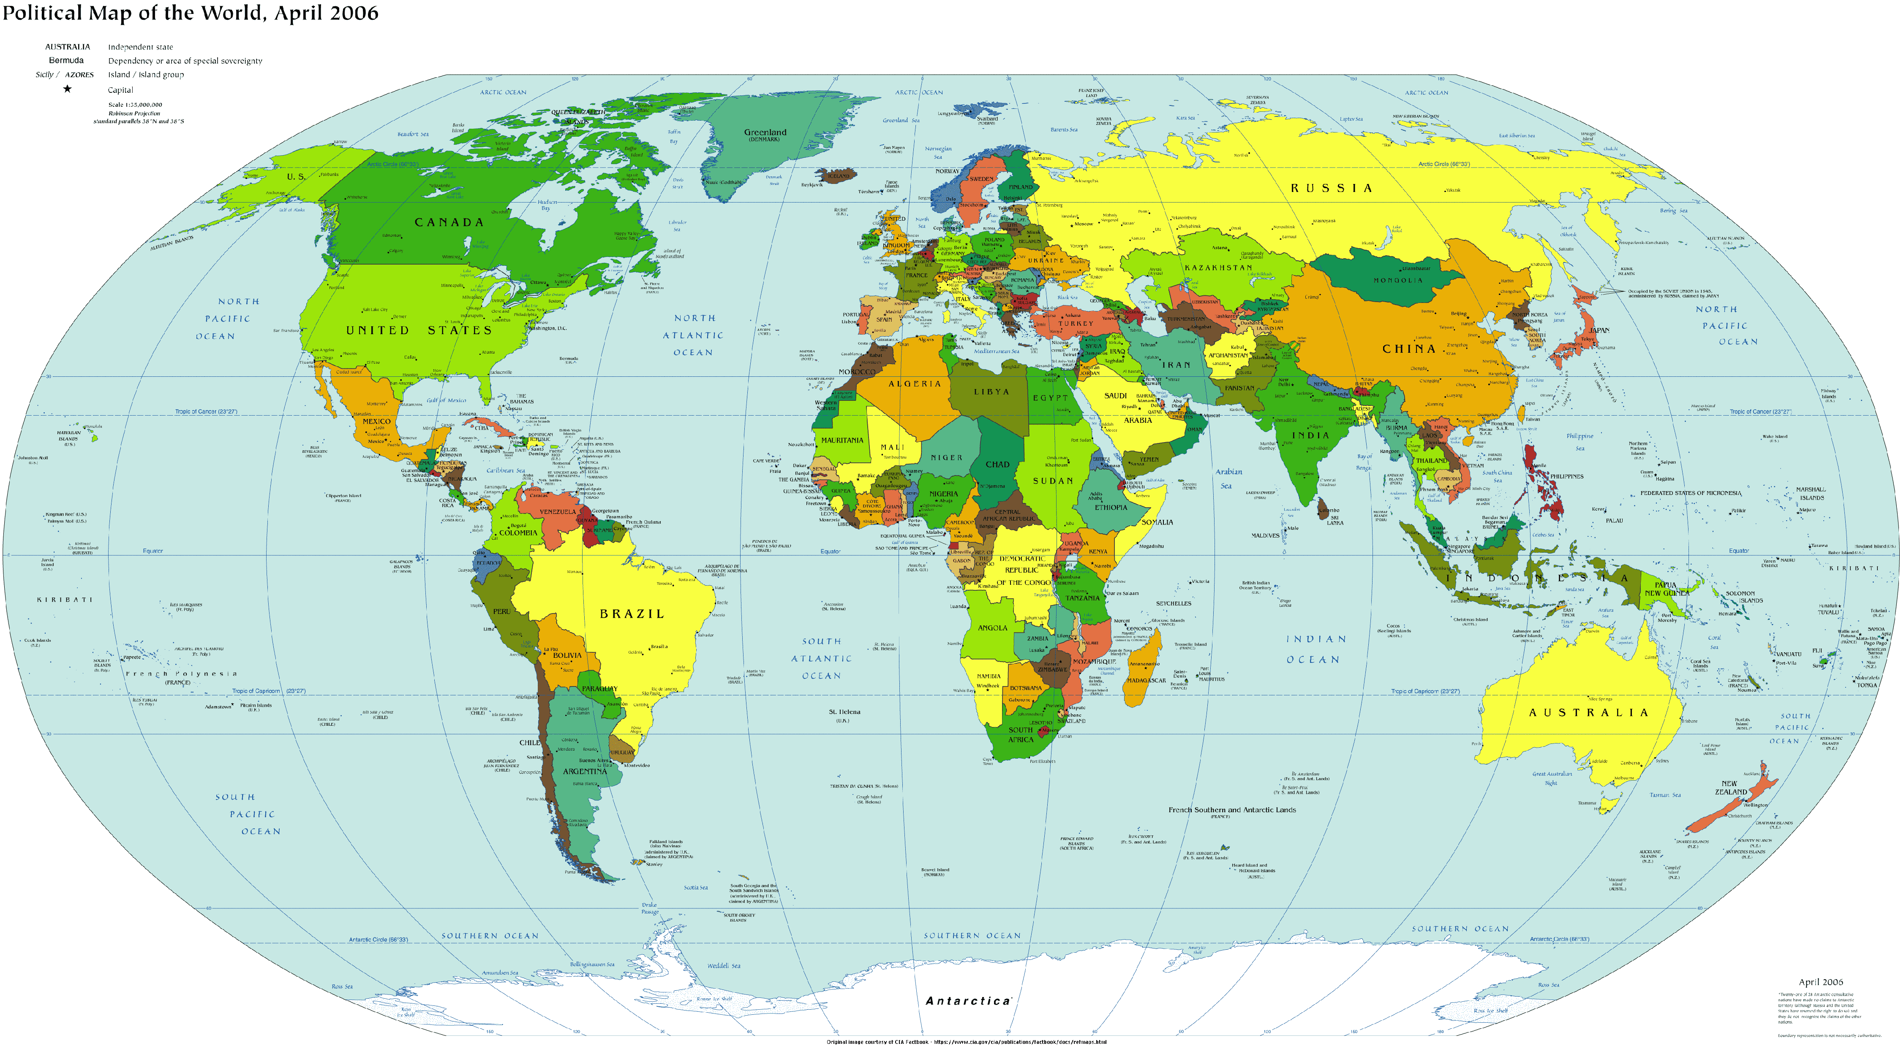
Old & New Thoughts
worldview
Old Thoughts | New Thoughts
1. | 1.
2. | 2.
3. | 3.
4. | 4.
5. | 5.

Slide 12
Being Coached
Practice:
New Feelings
Practice is the hardest part of learning, and training is the essence of transformation. (Ann Voskamp)

Slide 13
Old & New Feelings
Positive Emotions
Old Feelings | New Feelings
1. | 1.
2. | 2.
3. | 3.
4. | 4.
5. | 5.

Slide 14
Being Coached
Practice:
New Perceptions
Knowledge is a treasure but practice is the key to it. Lao Tzu

Slide 15
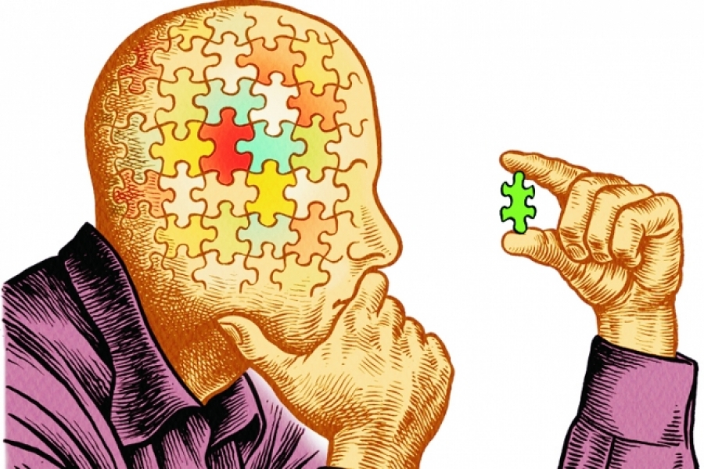
Old & New Perceptions
Understanding
Old Perceptions | New Perceptions
1. | 1.
2. | 2.
3. | 3.
4. | 4.
5. | 5.

Slide 16
Developing Trust & Deep Relationships
Why?
Enable the individual to follow God’s leadership
Enable the individual to process each discovery
Luke 6:46 J.B. Phillips New Testament
“And what is the point of calling me, ‘Lord, Lord’, without doing what I tell you to do?”

Slide 17
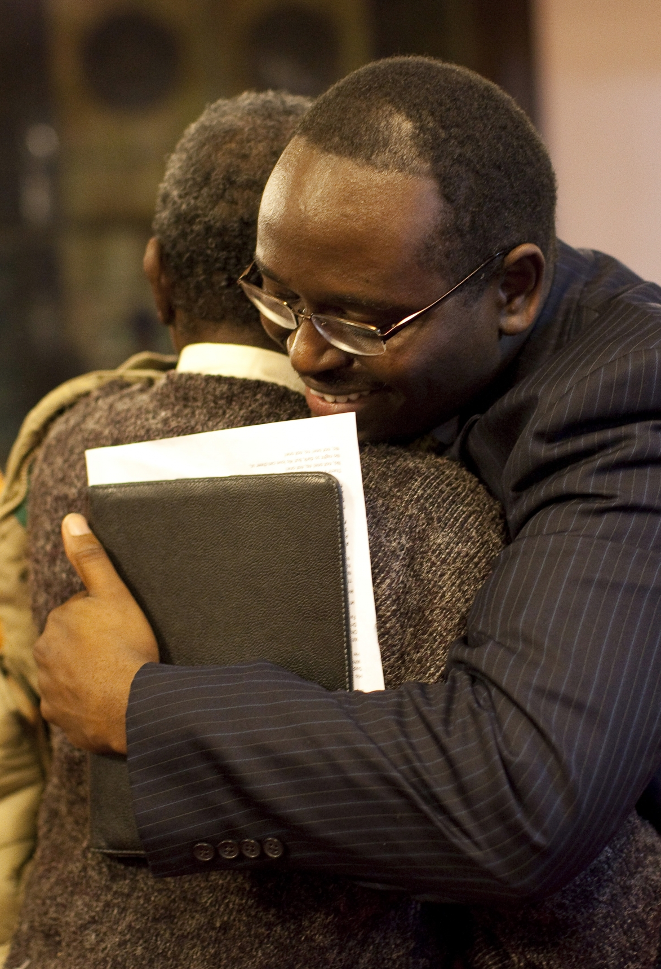
Developing Trust & Deep Relationships
Without empathy, no trust
Without trust, no influence
Without influence, no effective change
Without effective change, no progress
Without progress, we remain stagnant, which leads to little or no growth.
Without growth, we die.
‘Without’ is absence.

Slide 18
Six Important Facts
We pass through these discoveries in a cycle that repeats as the individual changes.
Our relationships with each other are an important part of change.
Crucial to our ability to change are awareness and empathy to the relationships in groups that are particularly important to us.
Awareness and empathy provide the context in which we can see God is at work on our desired changes.
Our relationships in groups can be sources of support for our change as well as for feedback.
Relationships also can help us from slipping back into our former ways of behaving.

Slide 19
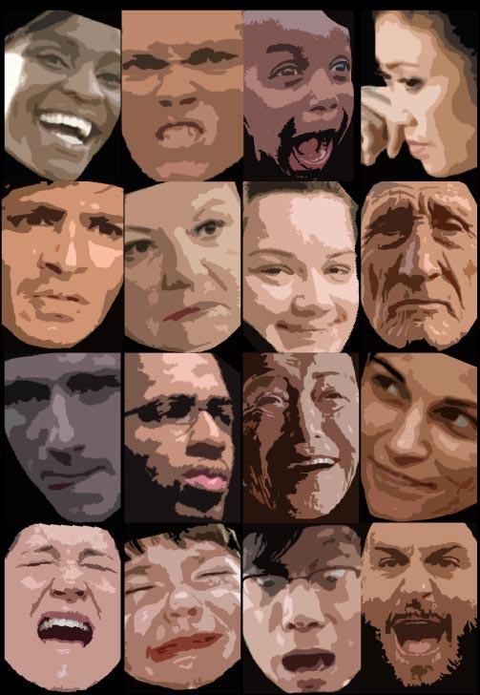
Basic Emotions
Romans 12:2
English Standard Version
Do not be conformed to this world,^{[a]} but be transformed by the renewal of your mind, that by testing you may discern what is the will of God, what is good and acceptable and perfect.
Anger (strong feeling of displeasure)
Anticipation (regard as probable)
Joy (a feeling of great pleasure)
Trust(a bold confidence, sure security)
Fear (an unpleasant emotion caused by the belief that someone or something is dangerous, likely to cause pain or a threat.
Surprise (an unexpected or astonishing event, fact or thing)
Sadness (the state of being sad, showing sorrow, unhappy)
Disgust (a feeling of revulsion or strong disapproval aroused by something unpleasant or offense.

Slide 20
Opposite Psychological Response
Anger & Fear
Anticipation & Surprise
Joy & Sadness
Disgust & Trust
James 1:19-20 (NIV)
¹⁹ My dear brothers and sisters, take note of this: Everyone should be quick to listen, slow to speak and slow to become angry, ²⁰ because human anger does not produce the righteousness that God desires.
How we respond matters!

Slide 21
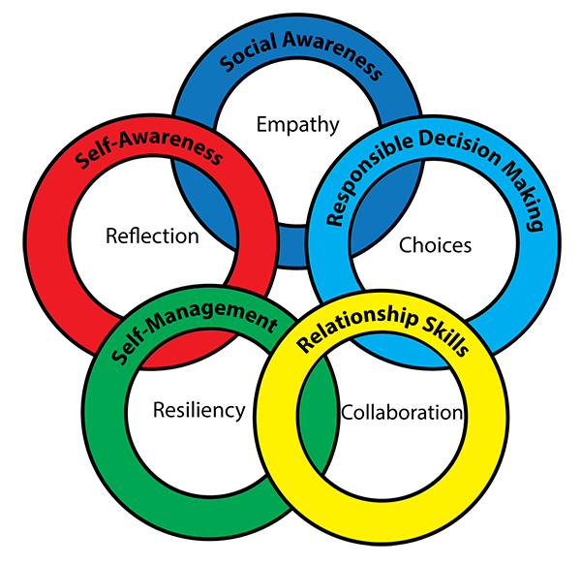
Elements of Emotional Intelligence
Knowing Emotions
Managing Emotions
Self-Motivating Emotions
Recognizing Emotions in Others
Handling Relationships
Goleman, D.(1995). Emotional Intelligence. NY: Bantam Books.

Slide 22
Questions & Answers
~Break~

Slide 23
Knowing & Caring for Ourselves
1 Corinthians 6:19-20 NIV
¹⁹ Do you not know that your bodies are temples of the Holy Spirit, who is in you, whom you have received from God? You are not your own; ²⁰ you were bought a price. Therefore, honor God with your bodies.

Slide 24
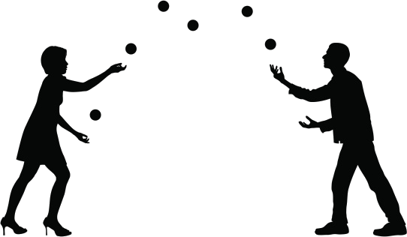
Five Concepts of Self-Care
Juggling the
Physical Care
Social Care
Emotional Care
Physical Care
Spiritual Care
Come to me all you who are weary and burdened
and I will give you rest. Jesus (Matthew 11:28

Slide 25
Physical Self-Care
Avoid Compassion Fatigue
Set Emotional Boundaries
Regular Exercise
Healthy, Balance Diet
Sleep/Rest
Activities You Enjoy

Slide 26
Social Self-Care
Create Network of Support
Family
Colleagues
Maintain Old Friends
Find New Friends
This Photo by Unknown Author is licensed under CC BY

Slide 27
Cognitive Self-Care
Evaluate Reasoning/Thinking Patterns
Seek Professional Help
You are Not Crazy Unless You…
This Photo by Unknown Author is licensed under CC BY-NC-ND

Slide 28
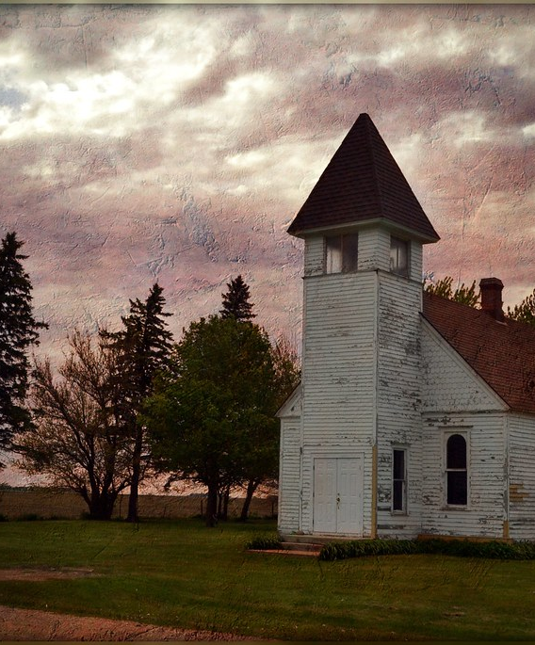
Spiritual Self-Care
Maintain Spiritual Discipline
Stop
Listen
Discern
Just “Be”
This Photo by Unknown Author is licensed under CC BY-SA-NC

Slide 29
God comes first, followed by our families, and then everything else (including our occupation and church) comes next!
Questions & Answers
Closing Thoughts

